Slide 1
2017 NAA Capitol Conference and Lobby Day:
Issues Briefing and Advocacy Training

Slide 2
Research

Slide 3
Demand Research
Commissioned Research – Hoyt Advisory Services
Apartment supply has not kept up with demand.
If policies which inhibit new construction continue, we will have a significant shortage of rental housing nationwide by 2030, exacerbating affordability issues.
Number of apartments needed by 2030 forecasted for the U.S., 50 states, D.C., and 50 metropolitan areas.

Slide 4
Why Apartments Work – Unprecedented Demand for Apartments
18.7 million apartment households – 42.9 percent of all renter-occupied households
1% decrease in homeownership rate = +1.2 million renter households
Source: U.S. Census Bureau, Housing Vacancy Survey

Slide 5
Why Apartments Work – Demand Could Continue
75 million young adults (18-34 year olds)
73 million Baby Boomers
Source: U.S. Census Bureau, Current Population Survey

Slide 6
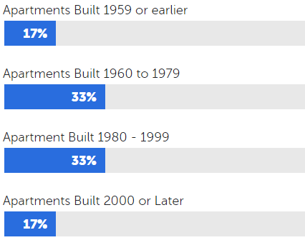
Why Apartments Work – Economic Impact
New Apartment Construction
$92.6 billion economic contribution
Over 700,000 jobs supported
Apartment Operations
$190.7 billion economic contribution
1.5 million jobs supported
Resident Spending
$1.0 trillion economic contribution
Almost 10.1 million jobs supported

Slide 7
Why Is There an Affordability Problem?
Expensive to build (labor, materials, land costs)
Record demand for apartments
Rents have increased, while incomes remained relatively stagnant
Source: U.S. Census Bureau, New Residential Construction; NMHC

Slide 8
Political Overview

Slide 9
Political Landscape
Republicans control the House, Senate, and White House
GOP has a limited time to deliver results before 2018 election influences political landscape
Change in Administration has not happened in eight years
Cabinet nominees must be confirmed
Trump Administration has 4,000 jobs to fill
President Trump must submit a FY 2018 budget
Continuing Resolution must be extended by April 28
Debt ceiling expires March 15
Supreme Court nomination

Slide 10
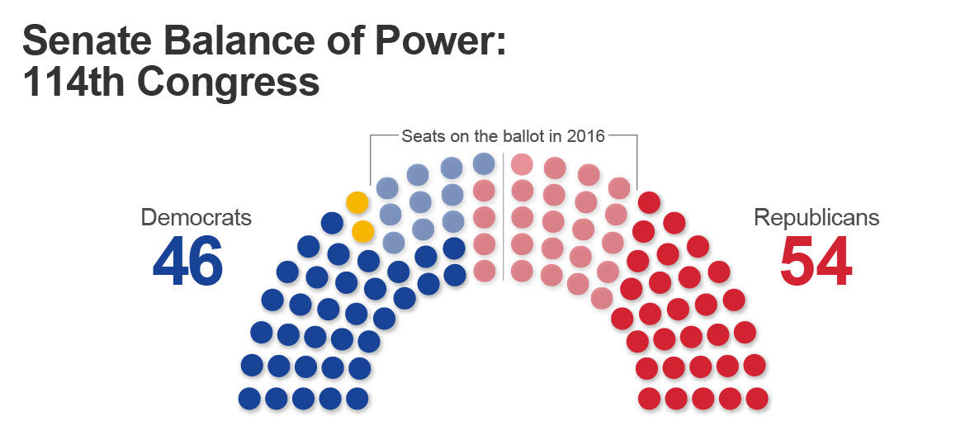
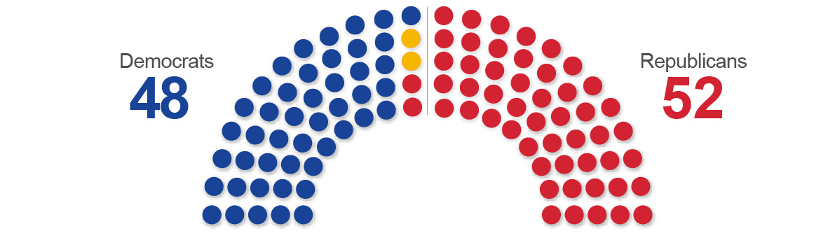
Senate: Democratic Wins Slimmed GOP Majority
But, 2018 Senate Race: Hard Math for Democrats
25 Democrats up for re-election
8 Republicans up for re-election

Slide 11
President Trump’s Agenda:
Policy Priorities
Tax Reform
Infrastructure
Immigration Reform
Affordable Care Act repeal and replace
Dodd-Frank roll back
Regulatory Relief (finance, energy, labor)

Slide 12
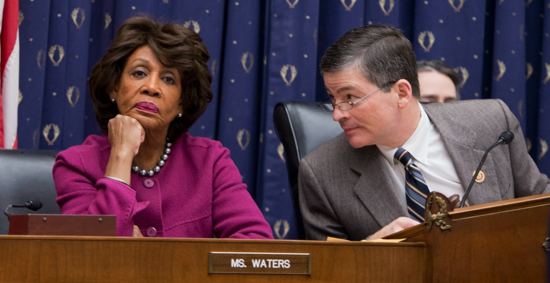
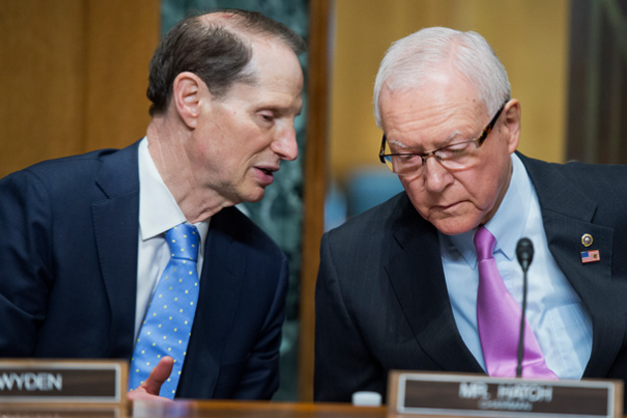
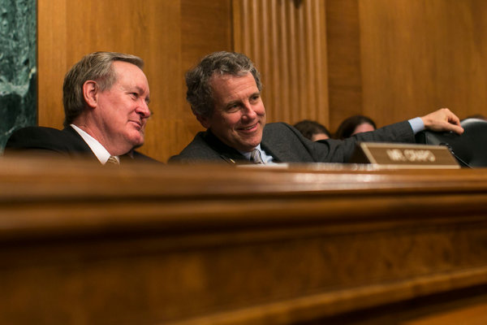
Key Players in 2017
Treasury Secretary Stephen Mnuchin
HUD Secretary Dr. Ben Carson
House Committees on Financial Services
& Ways and Means
Senate Committees on Finance & Banking

Slide 13
2017 Industry Legislative & Regulatory Priorities
Tax Reform
Housing Finance Reform
Flood Insurance Reform & Reauthorization
Immigration Reform
ADA Reform
Regulatory Reform (Dodd-Frank, WOTUS, Energy, etc.)
Housing Affordability
Fair Housing and Disparate Impact
Data Security

Slide 14
NAA Lobby Day Issues

Slide 15
NAA Lobby Day Issues
Tax Reform
Tax reform has the capacity to fundamentally reshape the multifamily industry, as it did after the passage of the last comprehensive tax reform law in 1986.
ADA Right to Cure
From 2013 to 2014, the number of ADA public accommodation/access lawsuits surged by more than 63%. Litigation driven by financial gain, not improvements to access for people with disabilities, is a growing trend.
Flood Insurance
The National Flood Insurance Program (NFIP) ensures access for all multifamily projects to affordable flood insurance, which is required for all federally backed mortgages.

Slide 16
Tax Reform

Slide 17
Tax Reform
Tax reform is center stage in 2017
Timing for reform is fluid but the Trump Administration and Congressional Republicans have expressed a desire to have it done by August
Tax reform has the capacity to significantly impact the multifamily industry
Apartment developers pay tax when they build, operate, sell, or transfer communities to their heirs
NAA/NMHC want to work with Congress and support reform that promotes economic growth and investment in rental housing

Slide 18
Tax Reform: Multifamily Priorities
Key priorities for multifamily:
Protecting flow-through entities that dominate the real estate industry
Maintaining like-kind exchanges
Retaining business interest deduction
Ensuring depreciation rules do not harm multifamily housing
Safeguarding carried interest tax treatment
Preserve the Low-Income Housing Tax Credit

Slide 19
Tax Reform
House Republican tax Blueprint is the starting point for the debate over tax reform. Key provisions would:
Reduce the top tax rate on pass through-firms to 25%
Enable all investment (except land) to be expensed immediately
Eliminate the deductibility of business interest
Provide a 50% capital gains exclusion
Repeal the estate tax
Jeopardize value of the Low-Income Housing Tax Credit
NAA/NMHC are currently analyzing the impact on the industry

Slide 20
Tax Reform: Key Message
NAA/NMHC supports tax reform that promotes economic growth and investment in rental housing without unfairly burdening apartment owners and renters.
Support preservation of the pass-through tax structure, sensible cost recovery rules, importance of like-kind exchanges, and continued existence of the Low-Income Housing Tax Credit (LIHTC).

Slide 21
ADA Right to Cure

Slide 22
ADA Right to Cure
The apartment industry supports the goals of the Americans with Disabilities Act and Fair Housing Act and is fully committed to creating communities that are accessible to people with disabilities.
Existing design guidelines and safe harbors fail to fully address the diversity of multifamily building types and real-world construction conditions, which results in varying interpretations of compliance under the Acts.
Predatory lawsuits (“drive-by lawsuits”) are on the rise.
Allegations of non-compliance create costly operational and legal challenges.

Slide 23
ADA Right to Cure: Specific Request
Co-sponsor H.R. 620 (House) and encourage companion legislation in the Senate. This bipartisan measure would provide a business owner with up to 120 days to cure an alleged ADA design defect prior to the initiation of a lawsuit. This increases access for the disabled and creates an important disincentive for complaints motivated purely for financial gain.

Slide 24
Flood Insurance

Slide 25
Flood Insurance & Risk Mitigation
The National Flood Insurance Program (NFIP) expires in 2017
Rates continue to increase 10%-25% per year for all property owners
Most multifamily properties need the NFIP for some or all of their flood insurance coverage
Flooding is the most common natural disaster in the United States and happens in every state and territory
Long-term viability of the National Flood Insurance Program (NFIP) must be guaranteed to lessen taxpayer funded disaster assistance and help apartment communities mitigate risk and protect properties.

Slide 26
Flood Insurance & Risk Mitigation: Specific Request
Support timely passage of a long-term NFIP reauthorization bill. Reauthorization efforts should include:
Sensible reforms that improve the accuracy of the flood maps
Increase apartment communities’ access to current flood mitigation funding and programs
Expand the NFIP to include Business Interruption coverage for rental properties
Provide Replacement Cost Value (RCV) instead of Actual Cost Value (ACV) to damaged apartment properties.

Slide 27
Questions?

Slide 28
Video:
The Faces Behind the Issues

Slide 29
Lobby Day Advocacy It’s all about the Grassroots

Slide 30
“We in America do not have a
government by the majority.
We have government by
the majority who participate.”
~ Thomas Jefferson

Slide 32
Search: “NAA Advocacy”

Slide 33
The Power of a Personal Story

Slide 34
97%

Slide 35
“The most effective way to influence a lawmaker is for a constituent to talk to a legislator about how the policy will affect the person or a particular group.”
- House Democrat

Slide 36
Build the “3 H’s” – Head, Heart, Health
Head: Reasoning on Issue
Heart: Emotional Connection
Health: Impact on District or State

Slide 37
Survey of Congressional Staff:
“How helpful is it for messages from constituents to include the following?”

Slide 38
Copyright 2016, Congressional Management Foundation

Slide 39
Pulling Together Your “Ask”
Your Connection
Your Personal Story
District/State Impact
Your “Ask”
Copyright 2016, Congressional Management Foundation

Slide 40
Your Member of Congress’ Brain
Wants to make a difference in the world
Ego
Amount of time thinking about your issue
Desire to please everyone
$$$$$$$$ capability

Slide 41
“Does your representative in Congress care what you think?”
(Rasmussen National Survey – 2013)
“Please rank the most important aspect of your job.”
(Congressional Management Foundation Survey of U.S. House of Representatives Members – 2011)

Slide 42
“Congress cares about what I think.”
- Public Opinion
“Staying in touch with constituents.”
- Member of Congress Opinion

Slide 43
The Meeting: What to Expect
You think this is who you are speaking with…
... But you are really speaking with someone more like this:
Legislative Advisors and Directors
Staff Assistant

Slide 44
Expect to Meet with Hill Staffers During Hill Meetings
Sample Organization of a Congressional Office
Member of Congress
Meetings are most often scheduled with and run through one or more of these staffers
It is not uncommon for Members to show up halfway through a meeting or leave part of the way through
Chief of Staff
Policy Staff
Communications Staff
Office Staff
District Staff
Legislative Director/Counsel
Communications Director
Personal Assistant/ Scheduler
District Director
Legislative Aide
Legislative Correspondent
Staff Assistant
District Caseworkers
LCs and SAs may join in meetings as a junior staffer or note-taker
Analysis
Because members of Congress have busy schedules, staffers will often have more time to devote to Hill meetings, and usually staffers can be more capable of affecting any takeaway
Source: “Hit the Ground Running: 112th Congress Edition,” Office of Rep. Eric Cantor; “2010 House Compensation Study,” Chief Administrative Office of the U.S.
House of Representatives.

Slide 45
The Meeting
BEFORE
Be Flexible
Brief the Office
During
Prompt
Organized
After
Follow-up
Cultivation
Work Ahead
Feedback
Tone
Collateral

Slide 46
How frequently do you experience the following in constituent meetings?
Copyright 2015, Congressional Management Foundation

Slide 48
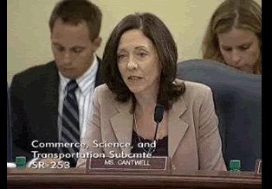
Build a Relationship with Staff

Slide 49
Use Meeting Follow Up to Build Trust, Serve as a Resource
INTERCEPT
REPORT
Send a Thank You Note and
Valuable Information
Attend Events in the District
Thank the Member of Congress and/or Hill Staffer for their time following the meeting
Add a reminder of the topic of the meeting in the note for the Member’s reference
Send along information from a reliable source to keep the Member’s office aware of your issue
Attend public events or town halls in your district to increase your visibility with your Member of Congress
Build relationships with district staff to serve as a trustworthy resource on your issue
Source: National Journal Research, 2015.

Slide 50
Questions?

Slide 51
NEW! NAAEI Continuing Education Credits
Available to All NAAEI Credential Holders
Issues Webinar (Feb. 22): 1 CEC
NAA Capitol Conference (12:45 – 4:30 p.m. March 7): 3 CECs
Lobby Day (March 8): 2 CECs
Certificates will be emailed to you shortly after each event. Please submit documentation online to NAAEI at www.naahq.org/renew.

Slide 52
Contact:
Jim Wilson, Director, Political Affairs, NAA
jwilson@naahq.org
Paula Munger, Director, Industry Research & Analysis, NAA
pmunger@naahq.org
Caitlin Walter, Director, Research, NMHC
cwalter@nmhc.org
Cindy Chetti, Senior Vice President, Government Affairs, NMHC
cchetti@nmhc.org
Matthew Berger, Vice President, Tax, NMHC
mberger@nmhc.org
Paula Cino, Vice President, Construction, Development & Land Use Policy, NMHC
pcino@nmhc.org
Kevin Donnelly, Vice President, Government Affairs, NMHC
kdonnelly@nmhc.org
Peter Fromknecht, Manager, Grassroots Advocacy, NAA
pfromknecht@naahq.org

