Slide 1
NOI-Enhancing Green Strategies in
Rehabs and New Development
Julie Roby - Director of Residential Energy Solutions
Curt Mann – Director of Sustainability and Energy Mngt.
Moderator: Jim Kjolhede
10/15/2014

Slide 2
NOI Enhancing Green Strategies
Enhancing Old and Exciting New Ideas
High Tech and Low Hanging Fruit
Proven Success Systems and Techniques
Q and A At the End, plus Speaker Time
Notes:
first question right off the bat - renewable or efficiency? efficiency first.

Slide 3
NOI-Enhancing Green Strategies in
Rehabs and New Development
Julie Roby,
Director of Residential Energy Solutions
greeNEWit
10/15/2014

Slide 4
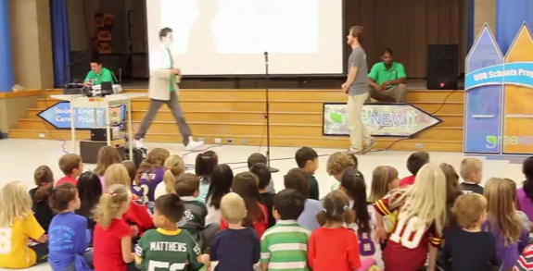
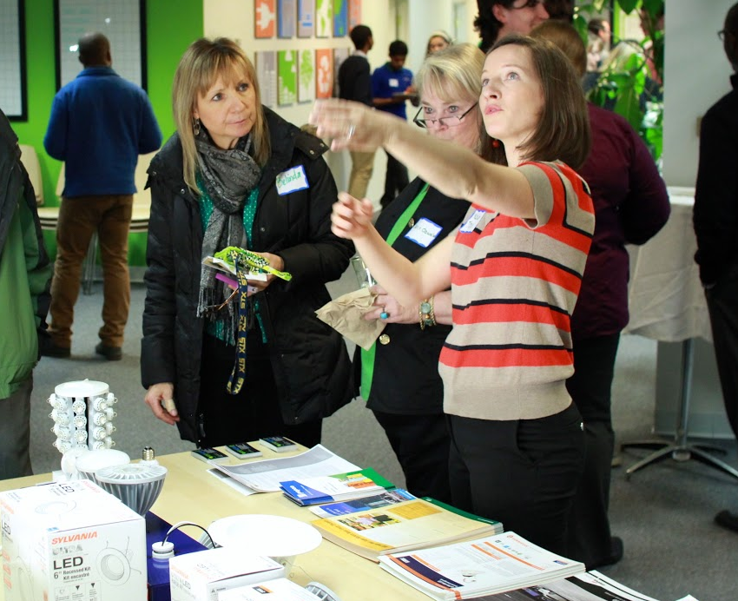
Founded in 2008 to continuously educate customers on opportunities to use energy more intelligently and efficiently.

Slide 5
Green Strategies = Energy Efficiency
The cheapest energy is the energy you never use at all.
You’re all here to learn:
What projects are best?
How to implement?
HOW TO PAY FOR IT?
But first, it’s important to address the WHY...
Notes:
first question right off the bat - renewable or efficiency? efficiency first.

Slide 6
The WHY: Changing Landscape
EPA’s Clean Air Act, Section 111 B (new and modified power plants) & D (existing power plants; states differ)
Natural gas issues
= Rising energy prices
With that in mind, let’s consider:
Risk reduction
Cost of waiting
Getting in front of capital planning
Notes:
D - EPA released proposed carbon pollution standards 6/1/2014; will finalize 6/1/2015 and states will have to submit plans no later than 6/30/2016

Slide 7
The WHY: Increasing Asset Value
This is how you convince the CFO:
Speak in financial terms
Internal rate of return should be higher than company’s internal minimum rate of return
Identify how the project can help drive the core business (i.e. illustrate incremental cash flows)
Talk about financing options
(source: Noesis, 2014)

Slide 8
The WHAT: Comprehensive Implementation
Strategic energy solutions partner
Manages processes
Submits paperwork/compliance
Quality control
Looks ahead to new technologies
Like a lot of things in life, it’s about taking it from where you are, to where you could be.

Slide 9
The WHAT: Data Needed to Act
From you:
12 months utility data
From energy solutions partner:
Project benchmarks
Project scope/costs
Financial analysis

Slide 10
The WHAT: Plan it, Do it, Promote it
Portfolio level - prioritize costs, rebates, existing needs
Building level - consider systems’ interaction
Improve performance:
Analyze
Direct install low hanging fruit
Retrofit buildings with less sexy stuff like air sealing and insulation
Measure and verify results
Don’t forget about the residents...
Notes:
over 40,000 doors opened to energy efficiency, you’d be surprised how cognisant residents are to energy prices. In a highly competitive market like where greeNEWit started, we’ve found that even the little things, like DI, can help them to feel taken care of and make them want to stay.
resident satisfaction directly affects NOI

Slide 11
Notes:
wine and dine
resident info sessions

Slide 12
Examples: Putting it into Practice
Bill analysis/benchmarking
Rebate/incentive analysis
Scope development with ROI analysis
Commercial energy audits
Retrofit project management
Measurement and verification

Slide 13
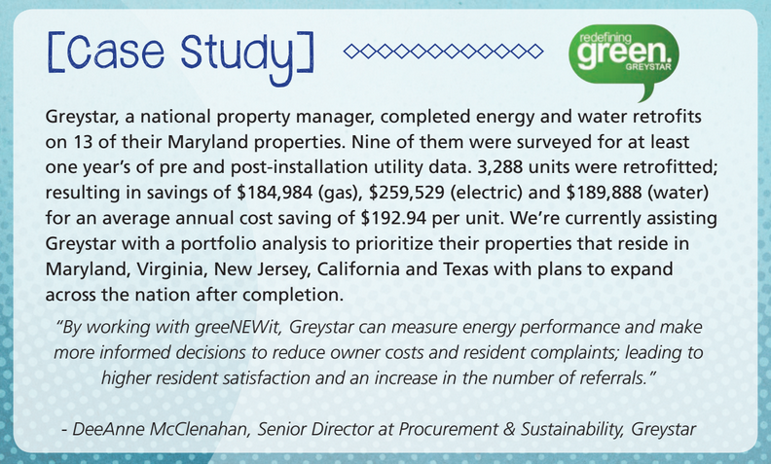
Case Study: Greystar

Slide 14
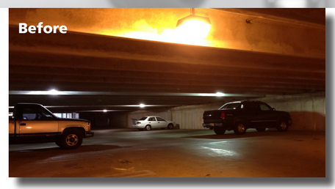
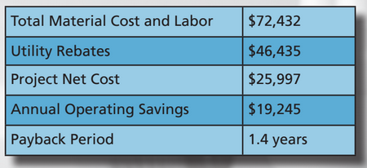
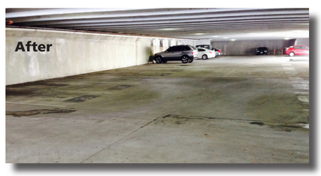
Case Study: Dolben
Notes:
After successfully helping Park Station’s tenants
saving over 90,000 kWh annually, the Dolben Com-
pany asked greeNEWit to also uncover savings po-
tentials in the common areas. Our lighting analysis
projected over $19,000 of savings potential for all
common and exterior areas, including walkways,
parking garage, and the leasing office and com-
munity center.
The parking garage was previously lit by 150W
- 175W Metal Halide and Low Pressure Sodium
lamps. Some dark areas and poor color rendering
made the parking garage appear dark and unsafe.
greeNEWit replaced 144 canopy lights with 40W
LED low-profile canopies. The retrofit eliminated
previously dark areas and now provides even, day-
light quality lighting.

Slide 15
Case Study: Corvias Military Living
https://www.youtube.com/v/1DO4AVBBD1U&start=87&autoplay=1
Notes:
After successfully helping Park Station’s tenants
saving over 90,000 kWh annually, the Dolben Com-
pany asked greeNEWit to also uncover savings po-
tentials in the common areas. Our lighting analysis
projected over $19,000 of savings potential for all
common and exterior areas, including walkways,
parking garage, and the leasing office and com-
munity center.
The parking garage was previously lit by 150W
- 175W Metal Halide and Low Pressure Sodium
lamps. Some dark areas and poor color rendering
made the parking garage appear dark and unsafe.
greeNEWit replaced 144 canopy lights with 40W
LED low-profile canopies. The retrofit eliminated
previously dark areas and now provides even, day-
light quality lighting.

Slide 16
The HOW: Planning to Pay for It
Owner out of pocket
Plug it into upcoming year’s capital budget
Time of sale or refinance by incorporating it into your loan
When your lender is ordering the PNA, make sure your energy upgrade quotes are included like lighting, hvac, controls, etc.
You will become empowered to advocate for yourselves to have energy efficiency
Notes:
based on how proactive or reactive your capital planning process is, you and the other decision makers may choose to 1. , 2. or 3.

Slide 17
The HOW: Conference Call
Tax exempt leases
Operating leases (“off balance sheet”)
Capital leases
Shared savings agreements
Local rebates
Local financing (PACE)
On bill financing
Notes:
CFO, energy solutions partner, accountant

Slide 18
RECAP
Energy solutions partner
Analysis
Prioritization
Planned scope
Financial common sense
Marketing to residents
Opportunity: reinvest savings!
Notes:
not perfectly easy or quick; planning for 2015-2020; next year I would hope that you’re on track with this methodology

Slide 19
What the future holds...
Owners able to market net comparative energy cost
Building Energy Data Exchange Specifications (BEDES) database to be piloted by DOE
CA
DCSEU?
Incorporating building performance into dynamic pricing model
Ex. Corvias military - Live Army Green
Tying appliances to smart grid to take advantage of ancillary revenue
Notes:
we’re in the early stage, proud of yourselves. 5-10 years becoming more mainstream, info will be provided so it’s easier to compare apples to apples

Slide 20
Thank you!

Slide 21
Energy Smart
Strategies that work
Curt Mann
BluTrend

Slide 22
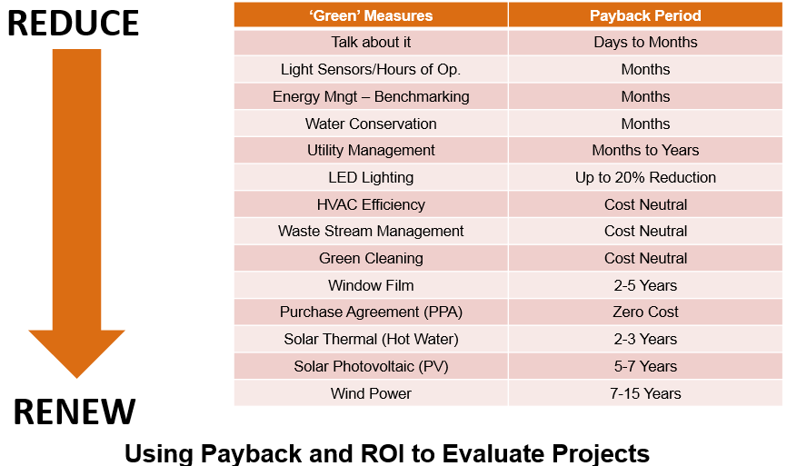
Green evaluation matrix

Slide 23
The Power of LED
 | Metal Halide | LED
 | 175W | 58W
Net Cost of Fixture | $150 | $490
Annual Electric Cost | $221 | $51
 | Payback | 15 Months
 | Increased Property Value | $ 1,798,261
Annual electric costs more than the fixture
The Gift that keeps on Giving
15-20 yr life
Notes:
Discussion on lumen diminution over time with MH, HPS, bulb expectancy, CRI, progress in light color (K Value), pricing coming down, quality going up. Make 175 and 58w larger, reduced heat, lower labor, etc.

Slide 24
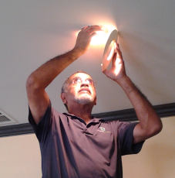
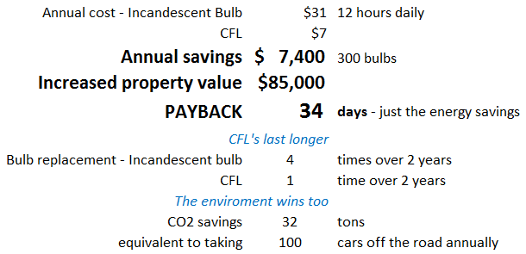
The Important Ones
Power Player of the Quarter
Here’s how Ruben Created Value :

Slide 25
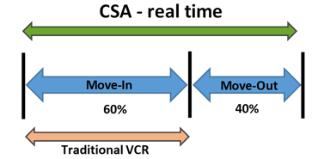
Technology is your friend
Automate your Utility log – eliminate utility theft.

Slide 26
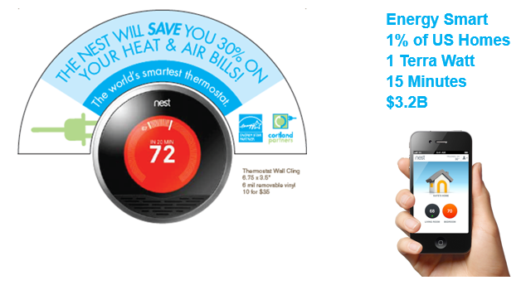
Eco Bling - that works
Notes:
Easy to implement motion detectors in common areas (bathroom / copy room / etc.)

Slide 27
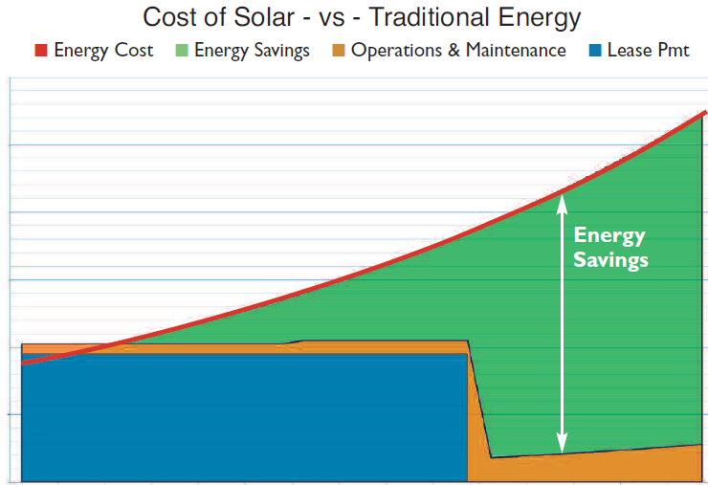
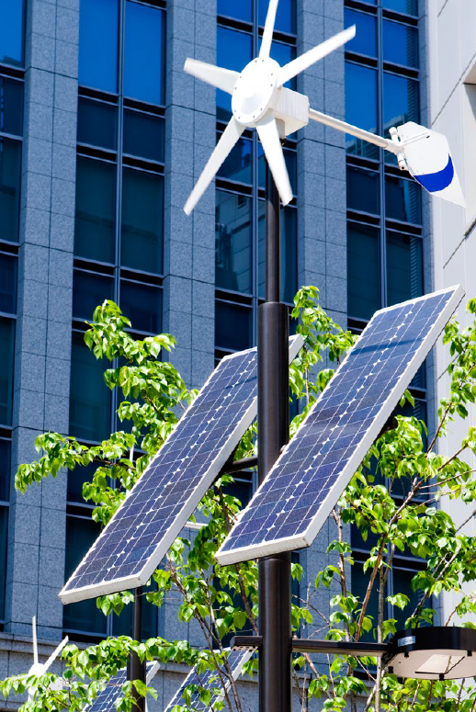
Cost of the Sun – $0
Cost of capture – it works

Slide 28
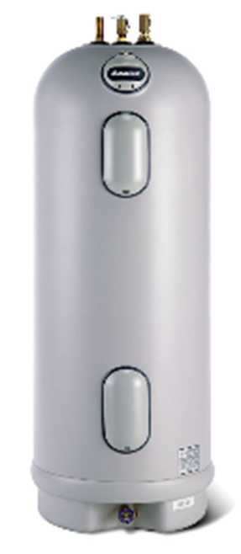
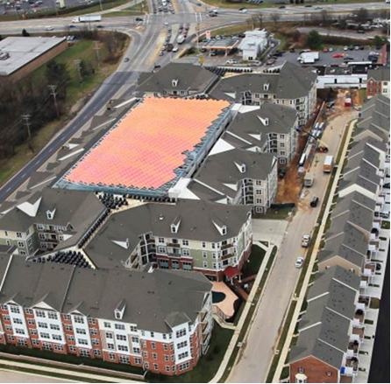
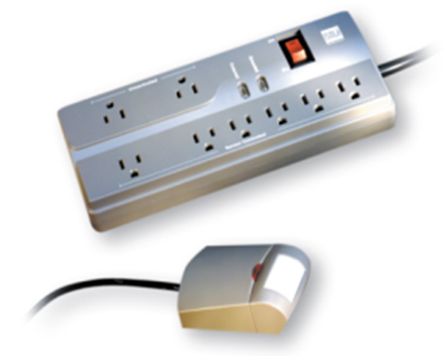
Incentives are everywhere
$28M
$100 per toilet
$.26 per kw

Slide 29
‘Green’ Features Relative to Importance
62% of renters felt energy efficiency and environmentally friendly features were of importance when choosing which apartment to rent.
How important are/were the following features when choosing an/you chose your apartment?
62% Collectively
“Green” is the 4th Most Important Feature

Slide 30
Why is ‘Green’ Important?
Environmental stewardship and cost efficiency drove importance of living
in an environmentally friendly apartment.
Why is it important to you to live in an ‘environmentally friendly’ apartment?
Base: Important to live in an ‘environmentally friendly’ apartment
Environmental Stewardship – 53%
Cost efficiency – 39%
Reduce Personal Footprint– 29%
Renters Grasp the Multi-Level benefits of Green Living

Slide 31
Interest in ‘Green’
Cost savings outweighed having a positive impact on the environment,
though not substantially.
Which would best describe your feelings about renting an apartment with
‘environmentally friendly’ features? Base: ‘Environmentally friendly’ is important
Cost Savings is 1st Benefit, Environmental Stewardship 2nd

Slide 32
Disinterest in ‘Green’
Cost and the low priority of concern for the environment
drove lack of interest.
Why is it not important to you to live in an ‘environmentally friendly’ apartment?
Base: Not important to live in an ‘environmentally friendly’ apartment
Cost – 57%
Environment not a Concern - 37%
57% Think ‘Green’ is Too Expensive

Slide 33
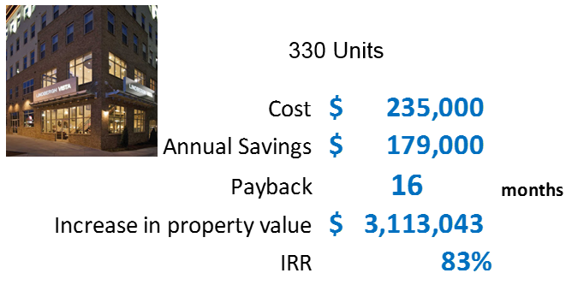
Real numbers – real savings
Notes:
Of course go into what all was done, the process that you all went through to benchmark, implement, measure, communicate (to residents / investors / employees, etc.) and even the calculation of how it turbo charges the value of the asset upon sale.

Slide 34
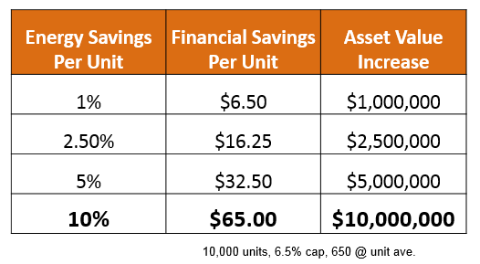
From Pennies to Millions
Notes:
This takes care of prior comment. Discussion of interim benefit (every month / every year) and then the BIG jump on sale.

Slide 35
Triple bottom line
Curt Mann
404.276.0084
Curt.mann@blutrend.com

Slide 36
Questions
And
Answers

Slide 37
Thank you and Drive Home Safely!!!
Julie Roby – julie.r@greenewit.com
Curt Mann – curt.mann@blutrend.com
Jim Kjolhede – jimk@satteron.com

