Slide 2


Hidden Costs of Utilities
NWP Service Corporation
Ron Reed
RReed@NWPSC.Com
@RonReed
Notes:
Imagine you’re called into the due diligence meeting for the sale of some properties.
One of the members of the buyers team has her MBA from the ERB institute of sustainability a at the U of M and it is her turn.
“Mr. Seller and Seller’s manager, I have a few questions about the utility costs.”
You know your accounting is buttoned up tight and you feel very the numbers are very tight and consistent across your portfolio. This is the easy and boring part of the meeting…
First, I’ve noticed a lot of resident dissatisfaction on the social networks about your resident utility costs. Do you feel that noise could be impacting occupancy?
“Second, I noticed that there was no line item in your GL for late fees, so it took me some time to research, but I noticed your late fees were nearly 50 basis points, which seems really high. Is that a function of your local utility or just an issue with the AP staff?”
You had no idea what the late fees were, since they are not separated from the normal utility accounts payables and are included in the Utility Line Item in the G&L
“I noticed some CapEx improvements made at several buildings, did that

Slide 3
What is Hidden
Visible are costs you easily see in your GL.
Hidden are…
  Expenses in your utility line that are not actually costs for utility consumption.
  Underlying costs of administration related to utility costs.
  Derivative or causal costs that are higher .
  Revenue impact or poorly managed utilities.

Slide 4
Administrative Costs
Costs of AP
Costs of Late Fees
Rates
Resident support
Regulatory Compliance of Recovery
Reducing administrative costs can require
significant discipline & process automation.

Slide 5
Maintenance Costs
Maintenance items are buried in utility invoices.
Difficult to identify some maintenance or utility costs at the property.
Difficult to manage corporate costs at the property level.
Avoiding the wild goose chase or crying wolf
is difficult.

Slide 6


Resident Satisfaction
Residents expect to pay for utilities.
Utility costs are shared among current and prospective residents making properties more or less desirable.
This is happening before city mandated disclosures!
Resident satisfaction can be impacted by utility co.
Residents want information about their costs…even if they’re part of the rent.
Loss of one or two residents
disrupts the best programs!

Slide 7
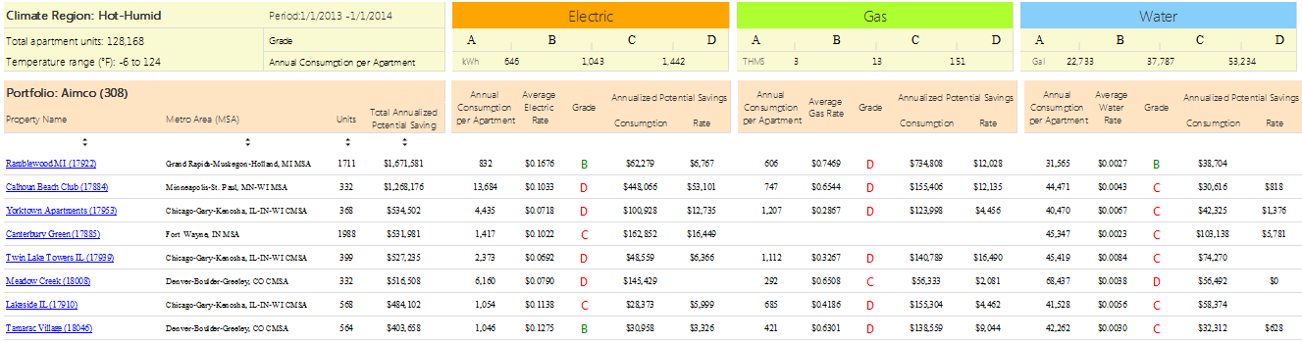
Asset Value
Lower operating costs as a percentage of
revenue improve asset value.
Choosing appropriate asset improvements among competing alternatives for capital is aided by benchmarking
Competitive consumption indicates of well maintained assets
Asset value improves
when utility consumption is competitive.

Slide 8
Hidden Costs Require a Proactive Approach
Finding the hidden costs requires deeper dive into invoices.
Reducing the costs requires tight coordination between corporate and property staff.
Well balanced programs improve resident satisfaction.
Utility Management
Reduces Hidden Costs & Improves Asset Value!

Slide 9
Did I get a good rate?
A look at energy costs
Rhonda Kreitz
President, Energy Advisory Service (EAS)

Slide 10
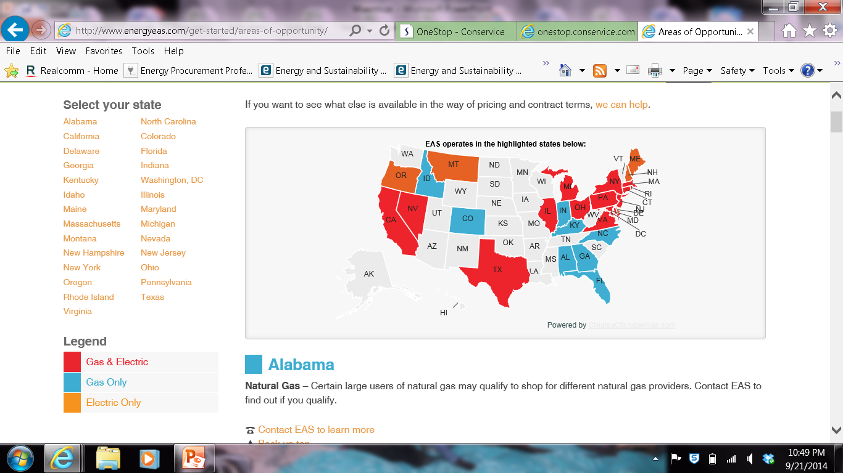

Slide 11

Which is Cheaper?
$.08 per Kwh
Bundled rate with
$2.95 service fee
$.06 rate with
No meter fee
VS.

Slide 12
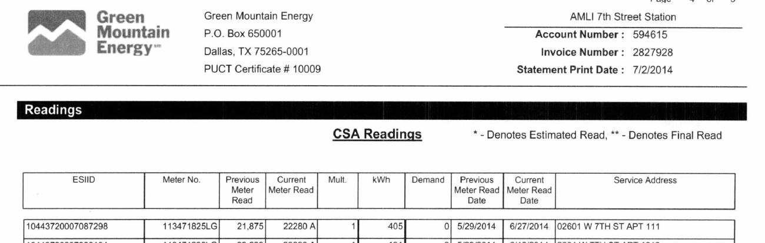
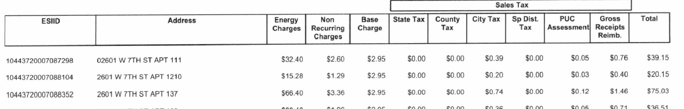
.08 rate for electricity, $2.95 meter Fee, Bundled rate ….total price paid per kwh is .0966

Slide 13
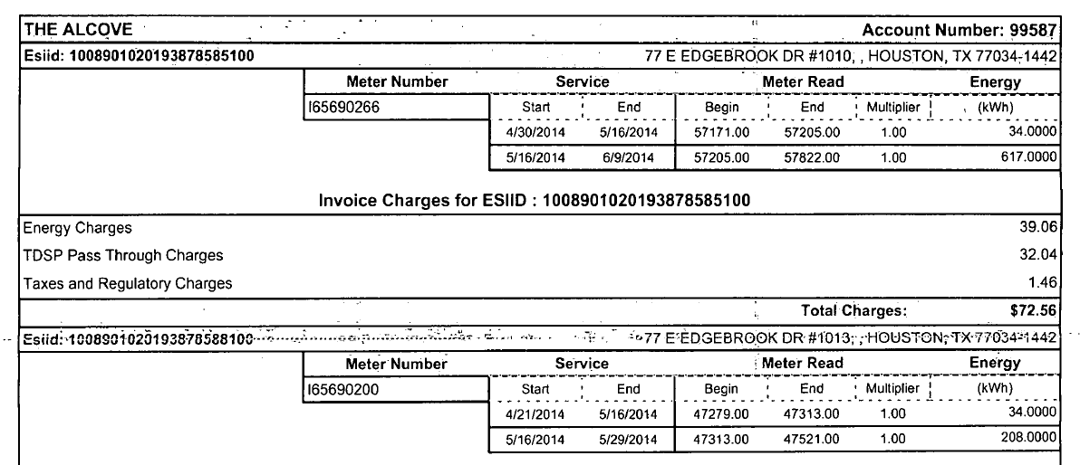
.06 rate for electricity, no meter fee, unbundled equals .11 per kwh
The average community uses 250,000 kwh annually. Making it a $3,500 cost difference Annually

Slide 14
Gas South
$.46 per therm
Infinite
$.62 per therm
GNG
$.60 per therm
$3.99 meter fee per meter
AGL charges
DDDC Charges
$5.95 service fee
AGL Charges
DDDC included
$3.99 meter fee
Plus AGL Charges
Plus DDDC charges
Which is Cheaper?

Slide 15
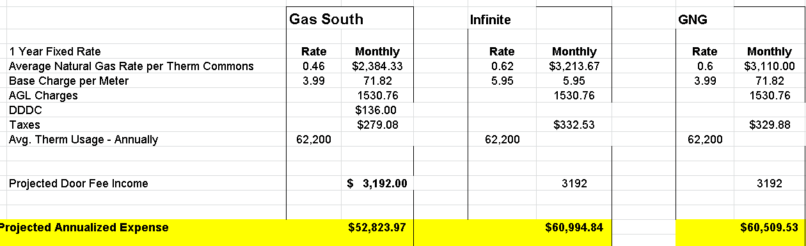
Georgia Case Study
This community uses 62,200 therms the best “unbundled” rate saves them $7,686 Annually

Slide 16
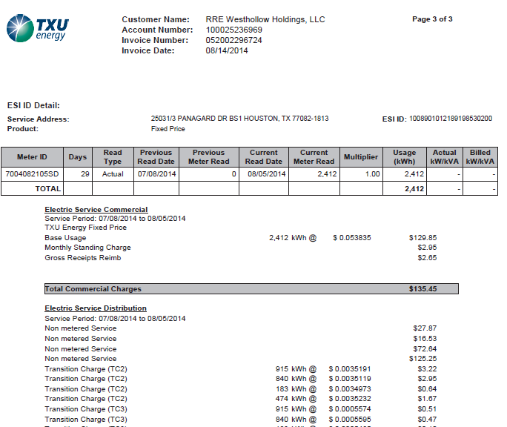

Slide 17
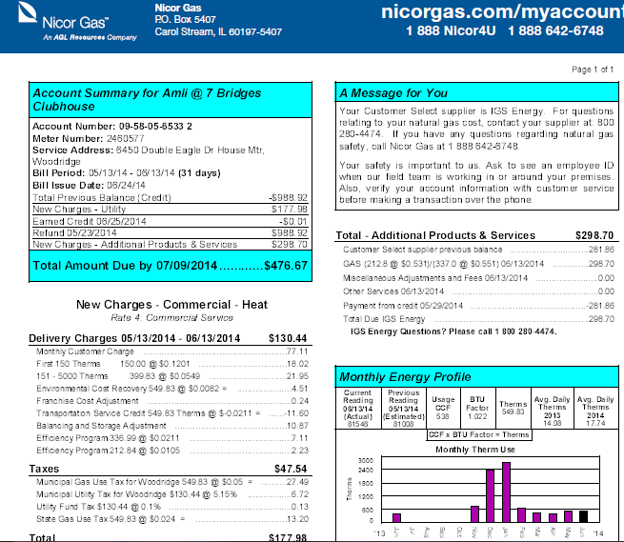

Slide 18

Rule # 1
What is included in the price?
Some Premiums in pricing
Is there Swing?
Time to execute
Termination Fees

Slide 19

Rule #2
How Much Risk you take dictates your price

Slide 20
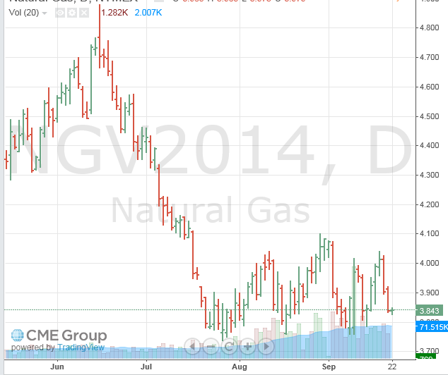
Notes:
About $4000 price difference annually……Here are some ways to midigate thise risk

Slide 21
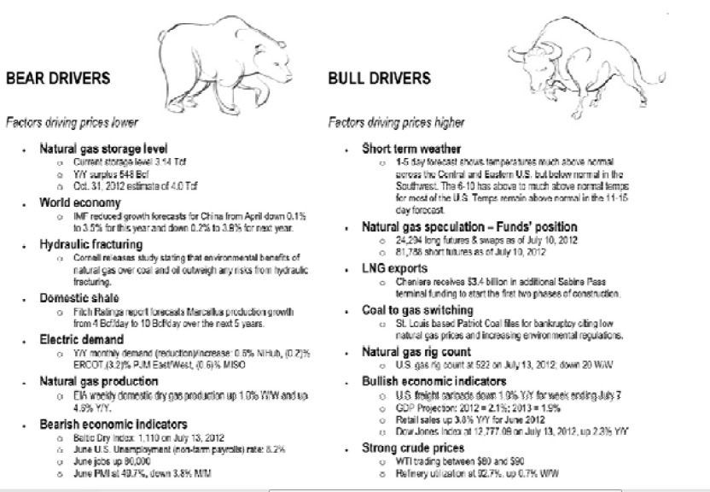

Slide 22
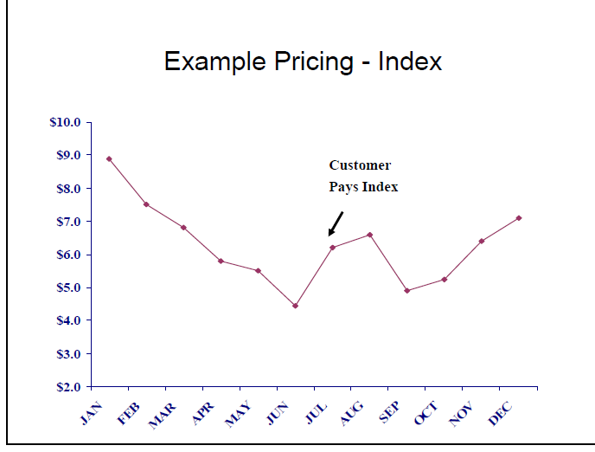
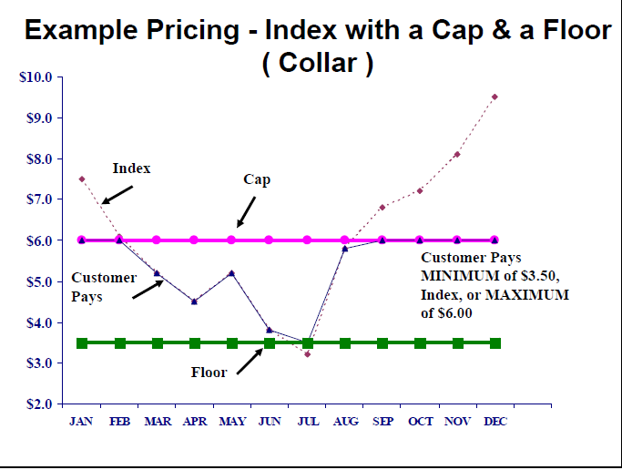
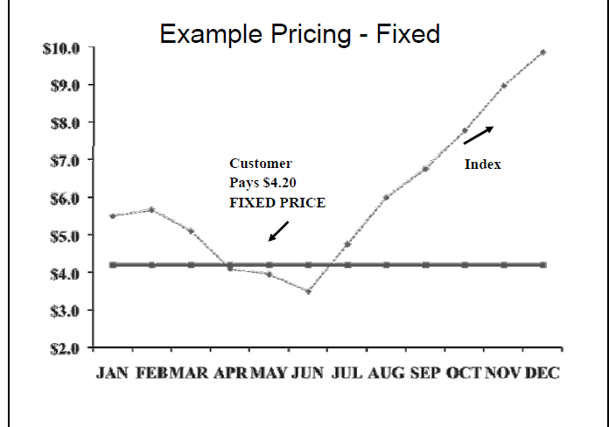

Slide 23


Rule #3
Price is a date and time
Value comes from the life of the contract

Slide 24
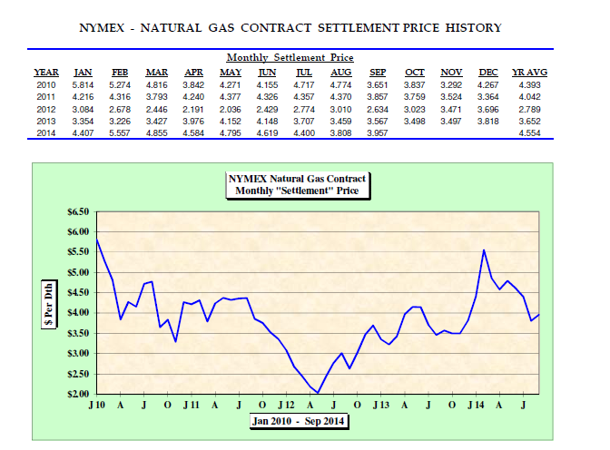

Slide 25

Questions

Slide 26
Unraveling the Hidden Costs and Usage of Utilities
Kimberly J. Mitchell, PhD, CPM®, CAM
Associate Teaching Professor and Program Director
Drexel University
October 13, 2014

Slide 27
Case Study
Nine Story, Class A, Well-Amenitized Building in a Metro Area
229 - 1, 2, and 3 BR Apartments
New Construction. Occupied in 2013
Rent: $1795 - $5995
95 WalkScore
Study Sample Size: 204 Households

Slide 28
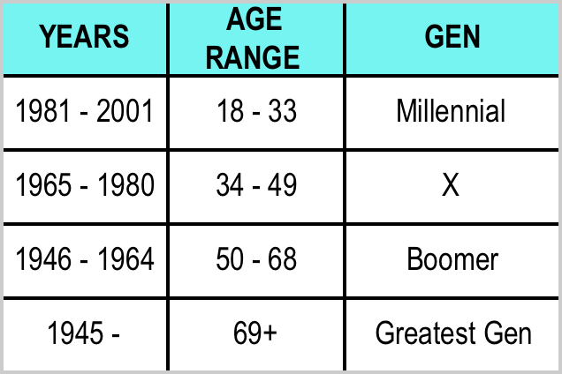
Sociodemographic Data
Yes really for Utility Management.
Case Study Households
Millennials: 119 – 58.3%
Gen X: 52 – 25.5%
Boomer: 33 – 16.2%
Greatest Gen: 0

Slide 29
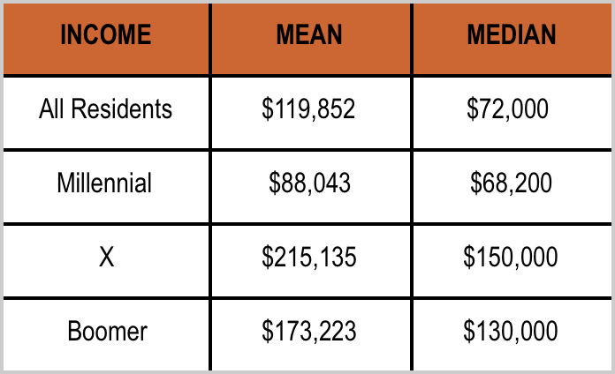
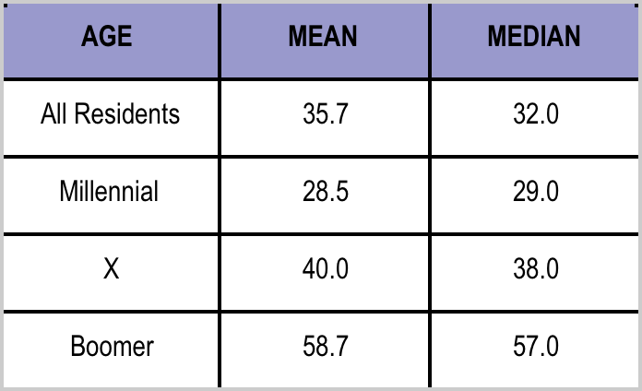
Sociodemographic Data
Millennial: 119 Gen X: 52 Boomer: 33

Slide 30
The User
Multifamily Renter – Who Is It?
Knowledgeable & Aware of Utilities
  Previous Homeowners
  Options Provided by Deregulation
Expectations of Utility Conservation, Earth Preservation, and Global Sustainability

Slide 31
Personal Utility Management
Which generation(s) of residents initiated their own personal utility management program?
Blackout Drapes, Thermal Blinds, etc.
Passive Solar and Passive Ventilation
Nest or Programmable Thermostats

Slide 32
RUBS vs. Metered Service
Resident electric usage changed when submeters were implemented
Usage also changed for water, even though water billing was still on RUBS
Usage post submetering changed differently within generations
Submetering at the subject property had a positive impact on the bottom line

Slide 33
Please feel free to contact me with additional questions. Thank You!
Kimberly J. Mitchell, PhD, CPM®, CAM
kjm367@drexel.edu
@KJ_Mitchell_
(215) 571-4427

