Slide 1
BGOV OnPoint: 2020 Election Outlook
By Bloomberg Staff
bgoveditors@bgov.com
March 11, 2020

Slide 2
Big Picture on 2020 Senate Races
There are 35 Senate seats up for election
Republicans hold 23 of the seats, Democrats hold 12
President Trump in 2016 carried all but two states where Republicans are defending Senate seats in 2020; he won 15 of those states by at least 14 percentage points
Senate Incumbents Up for Re-Election in 2020
Doug Jones (D-Ala.) | Dick Durbin (D-Ill.) | Cindy Hyde-Smith (R-Miss.) | Jack Reed (D-R.I.)
Dan Sullivan (R-Alaska) | Joni Ernst (R-Iowa) | Steve Daines (R-Mont.) | Lindsey Graham (R-S.C.)
Martha McSally (R-Ariz.) | Open (R-Kan.) | Ben Sasse (R-Neb.) | Mike Rounds (R-S.D.)
Tom Cotton (R-Ark.) | Mitch McConnell (R-Ky.) | Jeanne Shaheen (D-N.H.) | Open (R-Tenn.)
Cory Gardner (R-Colo.) | Bill Cassidy (R-La.) | Cory Booker (D-N.J.) | John Cornyn (R-Texas)
Chris Coons (D-Del.) | Susan Collins (R-Maine) | Open (D-N.M.) | Mark Warner (D-Va.)
Kelly Loeffler (R-Ga.) | Ed Markey (D-Mass.) | Thom Tillis (R-N.C.) | Shelley Moore Capito (R-W.Va.)
David Perdue (R-Ga.) | Gary Peters (D-Mich.) | Jim Inhofe (R-Okla.) | Open (R-Wyo.)
Jim Risch (R-Idaho) | Tina Smith (D-Minn.) | Jeff Merkley (D-Ore.)
Notes: Pat Roberts (R-Kan.), Tom Udall (D-N.M.), Lamar Alexander (R-Tenn.) and Mike Enzi (R-Wyo.) are retiring; McSally was appointed to fill the remainder of John McCain’s (R) term and is running in a special election that will occur in 2020 and the seat also will be on the ballot in 2022; Loeffler, who was sworn in Jan. 6 to succeed Johnny Isakson (R), is running in a November 2020 special election to fill the remaining two years of the unexpired term

Slide 3
States With Senate Races in 2020
Democratic-held seat Republican-held seat
Democratic-held seat – state won by Trump in 2016 Republican-held seat – state won by Clinton in 2016
Wash.
Idaho
Maine
Mont.
Minn.
Ore.
N.D.
Vt.
Wis.
Mich.
N.Y.
N.H.
Wyo.
S.D.
Calif.
Mass.
Nev.
Neb.
Iowa
Pa.
R.I.
Utah
Ill.
Ind.
Ohio
N.J.
Conn.
Colo.
W.Va.
Md.
Kan.
Va.
Del.
Ky.
Ariz.*
Mo.
N.C.
Va.
N.M.
Okla.
Tenn.
Texas
Ark.
S.C.
Miss.
Ala.
Ga.*
La.
Alaska
Fla.
Hawaii
Source: U.S. Senate; Bloomberg Government
Note: Georgia has one regularly scheduled election and one special election; Arizona has a special election

Slide 4
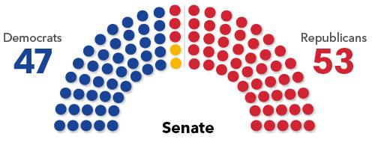
Senate Balance of Power
Trump’s re-election outlook and each party’s ability to field strong candidates are key
If Democrats net four seats they would take control of the Senate; netting three seats would result in a tie and the majority would be decided by the vice president’s party
If Bernie Sanders won the Democratic presidential nominee and defeated Trump, then Vermont’s GOP governor would be in a position to name an interim senator of his choosing until a special election could be held
Democrats last defeated more than two Republican senators in 2008, when Barack Obama’s victory helped Democrats beat five GOP incumbents
Senate Balance of Power
Source: Bloomberg Government
Note: Yellow reflects independents who caucus with Democrats

Slide 5
Super Tuesday and the Senate
Four states held Senate primaries March 3; three could determine majority
Sen. John Cornyn (R) running for third term
May 26 runoff between DSCC-backed MJ Hegar, state Sen. Royce West
Texas
Early polling shows tough race for Sen. Thom Tillis (R)
Democrats picked DSCC-backed former state Sen. Cal Cunningham
N.C.
Sen. Doug Jones (D) most vulnerable incumbent
March 31 GOP runoff: former attorney general and senator Jeff Sessions vs. Trump-backed former Auburn football coach Tommy Tuberville
Ala.
Ark.
Sen. Tom Cotton (R) unopposed in primary, Dems won’t field candidate
Note: DSCC – Democratic Senatorial Campaign Committee

Slide 6
Senate Races To Watch
To win Senate Democrats must unseat GOP in states that were mildly pro-Trump in 2016
Maine: Susan Collins (R) will face the winner of a Democratic primary that includes state House Speaker Sara Gideon; Collins is one of two GOP senators running for re-election in states won by Democrat Hillary Clinton in 2016.
Colorado: Cory Gardner (R) awaits a Democratic opponent, likely either former Gov. John Hickenlooper, the preferred candidate of the Democratic Senatorial Campaign Committee, or former state House Speaker Andrew Romanoff
Arizona: Martha McSally (R), who lost a 2018 Senate race and was subsequently appointed to fill John McCain’s (R) seat, is being challenged by former astronaut Mark Kelly, the husband of former Rep. Gabrielle Giffords (D), in the special election to serve the remainder of the term
Iowa: Joni Ernst (R) is gearing up to face a potentially strong Democratic challenger, DSCC-backed businesswoman Theresa Greenfield, in a state Trump won in 2016 but chose Obama in 2012
Georgia: Two races are on the ballot: David Perdue (R) is seeking a second full term; appointed Sen. Kelly Loeffler (R) faces Rep. Doug Collins (R), DSCC-backed Raphael Warnock and others in a special election jungle primary
Michigan: Gary Peters (D) will probably face Republican John James, a veteran and businessman who staged a strong challenge in 2018 to Debbie Stabenow, the state’s other Democratic senator; Michigan backed Trump by two-tenths of one percentage point in 2016, and is a pickup opportunity for the GOP
Massachusetts: It won’t affect Senate control, but Sen. Ed Markey, a veteran lawmaker, faces Rep. Joe Kennedy in the Sept. 1 Democratic primary, a closely watched and costly matchup defined by a generational contrast
Montana: Gov. Steve Bullock (D) announced at the March 9 filing deadline he’ll challenge Sen. Steve Daines (R), who previously appeared relatively safe for re-election

Slide 7
Senate 2020 Forecast
Solid Democratic
Solid Republican
Toss up
Likely Democratic
Likely Republican
No race
Lean Democratic
Lean Republican
Wash.
Mont.
Maine
N.D.
Vt.
Ore.
Minn.
N.H.
Idaho
S.D.
Wis.
N.Y.
Mass.
Wyo.
Mich.
R.I.
Pa.
Conn.
Neb.
Iowa
N.J.
Nev.
Ill.
Ind.
Ohio
Del.
Utah
W.Va.
Md.
Calif.
Colo.
Kan.
Va.
Mo.
Ky.
Tenn.
N.C.
Ariz.*
Okla.
Ark.
S.C.
N.M.
Miss.
Ala.
Ga.*
Texas
La.
Alaska
Fla.
Hawaii
Source: Race ratings from Cook Political Report; as of March 9
Note: * Georgia’s regularly scheduled election is rated Likely R, its special election Lean R; Arizona is a special election

Slide 8
2020 Republican-Held Senate Seats (1 of 2)
Incumbent | 2016 Presidential Winner | 2016 Percentage Point Margin | 2012 Presidential Winner | 2012 Percentage Point Margin | Cash on Hand (Dec. 31)
Dan Sullivan (Alaska) | Trump | 14.7% | Romney | 14.0% | $4,191,819
Martha McSally (Ariz.) | Trump | 3.5% | Romney | 9.1% | $7,659,881
Tom Cotton (Ark.) | Trump | 26.9% | Romney | 23.7% | $4,506,909
Cory Gardner (Colo.) | Clinton | 4.9% | Obama | 5.4% | $7,752,392
Kelly Loeffler (Ga.) | Trump | 5.1% | Romney | 7.8% | $5,449,122
David Perdue (Ga.) | Trump | 5.1% | Romney | 7.8% | $7,829,655
Jim Risch (Idaho) | Trump | 31.8% | Romney | 31.9% | $1,975,388
Joni Ernst (Iowa) | Trump | 9.4% | Obama | 5.8% | $4,856,481
Open (Kan.) | Trump | 20.6% | Romney | 21.7% | N/A
Mitch McConnell (Ky.) | Trump | 29.8% | Romney | 22.7% | $11,579,011
Bill Cassidy (La.) | Trump | 19.6% | Romney | 17.2% | $5,320,961
Susan Collins (Maine) | Clinton | 3.0% | Obama | 15.3% | $7,195,342
Source: Bloomberg Government; Federal Election Commission
Note: Pat Roberts (R-Kan.) is retiring; Cotton cash-on-hand total is current to Feb. 12

Slide 9
2020 Republican-Held Senate Seats (2 of 2)
Incumbent | 2016 Presidential Winner | 2016 Percentage Point Margin | 2012 Presidential Winner | 2012 Percentage Point Margin | Cash on Hand (Dec. 31)
Cindy Hyde-Smith (Miss.) | Trump | 17.8% | Romney | 11.5% | $783,909
Steve Daines (Mont.) | Trump | 20.4% | Romney | 13.7% | $5,036,999
Ben Sasse (Neb.) | Trump | 25.0% | Romney | 21.8% | $3,066,874
Thom Tillis (N.C.) | Trump | 3.7% | Romney | 2.0% | $5,403,423
Jim Inhofe (Okla.) | Trump | 36.4% | Romney | 33.5% | $2,317,019
Lindsey Graham (S.C.) | Trump | 14.3% | Romney | 10.5% | $10,336,750
Mike Rounds (S.D.) | Trump | 29.8% | Romney | 18.0% | $1,812,832
Open (Tenn.) | Trump | 26.0% | Romney | 20.4% | N/A
John Cornyn (Texas) | Trump | 9.0% | Romney | 15.8% | $12,008,298
Shelley Moore Capito (W.Va.) | Trump | 42.2% | Romney | 26.8% | $2,646,150
Open (Wyo.) | Trump | 46.3% | Romney | 40.8% | N/A
Source: Bloomberg Government; Federal Election Commission
Notes: Lamar Alexander (R-Tenn.), Mike Enzi (R-Wyo.) are retiring; Cornyn, Tillis cash-on-hand totals current to Feb. 12, Hyde-Smith to Feb. 19

Slide 10
2020 Democratic-Held Senate Seats
Incumbent | 2016 Presidential Winner | 2016 Percentage Point Margin | 2012 Presidential Winner | 2012 Percentage Point Margin | Cash on Hand (Dec. 31)
Doug Jones (Ala.) | Trump | 27.7% | Romney | 22.2% | $7,422,821
Chris Coons (Del.) | Clinton | 11.4% | Obama | 18.6% | $2,647,091
Dick Durbin (Ill.) | Clinton | 17.1% | Obama | 16.9% | $4,636,452
Ed Markey (Mass.) | Clinton | 27.2% | Obama | 23.1% | $4,550,451
Gary Peters (Mich.) | Trump | 0.2% | Obama | 9.5% | $8,036,796
Tina Smith (Minn.) | Clinton | 1.5% | Obama | 7.7% | $3,623,188
Jeanne Shaheen (N.H.) | Clinton | 0.4% | Obama | 5.6% | $5,757,662
Cory Booker (N.J.) | Clinton | 14.1% | Obama | 17.8% | $53,551
Open (N.M.) | Clinton | 8.2% | Obama | 10.1% | N/A
Jeff Merkley (Ore.) | Clinton | 11.0% | Obama | 12.1% | $3,222,344
Jack Reed (R.I.) | Clinton | 15.5% | Obama | 27.5% | $2,832,024
Mark Warner (Va.) | Clinton | 5.3% | Obama | 3.9% | $7,459,886
Source: Bloomberg Government; Federal Election Commission
Notes: Tom Udall (D-N.M.) is retiring; Jones’ cash-on-hand total is current to Feb. 12, Durbin’s to Feb. 26

Slide 11
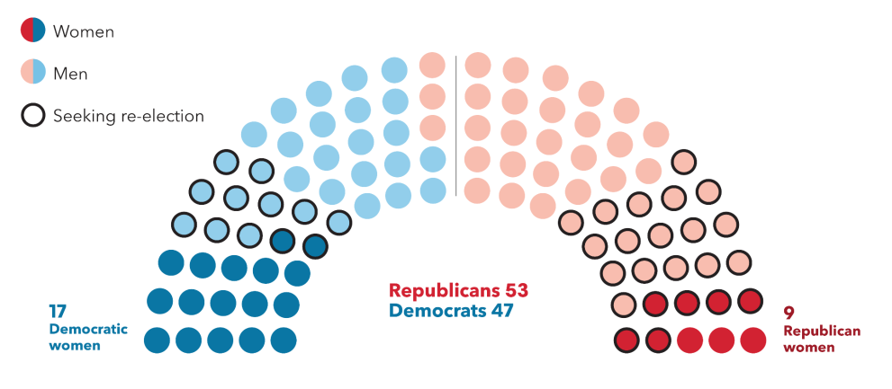
Senate Women in the Balance
There are 26 women in the Senate, or 26% of the membership. Two of the 17 Democratic women and six of the nine Republican women are on the ballot this year.
Note: Data of March 11

Slide 12
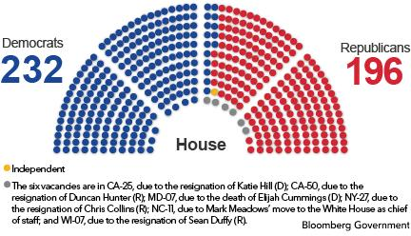
Big Picture on 2020 House Races
All 435 House seats are up in 2020
Democrats are defending their majority after a net gain of 40 seats in 2018 election
Republicans would need to net around 18 seats to flip the chamber
Some of the most closely watched races will be districts won by the other party’s 2016 presidential candidate

Slide 13
Congressional Comings & Goings
Senate
Resigned
Johnny Isakson (R-Ga.) resigned Dec. 31, 2019; Kelly Loeffler (R) was appointed to serve out the term
Not seeking re-election
Lamar Alexander (R-Tenn.)
Mike Enzi (R-Wyo.)
Pat Roberts (R-Kan.)
Tom Udall (D-N.M.)
Running for president
Bernie Sanders (I-Vt.)
House
Special election winners
NC-03 – Greg Murphy (R) elected Sept. 10, 2019
NC-09 – Dan Bishop (R) elected Sept. 10, 2019
PA-12 – Fred Keller (R) elected May 21, 2019
Party switches
NJ-02 – Jeff Van Drew switched from the Democratic to Republican party Jan. 7
Vacancies/pending vacancies
CA-25 – Katie Hill (D) resigned Nov. 3, 2019; special election May 12
CA-50 – Duncan Hunter (R) resigned Jan. 13; no special election
MD-07 – Elijah Cummings (D) died Oct. 17, 2019; special election April 28
NC-11 – Mark Meadows (R) was named White House chief of staff March 6, hasn’t resigned
NY-27 – Chris Collins (R) resigned Sept. 30, 2019; special election April 28
WI-07 – Sean Duffy (R) resigned Sept. 23, 2019; special election May 12
Not seeking re-election
AL-02 – Martha Roby (R)
CA-53 – Susan Davis (D)
FL-03 – Ted Yoho (R)
FL-19 – Francis Rooney (R)
GA-07 – Rob Woodall (R)
GA-14 – Tom Graves (R)
HI-02 – Tulsi Gabbard (D)
IA-02 – Dave Loebsack (D)
IL-15 – John Shimkus (R)
IN-01 – Pete Visclosky (D)
IN-05 – Susan Brooks (R)
LA-05 – Ralph Abraham (R)
MI-10 – Paul Mitchell (R)
NC-02 – George Holding (R)
NC-06 – Mark Walker (R)
NY-02 – Peter King (R)
NY-15 – José Serrano (D)
NY-17 – Nita Lowey (D)
OR-02 – Greg Walden (R)
TN-01 – Phil Roe (R)
TX-11 – Michael Conaway (R)
TX-13 – Mac Thornberry (R)
TX-17 – Bill Flores (R)
TX-22 – Pete Olson (R)
TX-23 – Will Hurd (R)
TX-24 – Kenny Marchant (R)
WA-10 – Denny Heck (D)
WI-05 – Jim Sensenbrenner (R)
Seeking other office
AL-01 – Bradley Byrne (R), Senate (lost in primary)
CA-08 – Paul Cook (R), elected in March to San Bernardino County Board of Supervisors
GA-09 – Doug Collins (R), Senate
HI-02 – Tulsi Gabbard (D), president
KS-01 – Roger Marshall (R), Senate
MA-04 – Joe Kennedy (D), Senate
MT-AL – Greg Gianforte (R), governor
NM-03 – Ben Ray Luján (D), Senate
UT-01 – Rob Bishop (R), lieutenant governor
Source: Bloomberg Government; as of March 11

Slide 14
Super Tuesday and the House
Calif. (53 seats)
Special election in ex-Rep. Katie Hill’s (D) district
Ex-Rep. Darrell Issa (R) seeks comeback
Open-seat races to replace Reps. Susan Davis (D), Paul Cook (R)
GOP targeting freshman Democrats in Orange County, Central Valley
Reps. Kay Granger (R), Henry Cuellar (D) survive primary challenges
Former Rep. Pete Sessions (R) advances to runoff in new district
Pierce Bush comes up short in open-seat primary
Texas
(36 seats)
N.C.
(13 seats)
New congressional map likely to net Democrats two seats
11th District GOP runoff to replace Mark Meadows (R)
GOP races to replace Reps. Bradley Byrne (R), Martha Roby (R) advance to March 31 runoffs
Ala.
(7 seats)
Ark.
(4 seats)
All four GOP House members unopposed in primaries
Rep. French Hill (R) faces state Sen. Joyce Elliott (D) in November

Slide 15
More House Races to Watch
Several incumbents facing higher-profile primary challengers
Some progressive Democrats are aiming to repeat Alexandria Ocasio-Cortez’s upset win by mounting liberal primary bids to oust long-time incumbents
New York (June 23): Eliot Engel, Jerry Nadler, Carolyn Maloney, and Yvette Clarke
Massachusetts (Sept. 1): Richard Neal
Maryland (April 28): Majority Leader Steny Hoyer
Illinois (March 17): Dan Lipinski
Ohio (March 17): Joyce Beatty
Ocasio-Cortez hails from a safely Democratic urban district and it’s unclear if a similar anti-incumbency phenomenon would be replicated in more centrist or suburban districts
An Iowa state senator aims to force out embattled incumbent Steve King in the GOP primary; King’s 2018 Democratic opponent also plans to run again after losing to King by only 3 points in 2018

Slide 16
GOP Aims to Defeat Trump-District Democrats
House Republicans released a list of more than 50 seats they intend to target in 2020
Among them are 30 districts that Trump won in 2016 (underlined)
40 members are facing their first re-election bids
NRCC Targets List
AZ-01 – Tom O’Halleran | GA-06 – Lucy McBath | NH-01 – Chris Pappas | PA-07 – Susan Wild
AZ-02 – Ann Kirkpatrick | IA-01 – Abby Finkenauer | NJ-03 – Andy Kim | PA-08 – Matt Cartwright
CA-10 – Josh Harder | IA-02 – (Dave Loebsack, retiring) | NJ-05 – Josh Gottheimer | PA-17 – Conor Lamb
CA-21 – TJ Cox | IA-03 – Cindy Axne | NJ-07 – Tom Malinowski | SC-01 – Joe Cunningham
CA-25 – (Open, Katie Hill resigned) | IL-06 – Sean Casten | NJ-11 – Mikie Sherrill | TX-07 – Lizzie Fletcher
CA-39 – Gil Cisneros | IL-14 – Lauren Underwood | NM-02 – Xochitl Torres Small | TX-32 – Colin Allred
CA-45 – Katie Porter | IL-17 – Cheri Bustos | NV-03 – Susie Lee | UT-04 – Ben McAdams
CA-48 – Harley Rouda | KS-03 – Sharice Davids | NV-04 – Steven Horsford | VA-02 – Elaine Luria
CA-49 – Mike Levin | ME-02 – Jared Golden | NY-11 – Max Rose | VA-07 – Abigail Spanberger
CO-06 – Jason Crow | MI-08 – Elissa Slotkin | NY-18 – Sean Patrick Maloney | VA-10 – Jennifer Wexton
FL-07 – Stephanie Murphy | MI-11 – Haley Stevens | NY-19 – Antonio Delgado | WA-08 – Kim Schrier
FL-13 – Charlie Crist | MN-02 – Angie Craig | NY-22 – Anthony Brindisi | WI-03 – Ron Kind
FL-26 – Debbie Mucarsel-Powell | MN-03 – Dean Phillips | OK-05 – Kendra Horn
FL-27 – Donna Shalala | MN-07 – Collin Peterson | OR-04 – Peter DeFazio
Source: National Republican Congressional Committee press release Feb. 8, 2019
Note: Horsford earlier served one term, but won his seat back in 2018; the 2020 election will be his first re-election bid

Slide 17
Democrats Aim to Protect Their Freshmen
House Democrats have a list of 42 competitive seats they intend to aggressively defend
Most are suburban and have experienced rapid diverse population growth in recent years
Nearly all of these districts feature lawmakers facing their first re-election bid
DCCC Frontline Program
AZ-01 – Tom O’Halleran | IA-01 – Abby Finkenauer | NJ-05 – Josh Gottheimer | PA-08 – Matt Cartwright
CA-10 – Josh Harder | IA-03 – Cindy Axne | NJ-07 – Tom Malinowski | PA-17 – Conor Lamb
CA-21 – TJ Cox | IL-06 – Sean Casten | NJ-11 – Mikie Sherrill | SC-01 – Joe Cunningham
CA-39 – Gil Cisneros | IL-14 – Lauren Underwood | NM-02 – Xochitl Torres Small | TX-07 – Lizzie Fletcher
CA-45 – Katie Porter | KS-03 – Sharice Davids | NV-03 – Susie Lee | TX-32 – Colin Allred
CA-48 – Harley Rouda | ME-02 – Jared Golden | NV-04 – Steven Horsford | UT-04 – Ben McAdams
CA-49 – Mike Levin | MI-08 – Elissa Slotkin | NY-11 – Max Rose | VA-02 – Elaine Luria
CO-06 – Jason Crow | MI-11 – Haley Stevens | NY-19 – Antonio Delgado | VA-07 – Abigail Spanberger
CT-05 – Jahana Hayes | MN-02 – Angie Craig | NY-22 – Anthony Brindisi | WA-08 – Kim Schrier
FL-26 – Debbie Mucarsel-Powell | NH-01 – Chris Pappas | OK-05 – Kendra Horn
GA-06 – Lucy McBath | NJ-03 – Andy Kim | PA-07 – Susan Wild
Source: Democratic Congressional Campaign Committee’s Frontline list

Slide 18
Dems Seek Additional Suburban GOP Seats
House Democrats are focused on flipping more than 40 GOP-held or independent districts
Most are suburban and have experienced rapid diverse population growth in recent years
Texas has the most targeted races with seven
Only three Republicans represent districts won by Hillary Clinton in 2016 (underlined); there were more than 20 of these districts in 2018
DCCC Offensive Battlefield
AK-AL – Don Young | IN-05 – (Susan Brooks, retiring) | NC-13 – Ted Budd | PA-16 – Mike Kelly
AZ-06 – Dave Schweikert | KS-02 – Steve Watkins | NE-02 – Don Bacon | TX-02 – Dan Crenshaw
CA-22 – Devin Nunes | KY-06 – Andy Barr | NJ-02 – Jeff Van Drew | TX-10 – Michael McCaul
CA-50 – (Open, Duncan Hunter, resigned) | MI-03 – Justin Amash (I) | NY-01 – Lee Zeldin | TX-21 – Chip Roy
CO-03 – Scott Tipton | MI-06 – Fred Upton | NY-02 – Peter King | TX-22 – (Pete Olson, retiring)
FL-15 – Ross Spano | MN-01 – Jim Hagedorn | NY-24 – John Katko | TX-23 – (Will Hurd, retiring)
FL-16 – Vern Buchanan | MO-02 – Ann Wagner | NY-27 – (Open, Chris Collins, resigned) | TX-24 – (Kenny Marchant, retiring)
FL-18 – Brian Mast | MT-AL – (Greg Gianforte, running for governor) | OH-01 – Steve Chabot | TX-31 – John Carter
GA-07 – (Rob Woodall, retiring) | NC-02 – (George Holding, retiring) | OH-12 – Troy Balderson | VA-05 – Denver Riggleman
IA-04 – Steve King | NC-08 – Richard Hudson | PA-01 – Brian Fitzpatrick | WA-03 – Jaime Herrera Beutler
IL-13 – Rodney Davis | NC-09 – Dan Bishop | PA-10 – Scott Perry
Source: Democratic Congressional Campaign Committee press release Jan. 28, 2019, press release Aug. 15, 2019 and press release Jan. 16
Note: The DCCC has also identified CA-25 as a battlefield district, which most recently was held by Democrat Katie Hill, who resigned

Slide 19
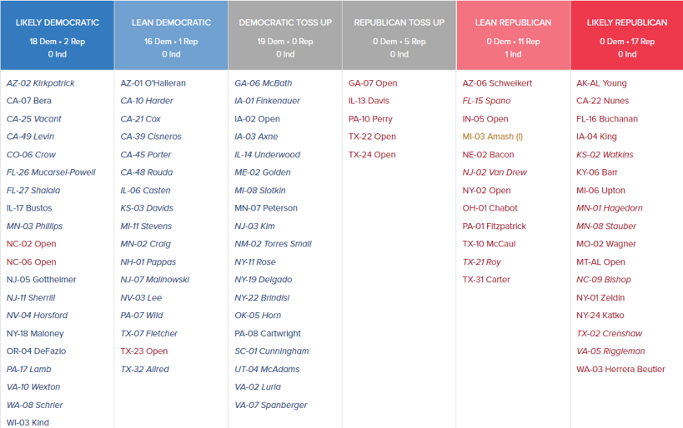
House Races: Cook Ratings
An edge for Democrats to maintain control
Source: Race ratings from Cook Political Report; as of Feb. 28, 2020
Note: Italics denote freshman lawmakers

Slide 20
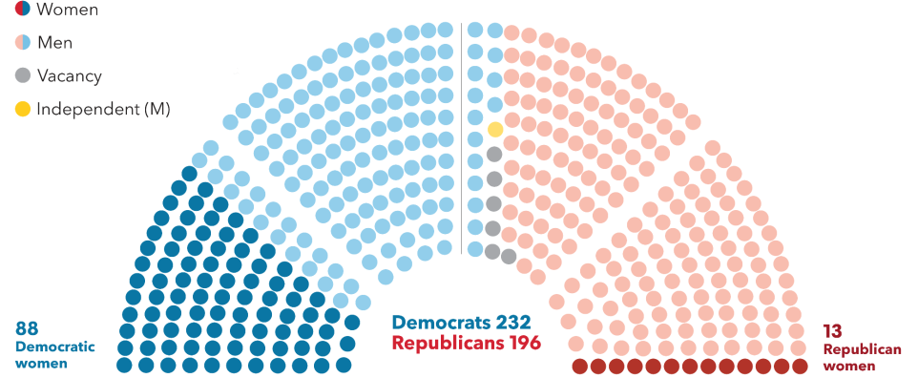
Women in the House
There are 101 women in the House, or 24% of the membership. The number of Democratic women rose to 89 from 64 after the 2018 election, while the number of Republican women fell to 13 from 23. Katie Hill (D-Calif.) resigned last November.
Notes: Data as of March 11, reflects impending departure of Mark Meadows (R-N.C.).

Slide 21
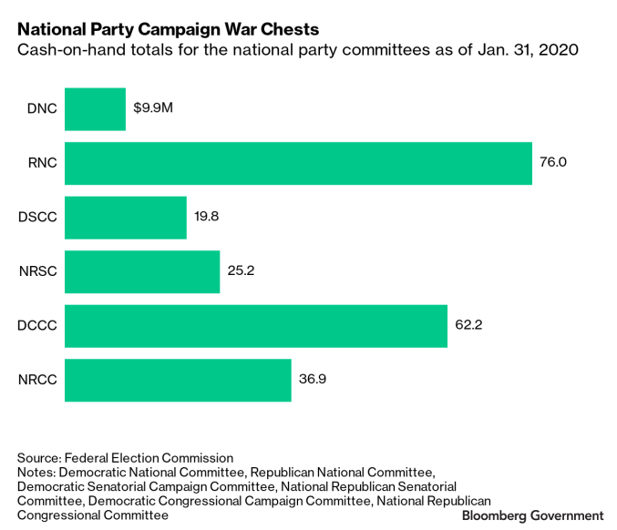
Party Fundraising

Slide 22
Congressional Primaries
State | Congressional primary | Major-party filing deadline | State | Congressional primary | Major-party filing deadline
Alabama | March 3 | Nov. 8, 2019 | South Carolina | June 9 | March 30
Arkansas | March 3 | Nov. 11, 2019 | Virginia | June 9 | March 26
California | March 3 | Dec. 6, 2019 | New York | June 23 | April 2
North Carolina | March 3 | Dec. 20, 2019 | Utah | June 23 | March 19
Texas | March 3 | Dec. 9, 2019 | Colorado | June 30 | March 17
Mississippi | March 10 | Jan. 15 | Oklahoma | June 30 | April 10
Ohio | March 17 | Dec. 18, 2019 | Arizona | Aug. 4 | April 6
Illinois | March 17 | Dec. 2, 2019 | Kansas | Aug. 4 | June 1
Maryland | April 28 | Feb. 5 | Michigan | Aug. 4 | April 21
Pennsylvania | April 28 | Feb. 18 | Missouri | Aug. 4 | March 31
Indiana | May 5 | Feb. 7 | Washington | Aug. 4 | May 15
Nebraska | May 12 | Feb. 18 (incumbents); March 2 (non-incumbents) | Tennessee | Aug. 6 | April 2
West Virginia | May 12 | Jan. 25 | Hawaii | Aug. 8 | June 2
Georgia | May 19 | March 6 | Connecticut | Aug. 11 | June 9
Idaho | May 19 | March 13 | Minnesota | Aug. 11 | June 2
Kentucky | May 19 | Jan. 28 | Vermont | Aug. 11 | May 28
Oregon | May 19 | March 10 | Wisconsin | Aug. 11 | June 1
Iowa | June 2 | March 13 | Alaska | Aug. 18 | June 1
Montana | June 2 | March 9 | Florida | Aug. 18 | April 24
New Jersey | June 2 | March 30 | Wyoming | Aug. 18 | May 29
New Mexico | June 2 | March 10 | Massachusetts | Sept.1 | May 5
South Dakota | June 2 | March 31 | New Hampshire | Sept. 8 | June 12
Maine | June 9 | March 16 | Rhode Island | Sept. 8 | June 24
Nevada | June 9 | March 13 | Delaware | Sept. 15 | July 14
North Dakota | June 9 | April 6 | Louisiana | Nov. 3 | July 17
Source: Bloomberg Government; dates are 2020 unless otherwise noted; filing deadlines are for major party candidates unless otherwise noted; dates are subject to change

Slide 23
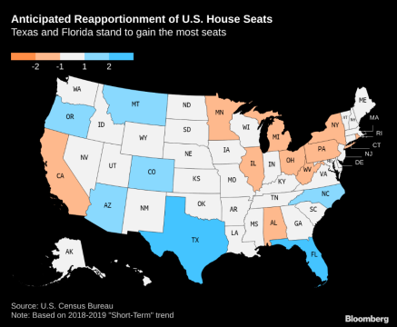
Bonus Look Ahead: House Reapportionment
Texas, Florida and North Carolina will likely gain House seats in the 2022 elections, while Michigan, Ohio and Pennsylvania will continue to lose political clout, according to an analysis by Election Data Services Inc. based on the lastest Census Bureau population count data
17 states’ House representation may be affected by the once-a-decade census, according to estimates
Continues decades-long trend of the South and West expanding more rapidly than other regions
California – projected to lose one of its 53 seats – would shrink its House representation for the first time
Florida is projected to have a larger delegation (29 seats) than New York (26 seats)
Reapportionment would be released in December 2020 after the census and in effect for 2022 elections

Slide 24
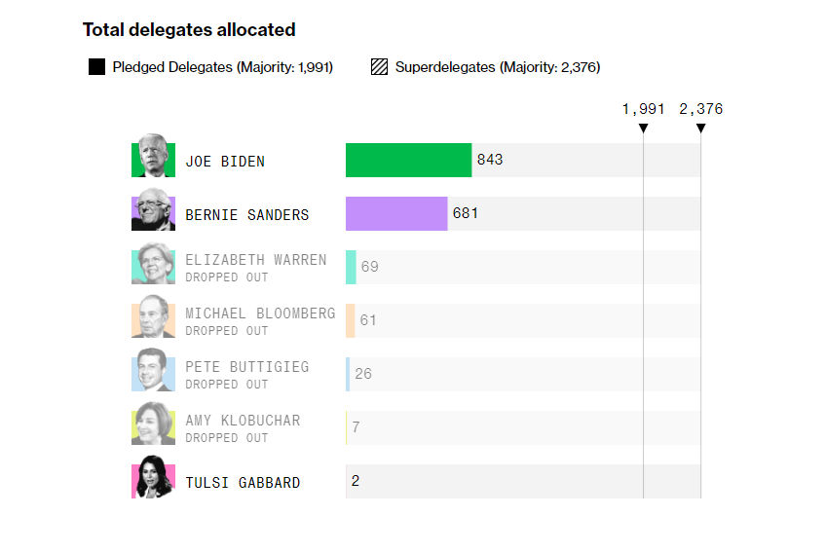
Biden Has Taken Commanding Lead in Delegates
Lead could grow on March 17 (Arizona, Florida, Illinois, Ohio) and March 24 (Georgia)
Note: Data as of March 11
Source: Bloomberg News “Who’s Winning the 2020 Presidential Delegate Count?”

Slide 25
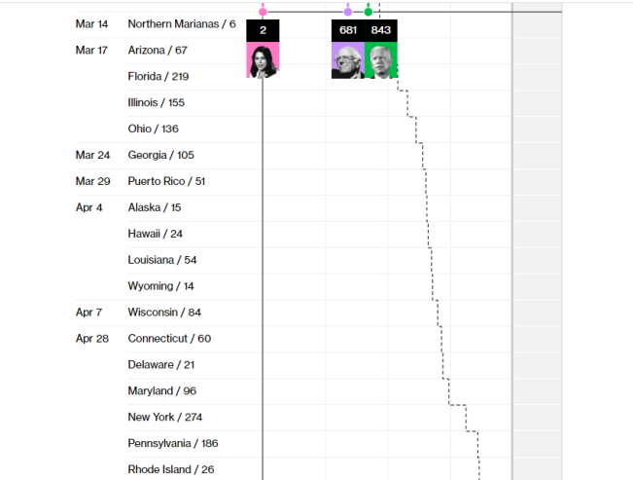
Where Biden, Sanders Stand on Nomination Path
A few big primary days are ahead, as Biden closes in on the 50% of delegates line
Note: The dotted line indicates the median of awarded delegates; data as of March 11
Source: Bloomberg News “Who’s Winning the 2020 Presidential Delegate Count?”

Slide 26
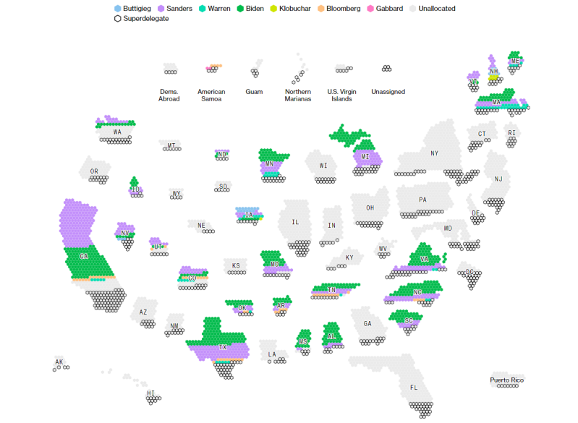
How the Delegates Were Allocated in Each State
Note: Data as of March 11
Source: Bloomberg News “Who’s Winning the 2020 Presidential Delegate Count?”

Slide 27
Major Dates on Presidential Calendar
March 15: 11th Democratic debate (Phoenix, Ariz.; hosted by CNN/Univision)
June 6: Last Democratic primary or caucus (Virgin Islands)
July 13-16: Democratic National Convention (Milwaukee, Wis.)
Aug. 24-27: Republican National Convention (Charlotte, N.C.)
Sept. 29: 1st presidential debate (Notre Dame, Ind.)
Oct. 7: Vice presidential debate (Salt Lake City, Utah)
Oct. 15: 2nd presidential debate (Ann Arbor, Mich.)
Oct. 22: 3rd presidential debate (Nashville, Tenn.)
Nov. 3: Election Day

Slide 28
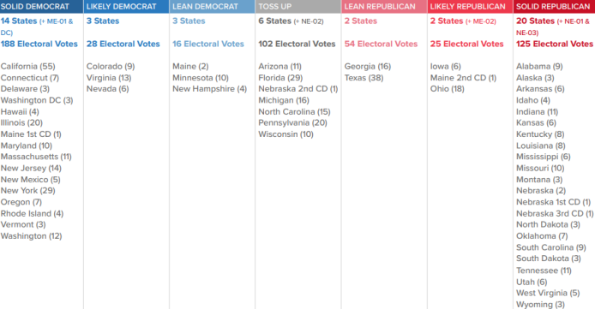
Electoral College Math Matters Most
Trump won the electoral vote 304 to 227, but lost the popular vote by 2.1 percentage points
Cook’s Latest Scenario: 232 - Democratic pick | 102 - Toss Up | 204 - Trump/Republican
Source: Nominees need 270 electoral votes to win; race ratings from Cook Political Report as of March 11

Slide 29
Governors’ 2020 Races
There are 11 governorships up for election in 2020; considerably fewer than in 2018
Seven are held by Republicans; four are held by Democrats
Each party is defending one open seat, with no incumbent
Montana: Steve Bullock (D) is term-limited; Rep. Greg Gianforte (R) is running
Utah: Gary Herbert (R) is retiring; ex-Gov. Jon Huntsman (R) is running
West Virginia’s incumbent, Jim Justice, was elected in 2016 as a Democrat, but changed party affiliation, is running for re-election as a Republican, and faces a May 12 primary; Sen. Joe Manchin (D) declined to run for his old job
Gubernatorial Incumbents 2020
John Carney Jr. (D-Del.) | Open (D-Mont.) | Doug Burgum (R-N.D.) | Jay Inslee (D-Wash.)
Eric Holcomb (R-Ind.) | Chris Sununu (R-N.H.) | Open (R-Utah) | Jim Justice (R-W.Va.)
Mike Parson (R-Mo.) | Roy Cooper (D-N.C.) | Phil Scott (R-Vt.)
In 2018, Democrats picked up seven governor seats previously held by Republicans; the GOP picked up one (in Alaska) previously held by an independent

Slide 30
Governors’ Races: 2020
Solid Democratic
Solid Republican
Toss up
Likely Democratic
Likely Republican
No race
Lean Democratic
Lean Republican
Wash.
Mont.
Maine
N.D.
Vt.
Ore.
Minn.
N.H.
Idaho
Wis.
N.Y.
Mass.
S.D.
Mich.
R.I.
Wyo.
Conn.
Neb.
Iowa
Pa.
N.J.
Nev.
Ill.
Ind.
Ohio
Del.
Utah
W.Va.
Md.
Calif.
Colo.
Kan.
Va.
Mo.
Ky.
Tenn.
N.C.
Ariz.
Okla.
Ark.
S.C.
N.M.
Miss.
Ala.
Ga.
Texas
La.
Alaska
Fla.
Hawaii
Source: Race ratings from Cook Political Report; last updated Dec. 13

Slide 31
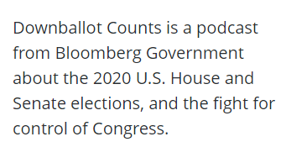
Listen to Our New Podcast
Listen and subscribe to Downballot Counts from your mobile device:
Apple Podcasts | Overcast | Stitcher | Spotify

Slide 32
About Bloomberg Government
On bgov.com
Sign up for Bloomberg Government's 2020 presidential election and congressional elections alerts
Learn more about Downballot Counts, BGOV’s podcast focused on the House and Senate elections
Michael Bloomberg, the majority owner of Bloomberg Government’s parent company, also sought the Democratic presidential nomination. He endorsed Joe Biden on March 4.

