Slide 1
Getting to Zero
Reducing Energy Usage
to Zero
Ted van der Linden
Dir. of Sustainability, DPR Construction
October 14, 2014

Slide 2
Agenda
Before + After: The Net Zero Opportunity
The Process: Integrated Design + Performance Goals
The Results: Performance
Smart Market Report: Green Multi-Family

Slide 3
What is Net Zero Energy?
Where a building creates as much energy as is utilized in one calendar year.

Slide 4
Net zero energy: Key drivers
Respect the Individual(s)
Form will follow function
Payback in >10 years
Bring the outside in

Slide 5
How do we get there?
Alignment, Visioning & Setting the Goal
Engage with a knowledgeable team
Approach Energy (& water) use responsibly
Paradigm Shifting
Total Cost of Ownership & ROI

Slide 6
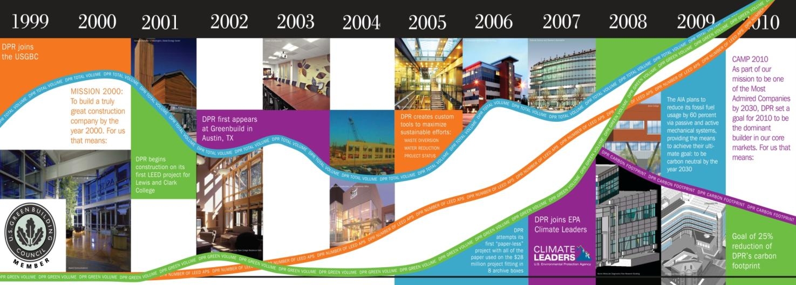
DPR sustainability Timeline

Slide 7
Before
+
After.

Slide 8
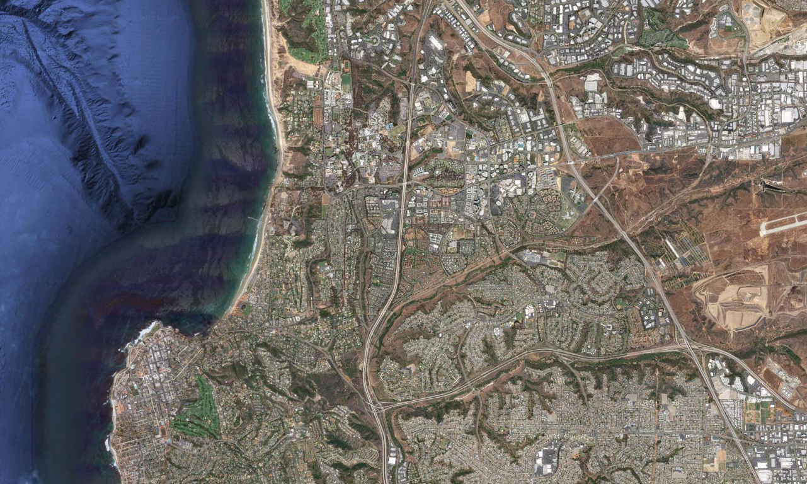
San Diego

Slide 9
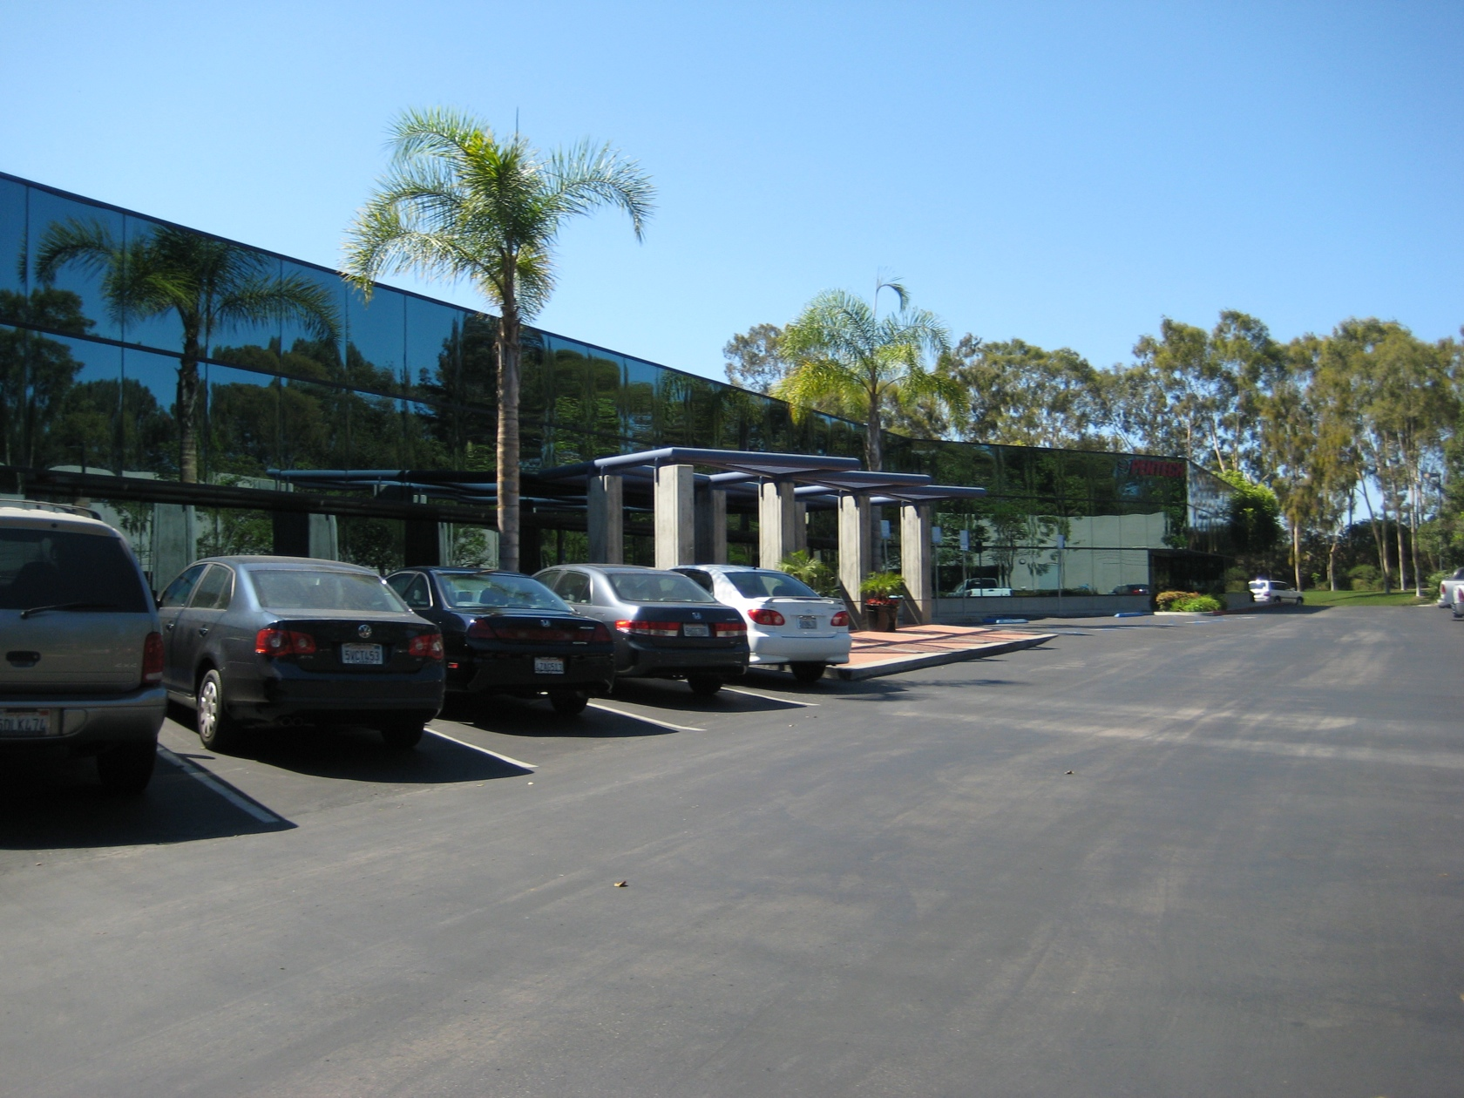

Slide 10
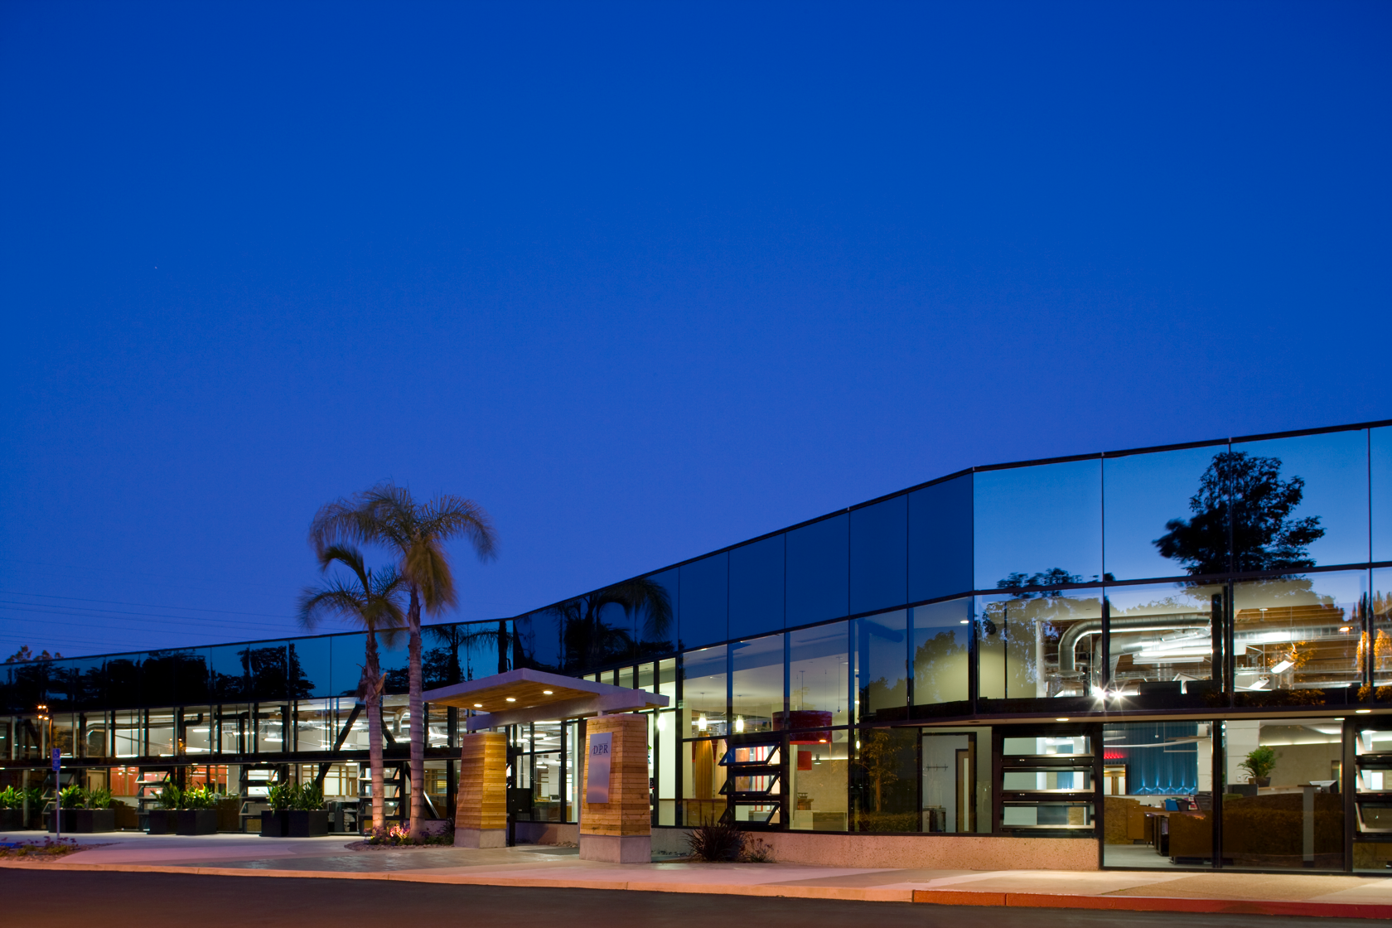

Slide 11
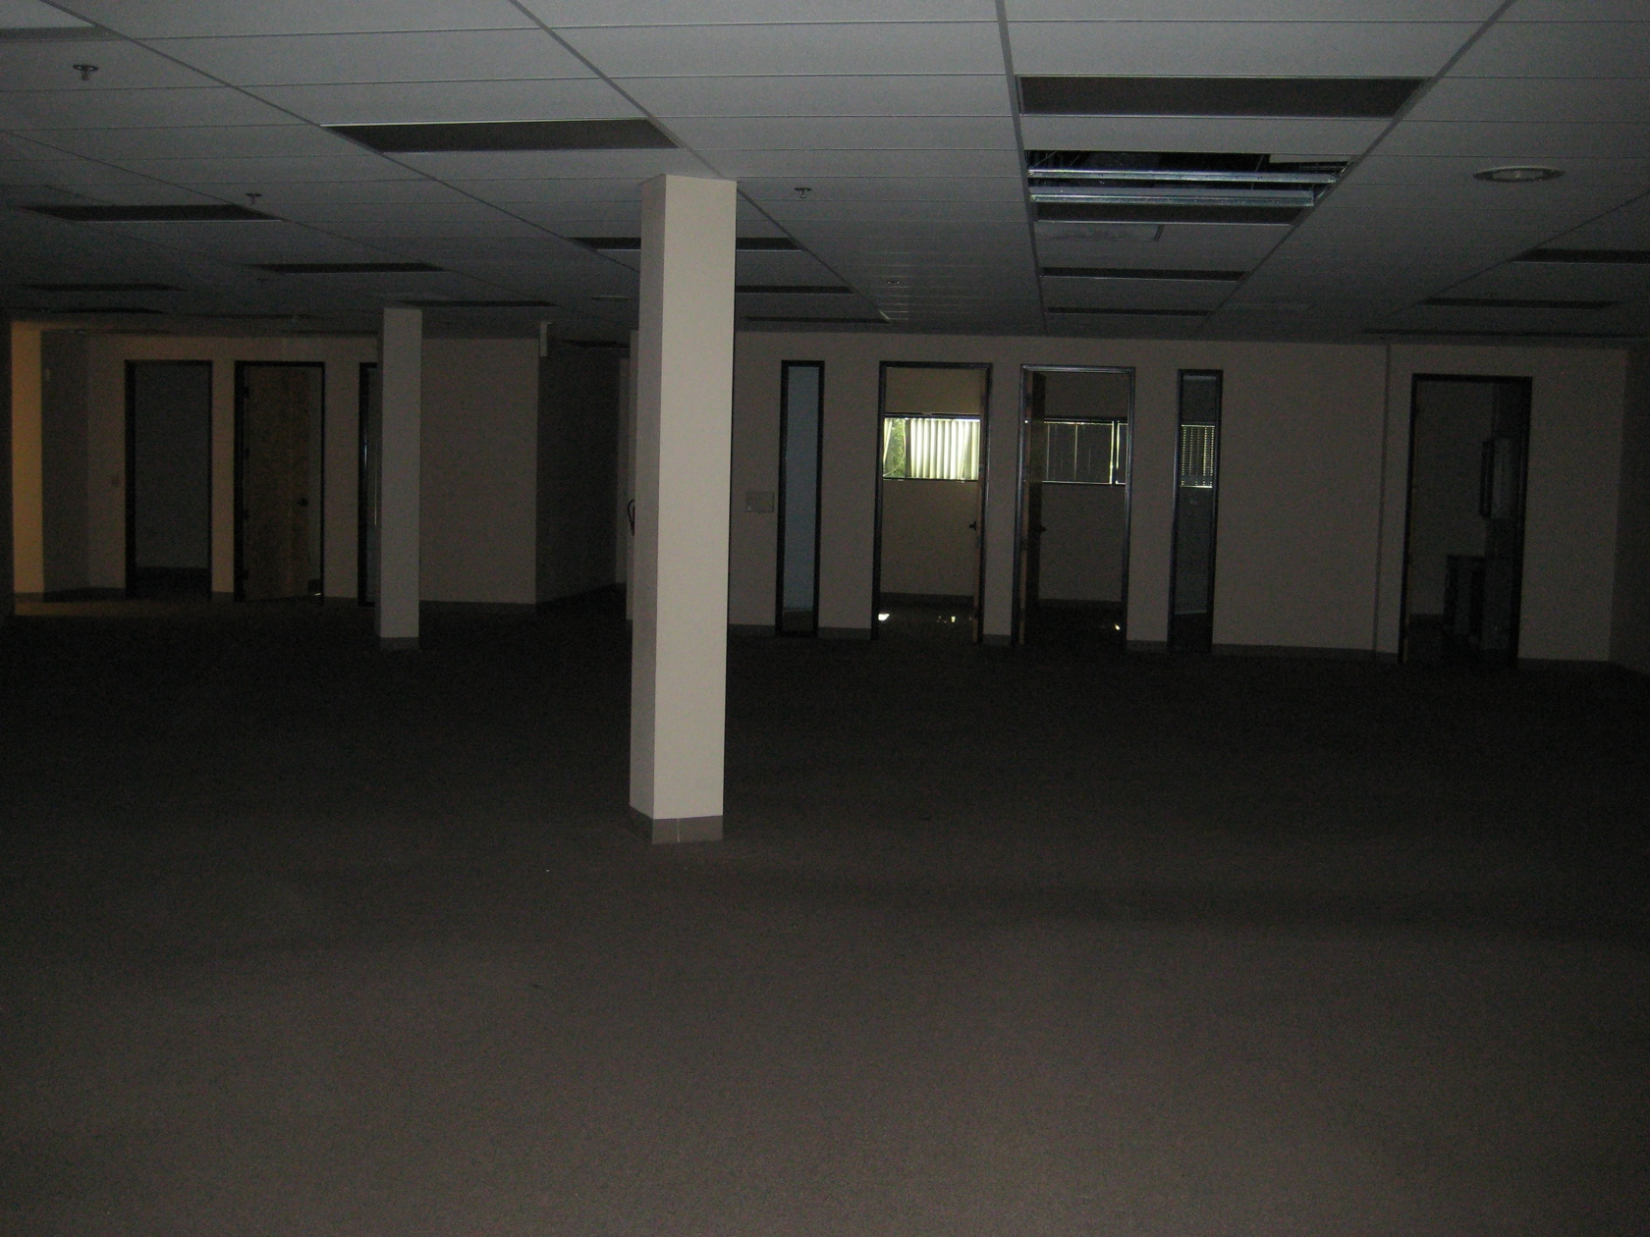
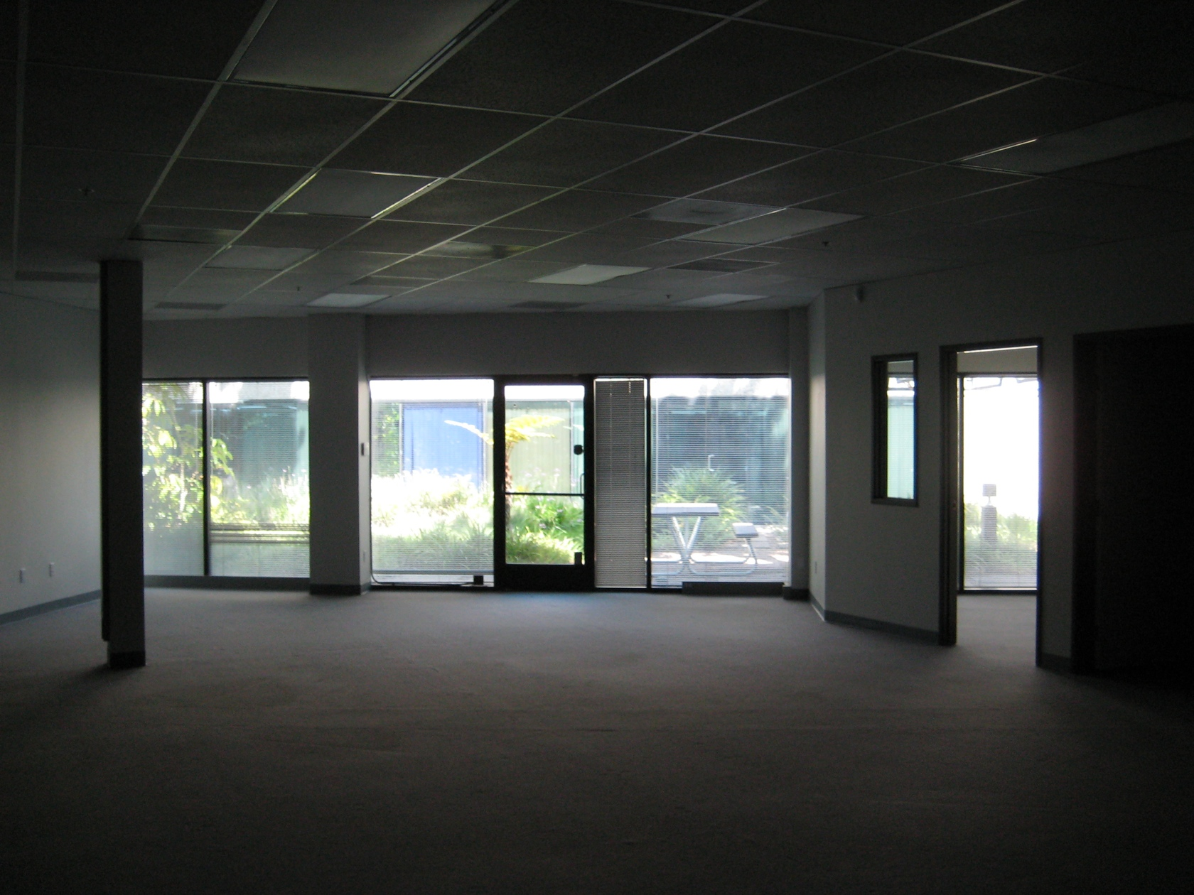
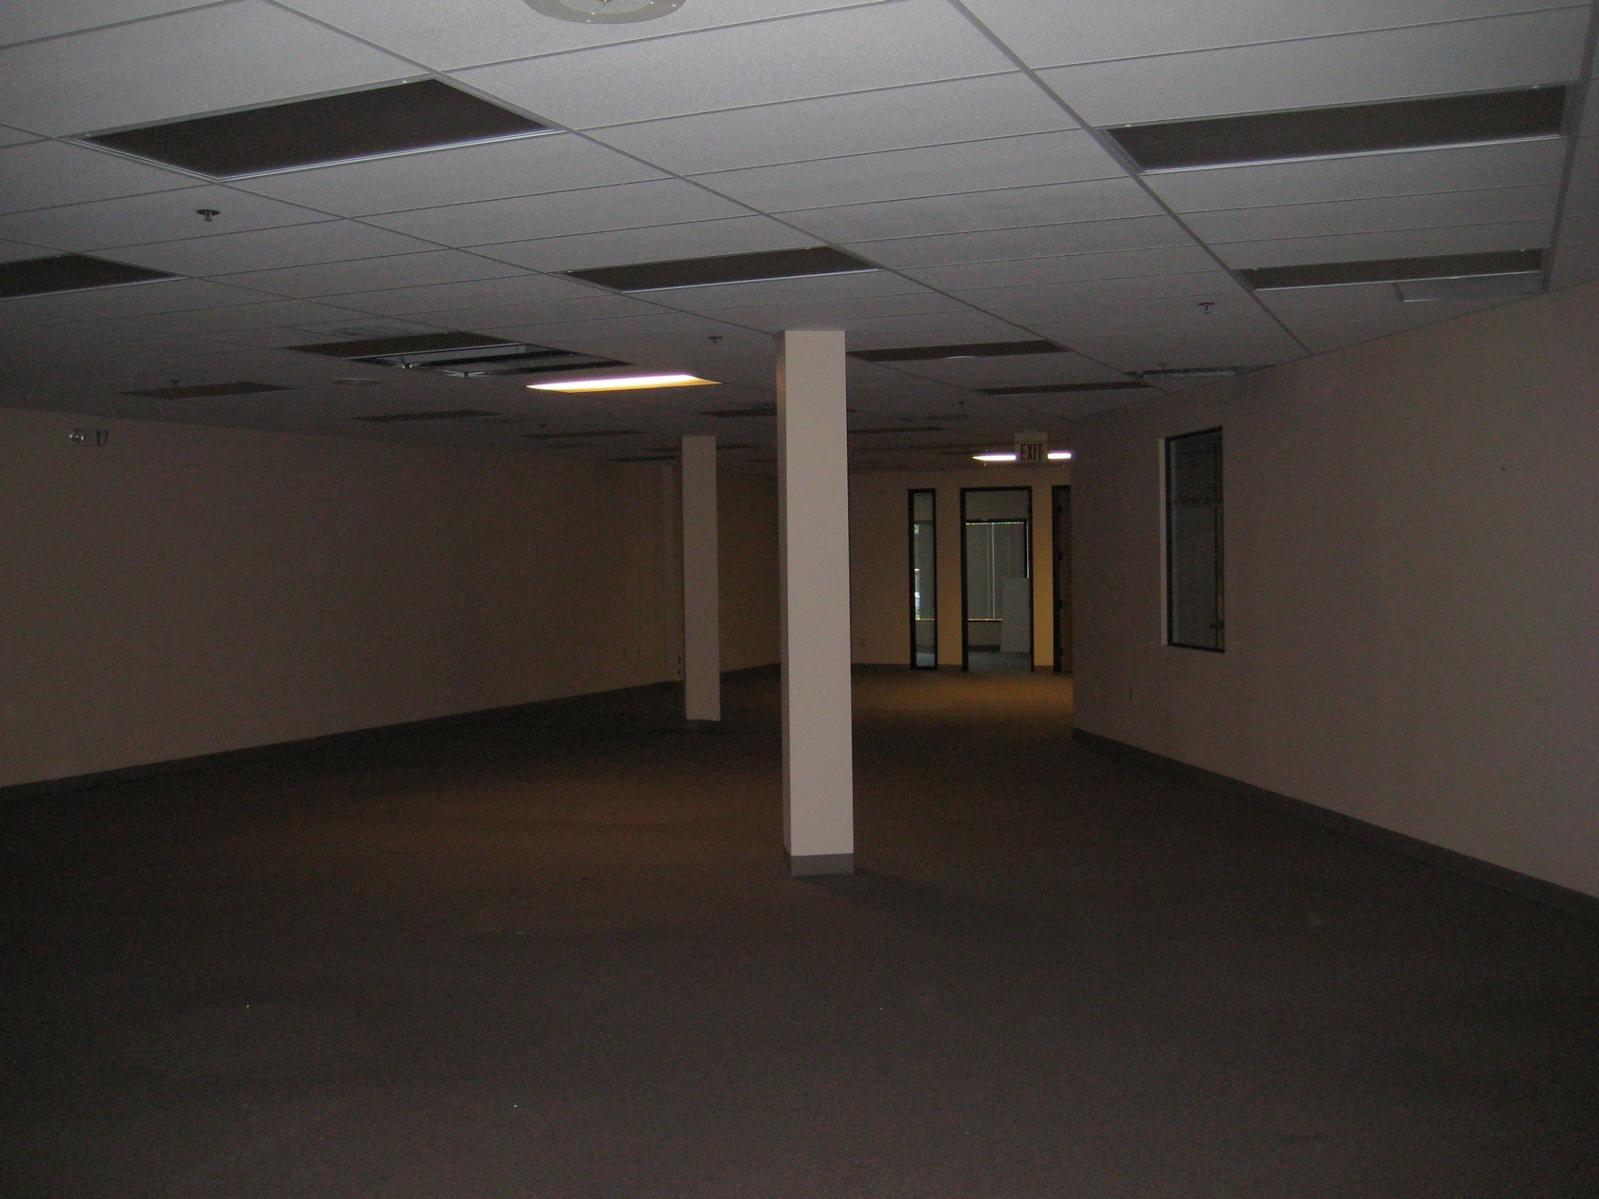

Slide 12
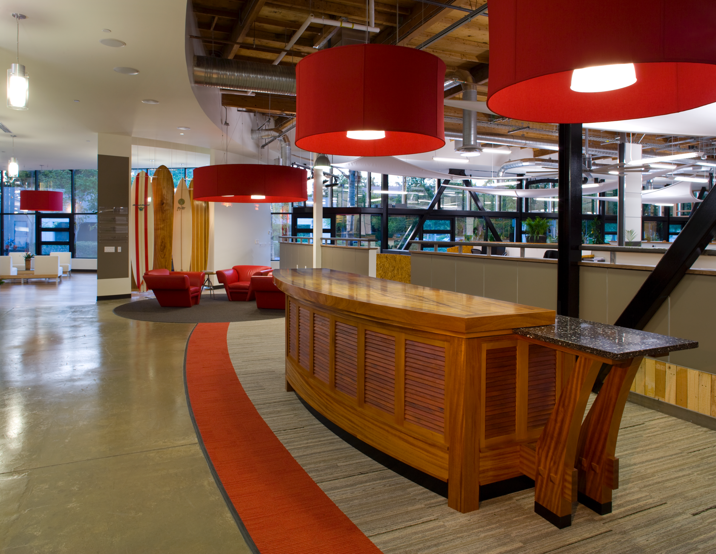

Slide 13
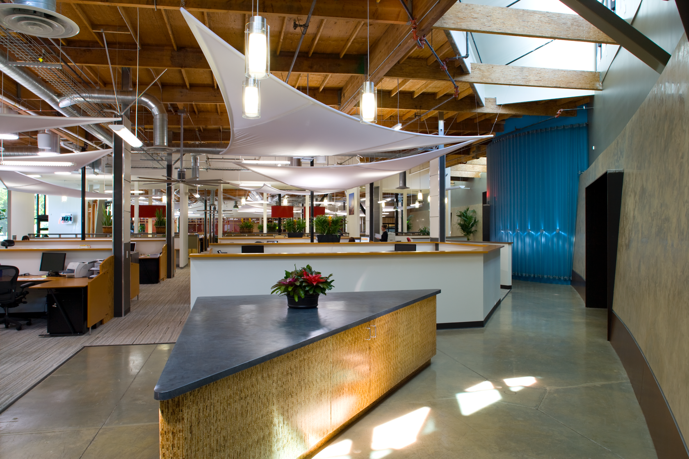

Slide 14
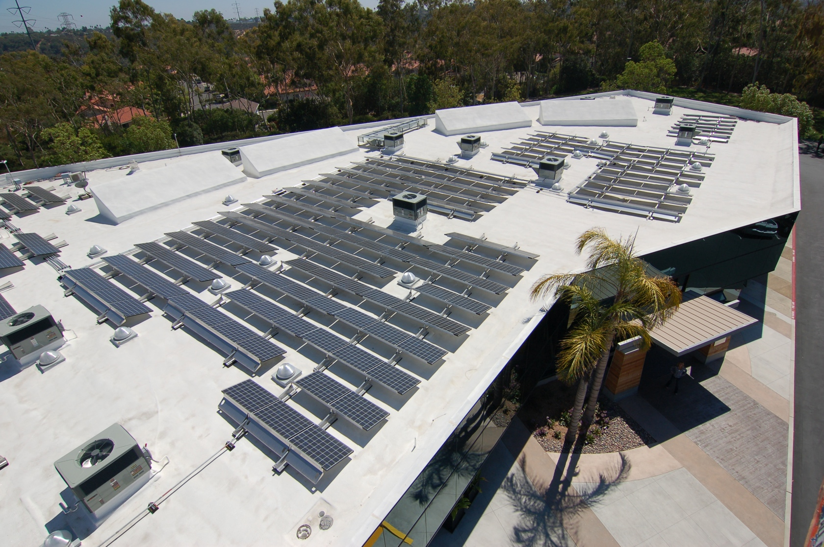

Slide 15
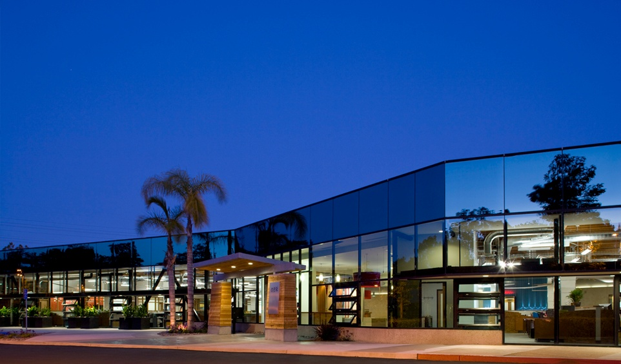
San Diego, CA
33,782 SF RENOVATION w/ PV ON ROOF
Cost Breakdowns
Core & Shell | $47/SF
Interiors | $91/SF
Subtotal | $138/SF
Green Premium/Upgrades | $17/SF
PV Array (75kW) | $9/SF
Total Construction | $164/SF
FF&E | $10/SF
Design/Engineering | $16/SF

Slide 16
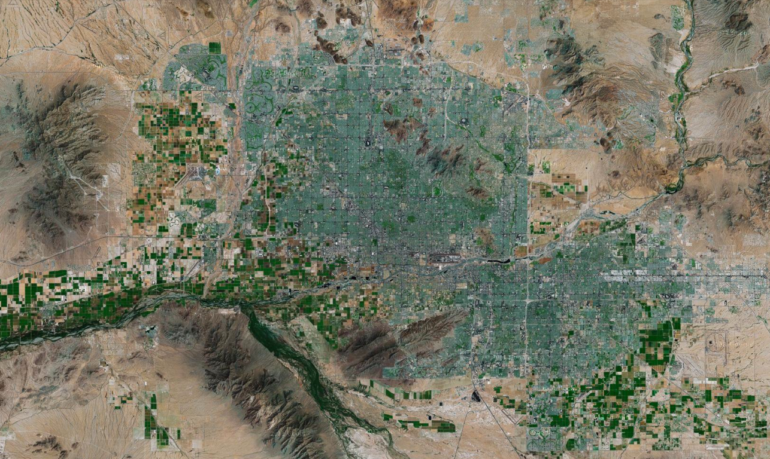
Phoenix

Slide 17
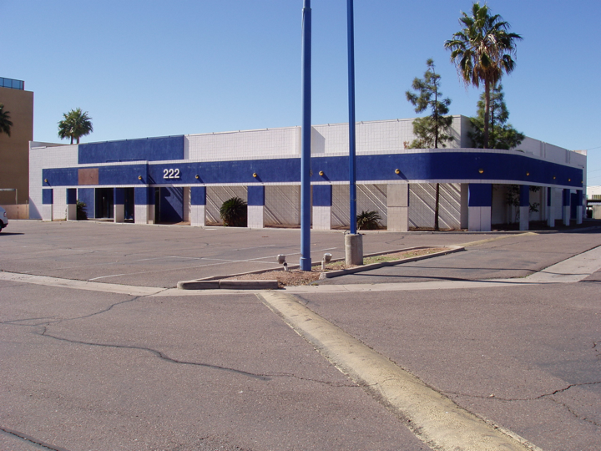

Slide 18
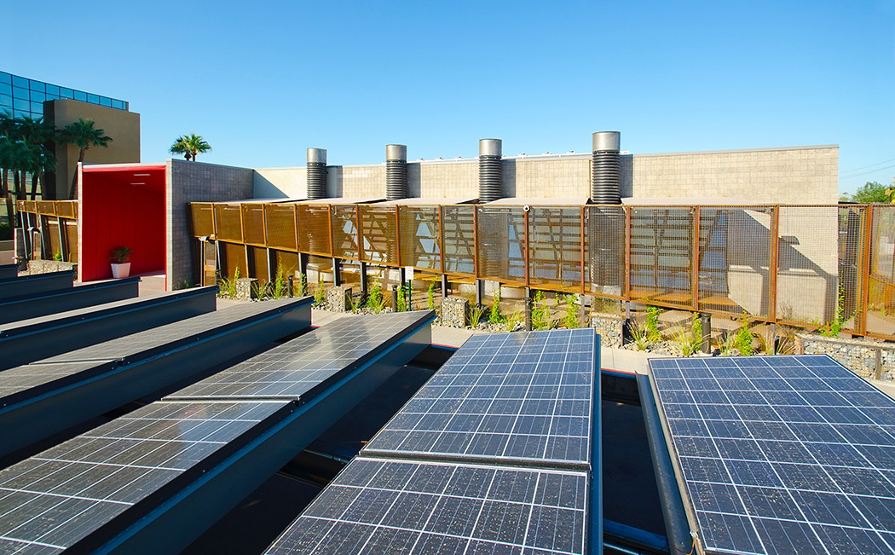

Slide 19
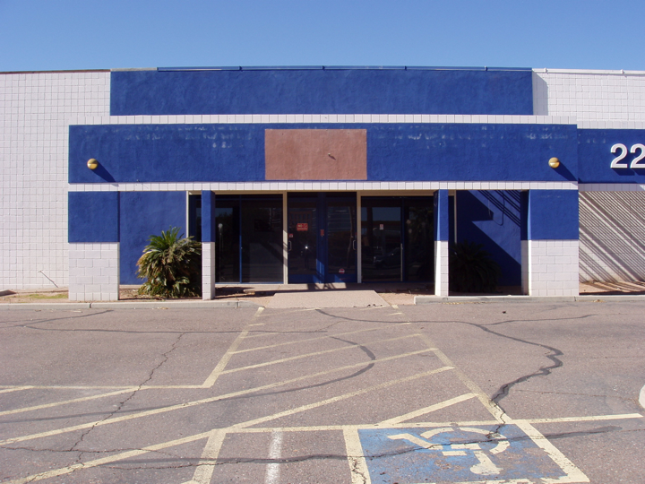

Slide 20
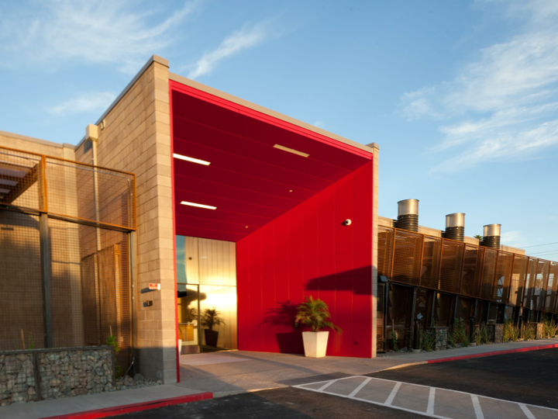

Slide 21
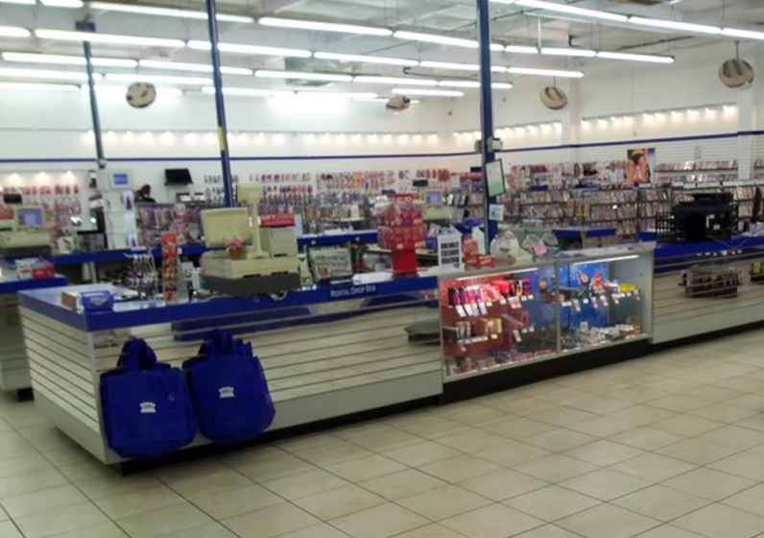

Slide 22
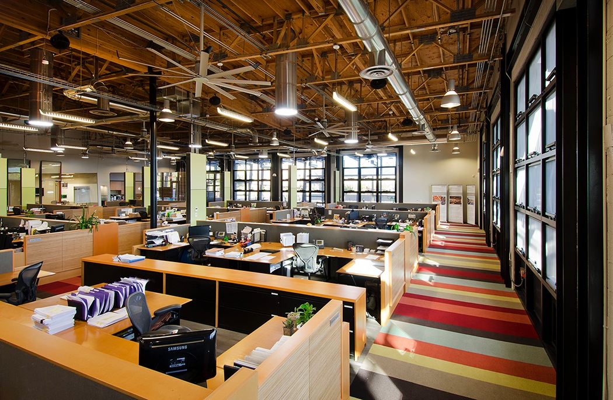

Slide 23
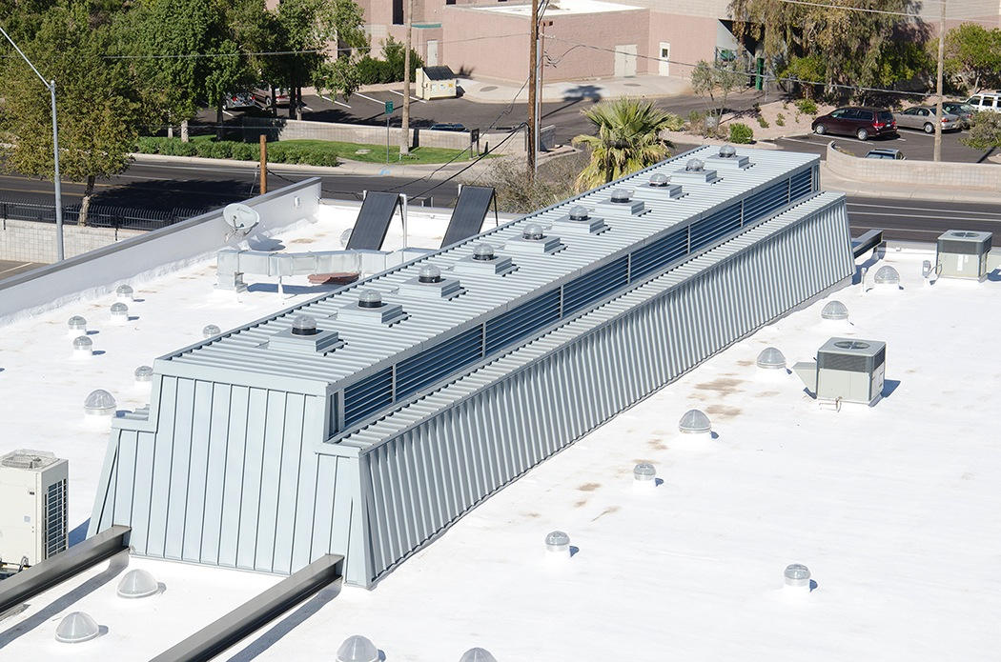

Slide 24
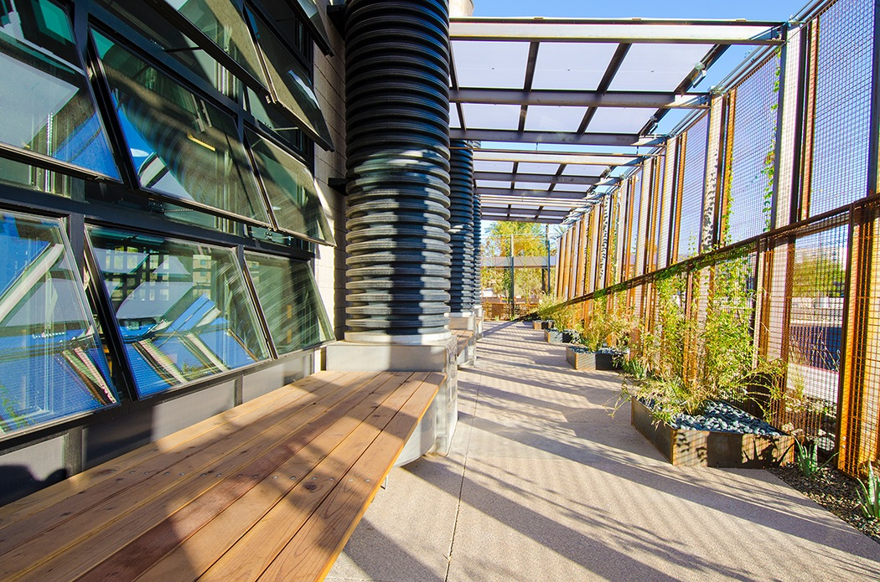

Slide 25
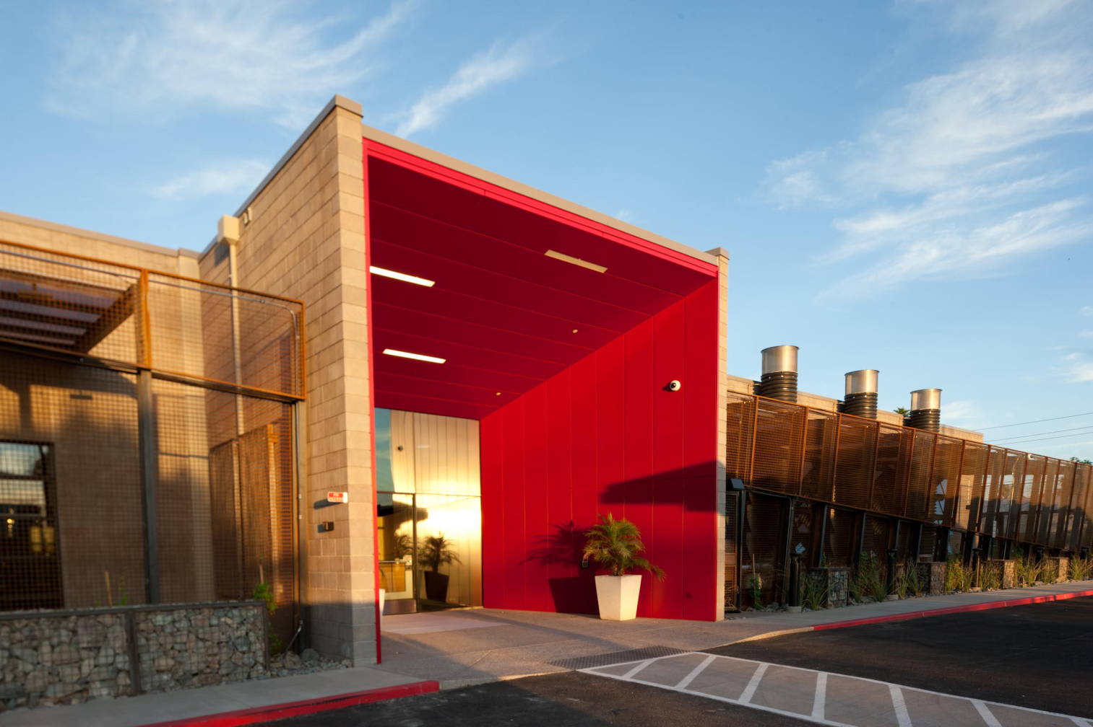
Phoenix, AZ
16,533 SF RENOVATION, w/ PV OVER PARKING LOT
Cost Breakdowns
Core & Shell | $42/SF
Interiors | $111/SF
Subtotal | $153/SF
Green Upgrades/Premium | $43/SF
PV Array (79kW DC) | $19/SF
Total Construction | $215/SF
FFE | $15/SF
Design/Engineering | $24/SF

Slide 26
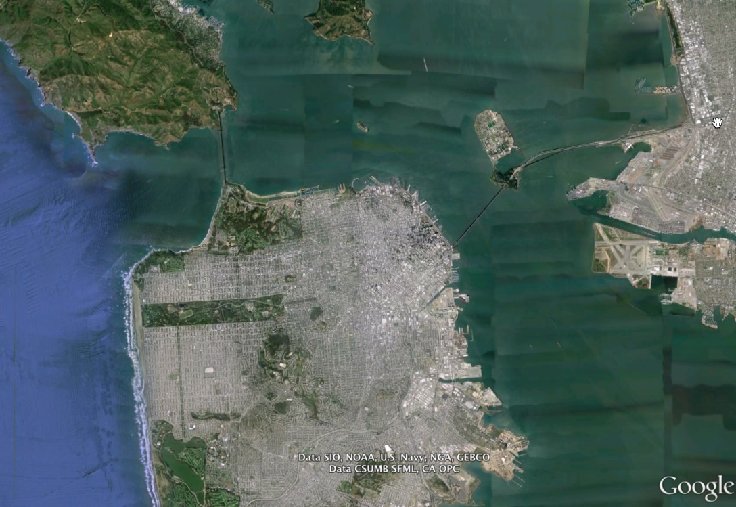
San Francisco

Slide 27
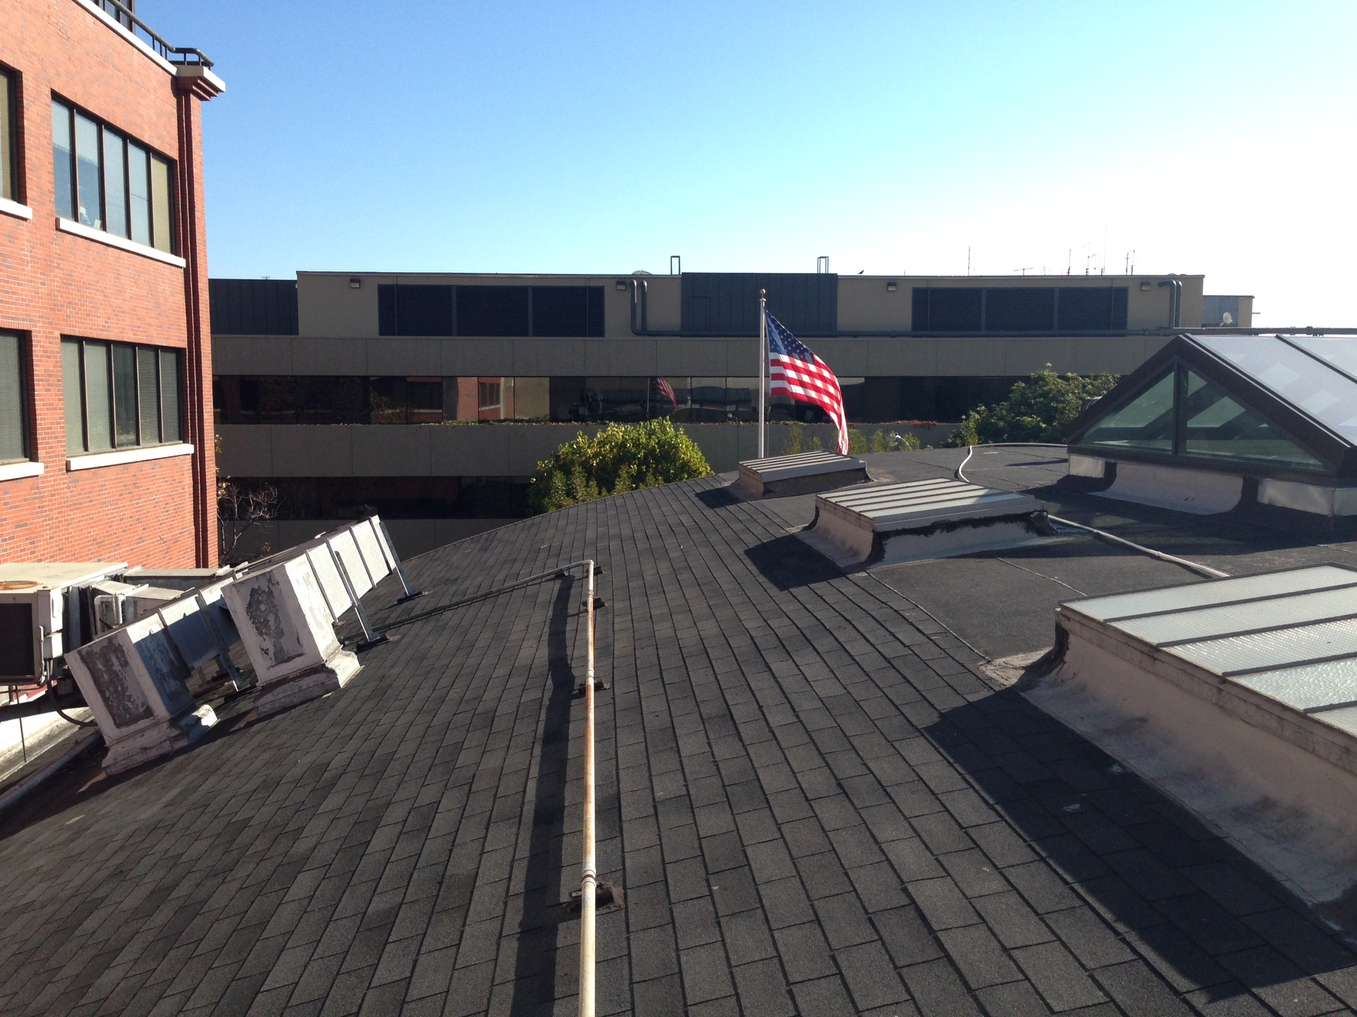

Slide 28
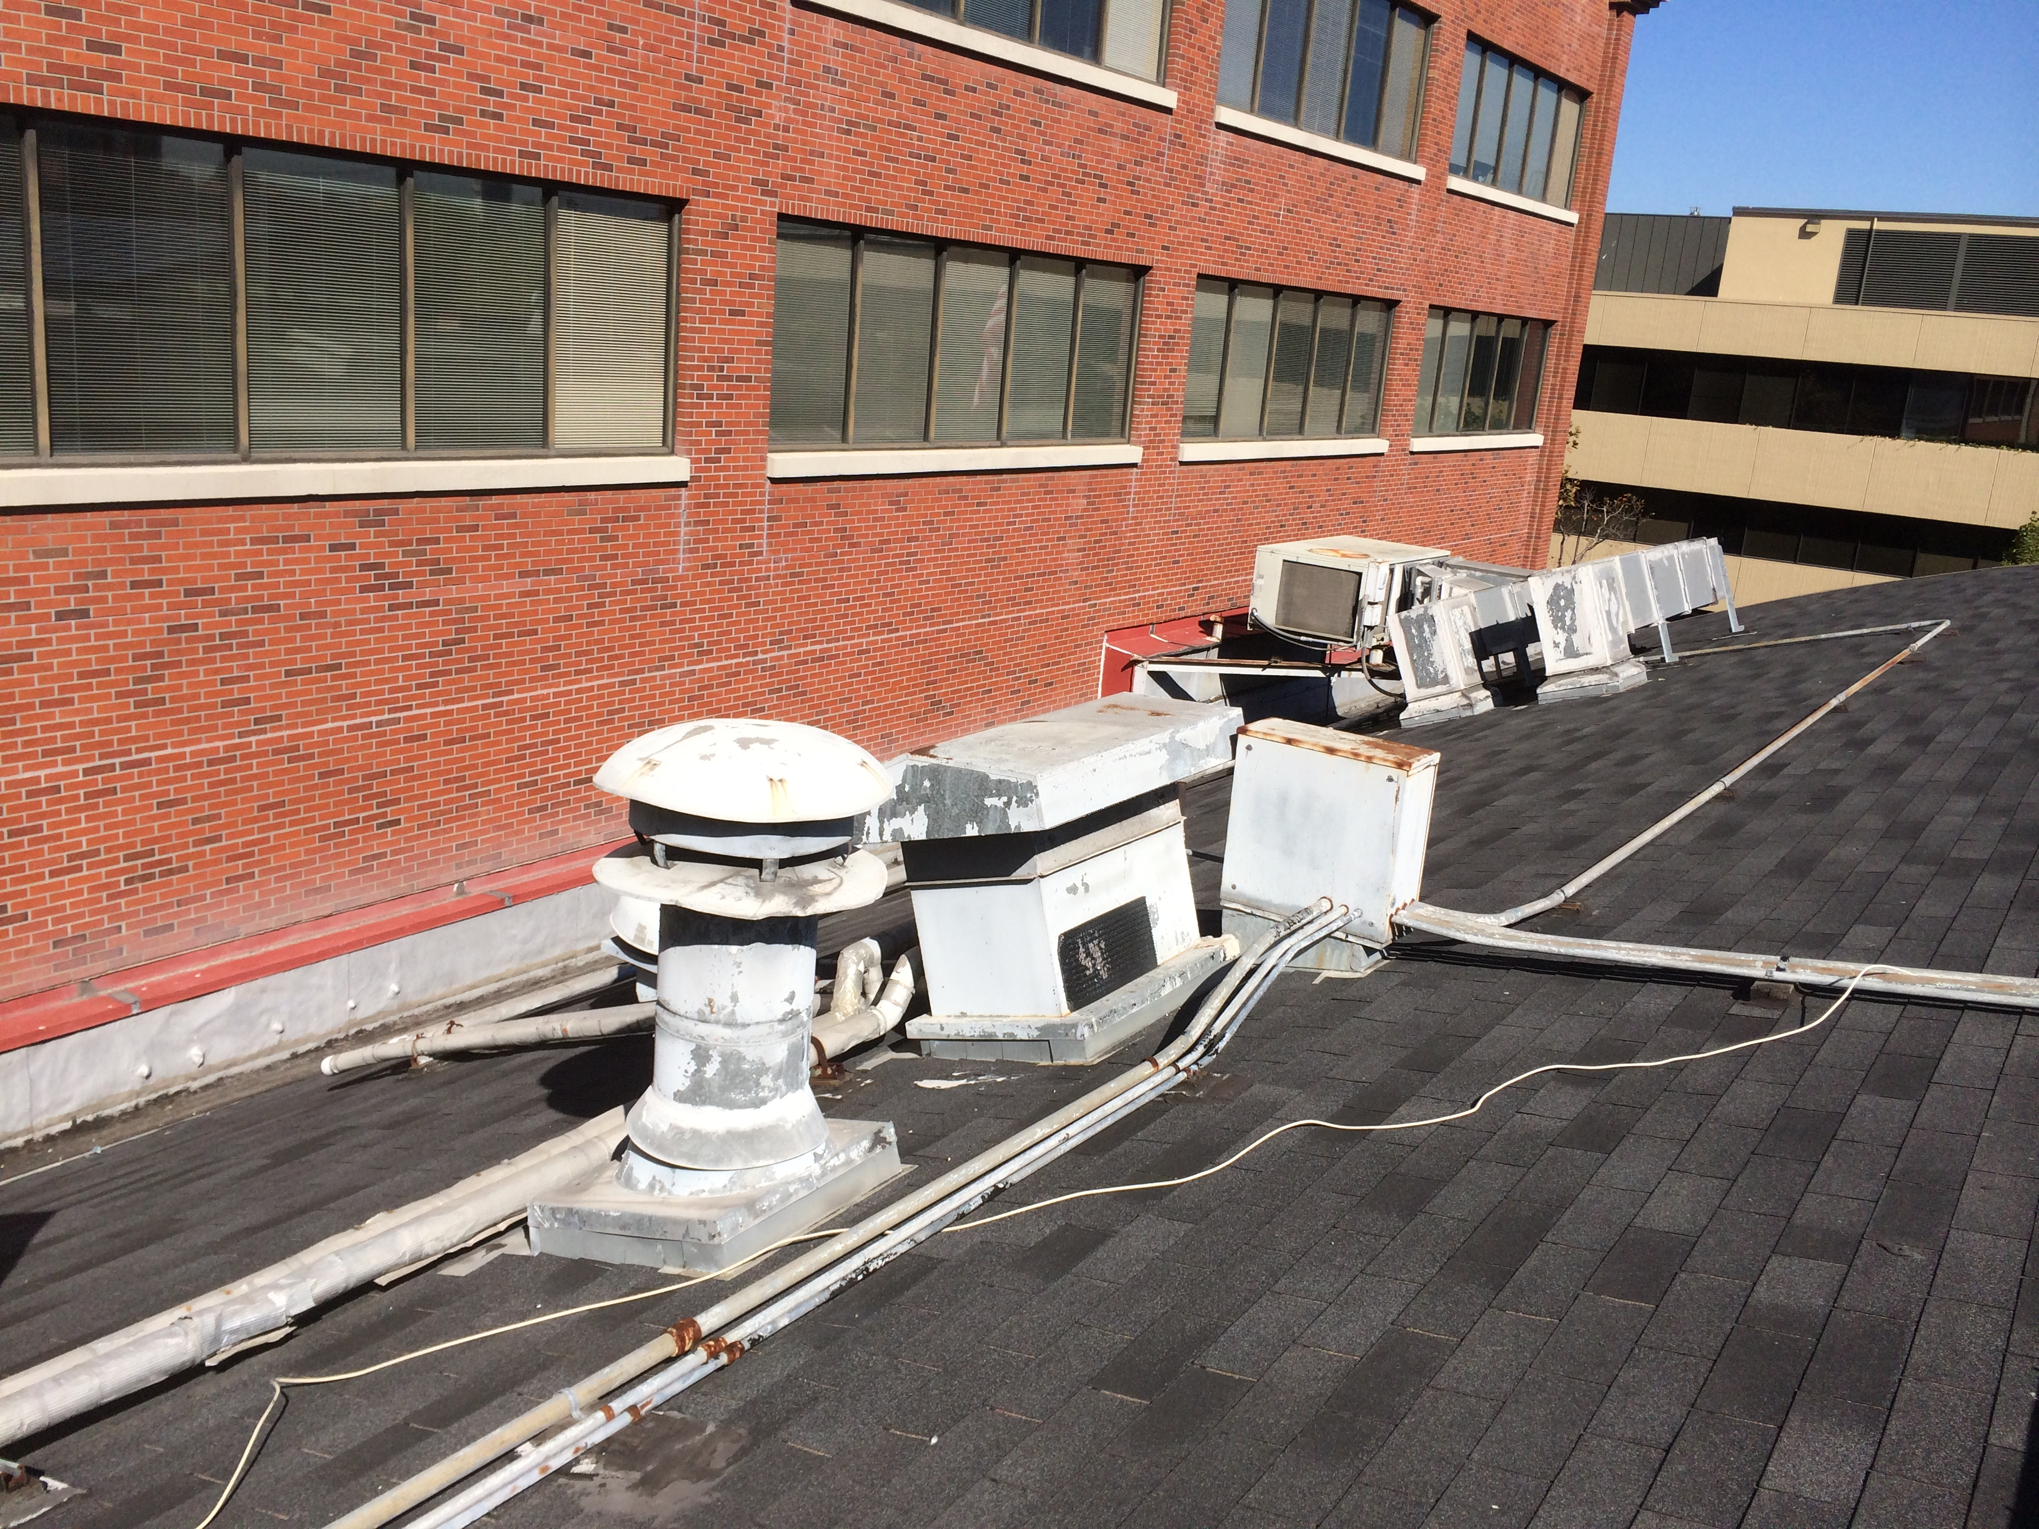

Slide 29
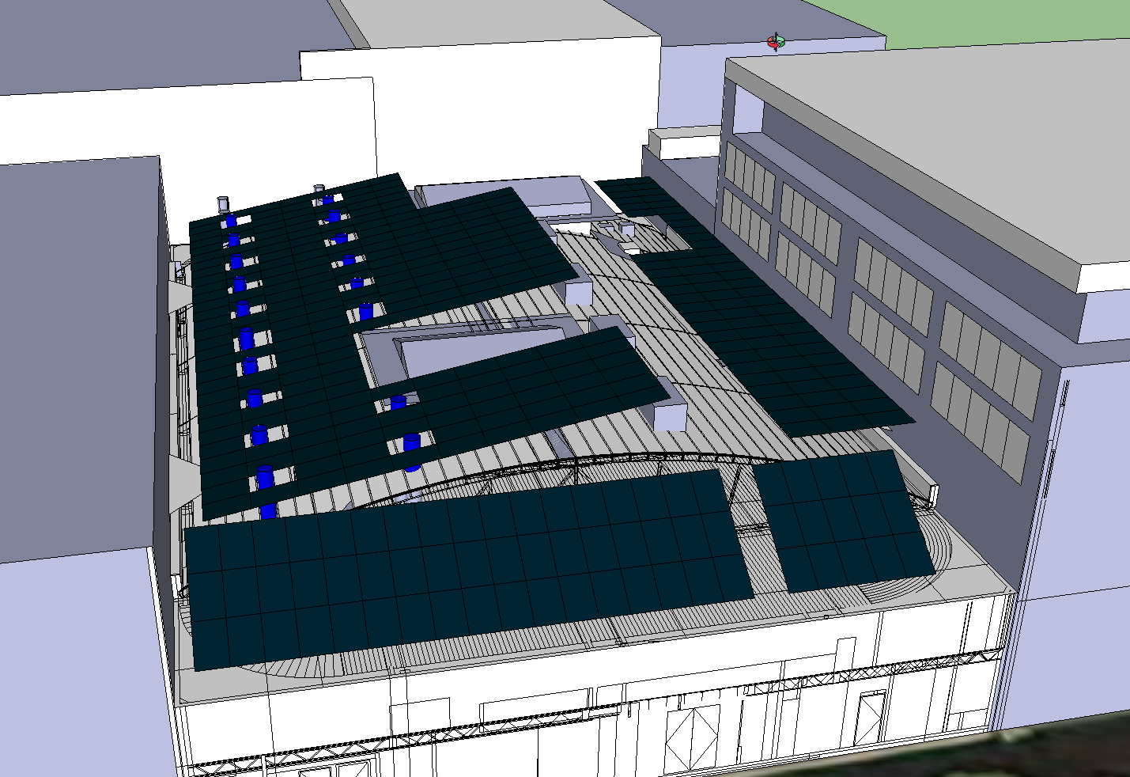

Slide 30
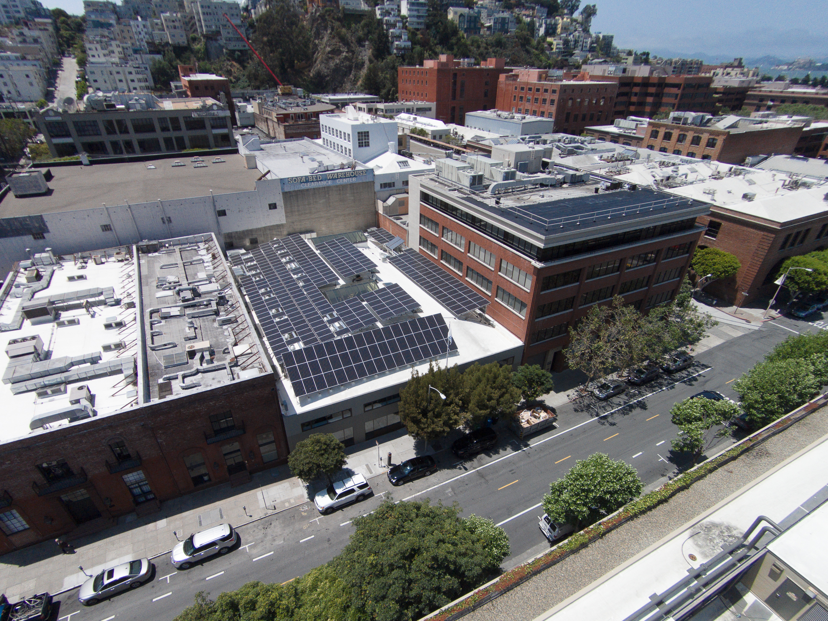

Slide 31
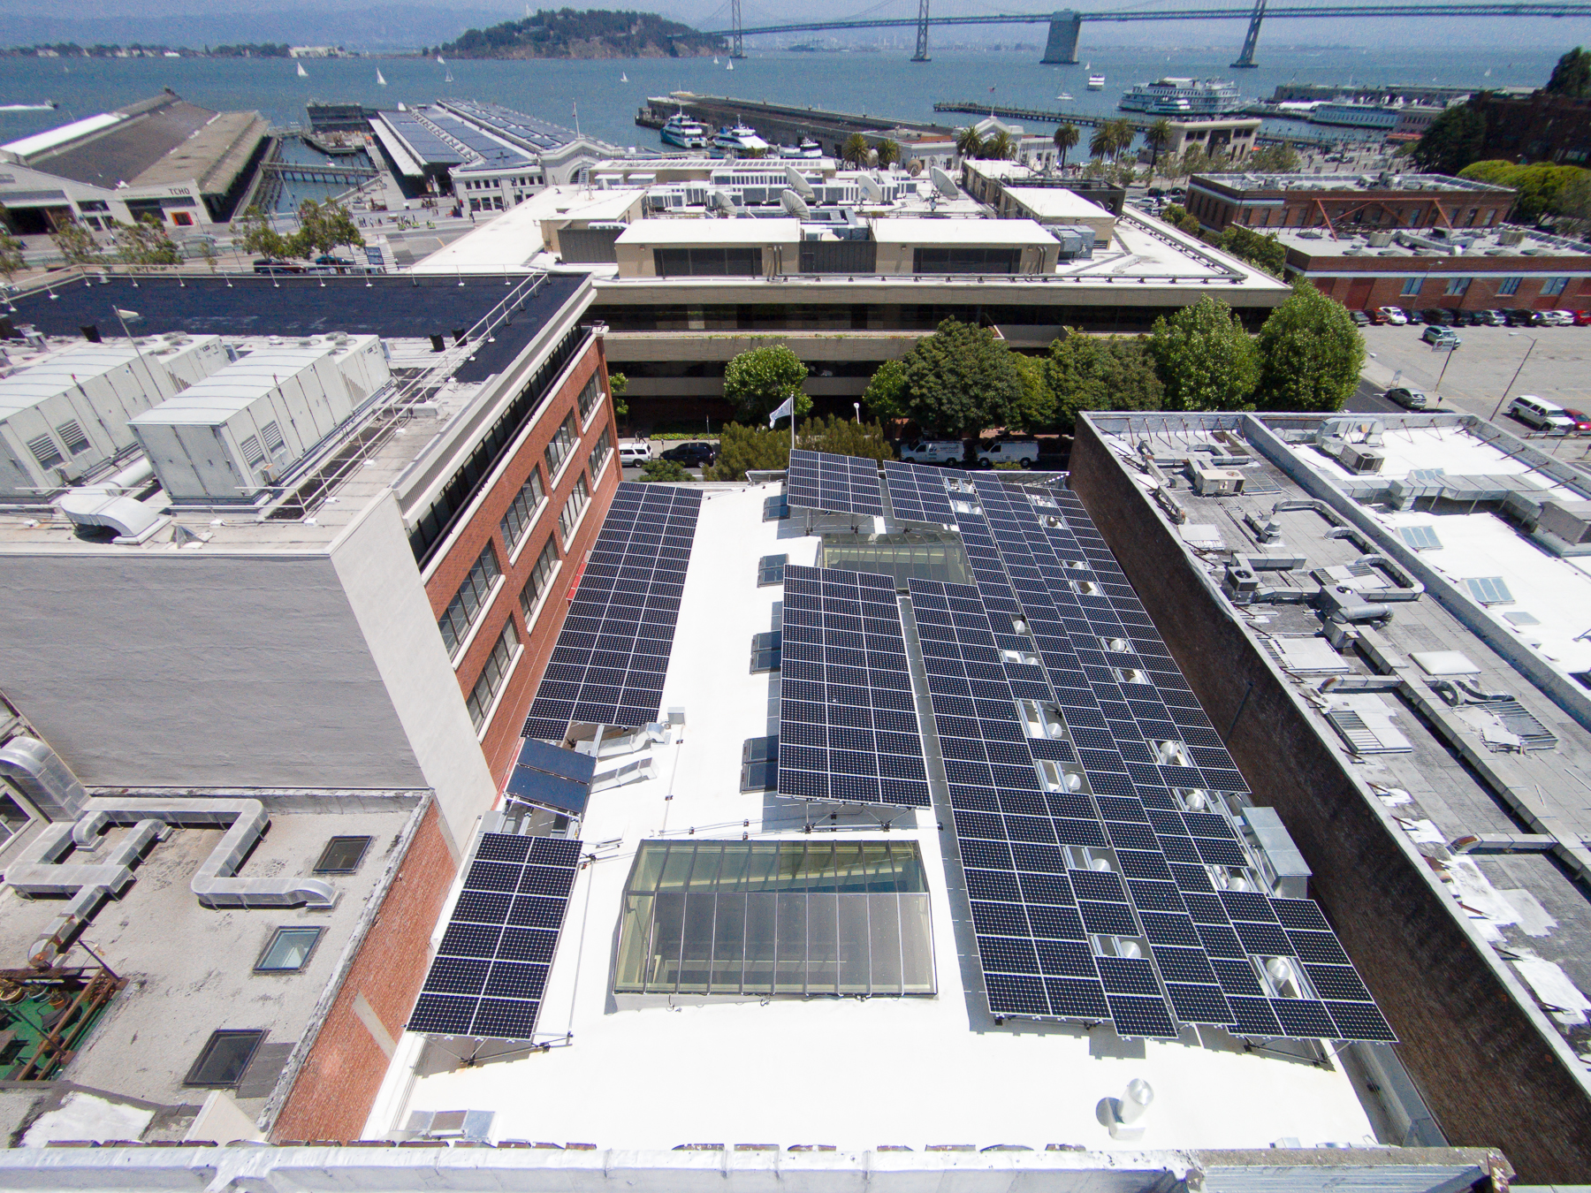

Slide 32
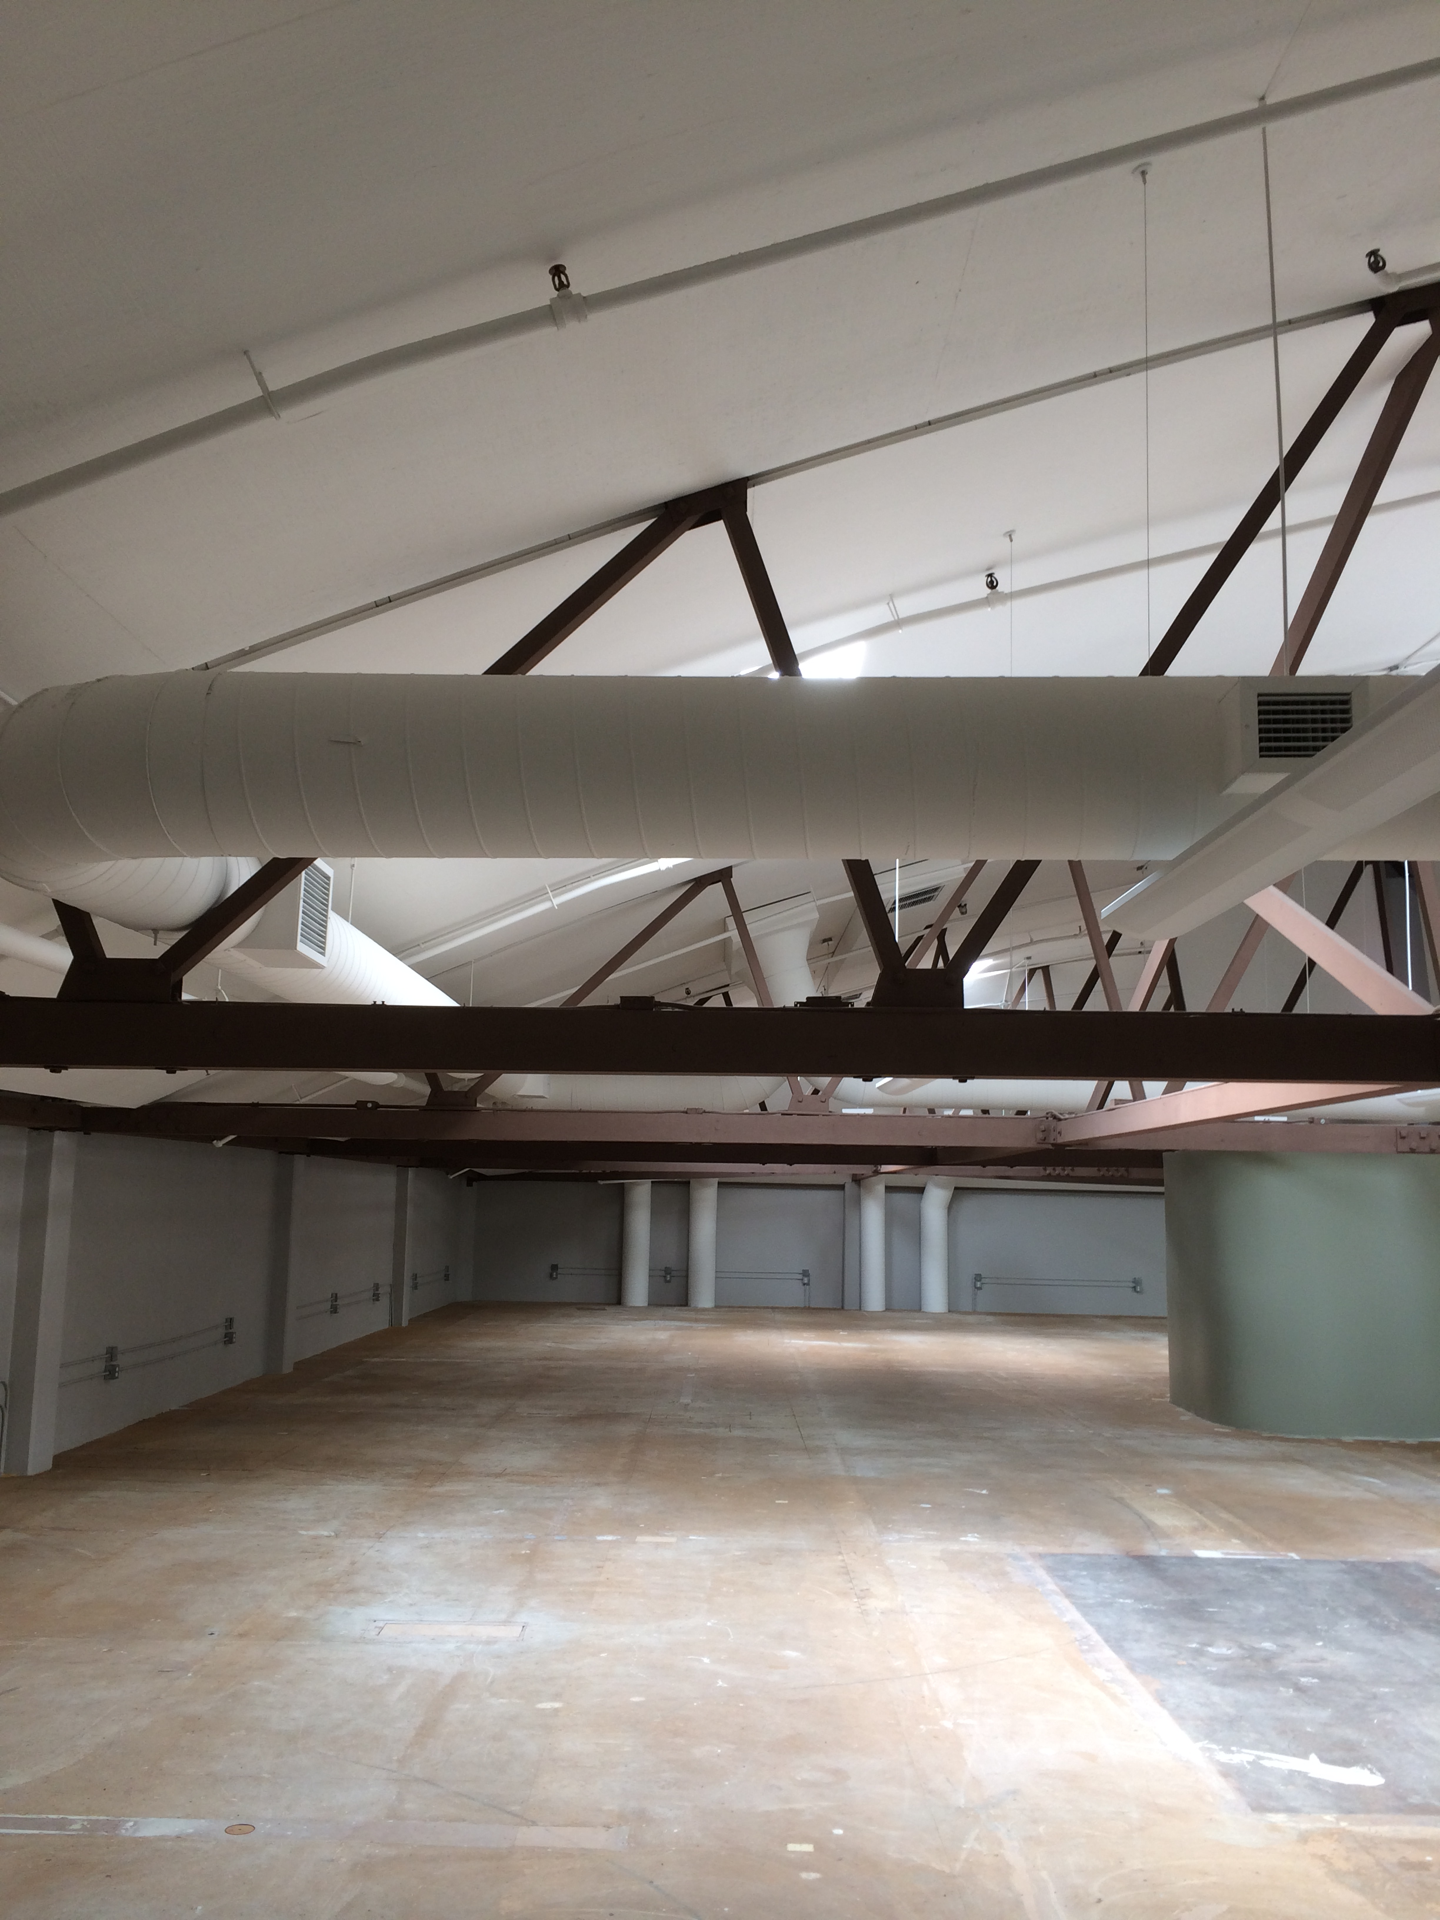

Slide 33
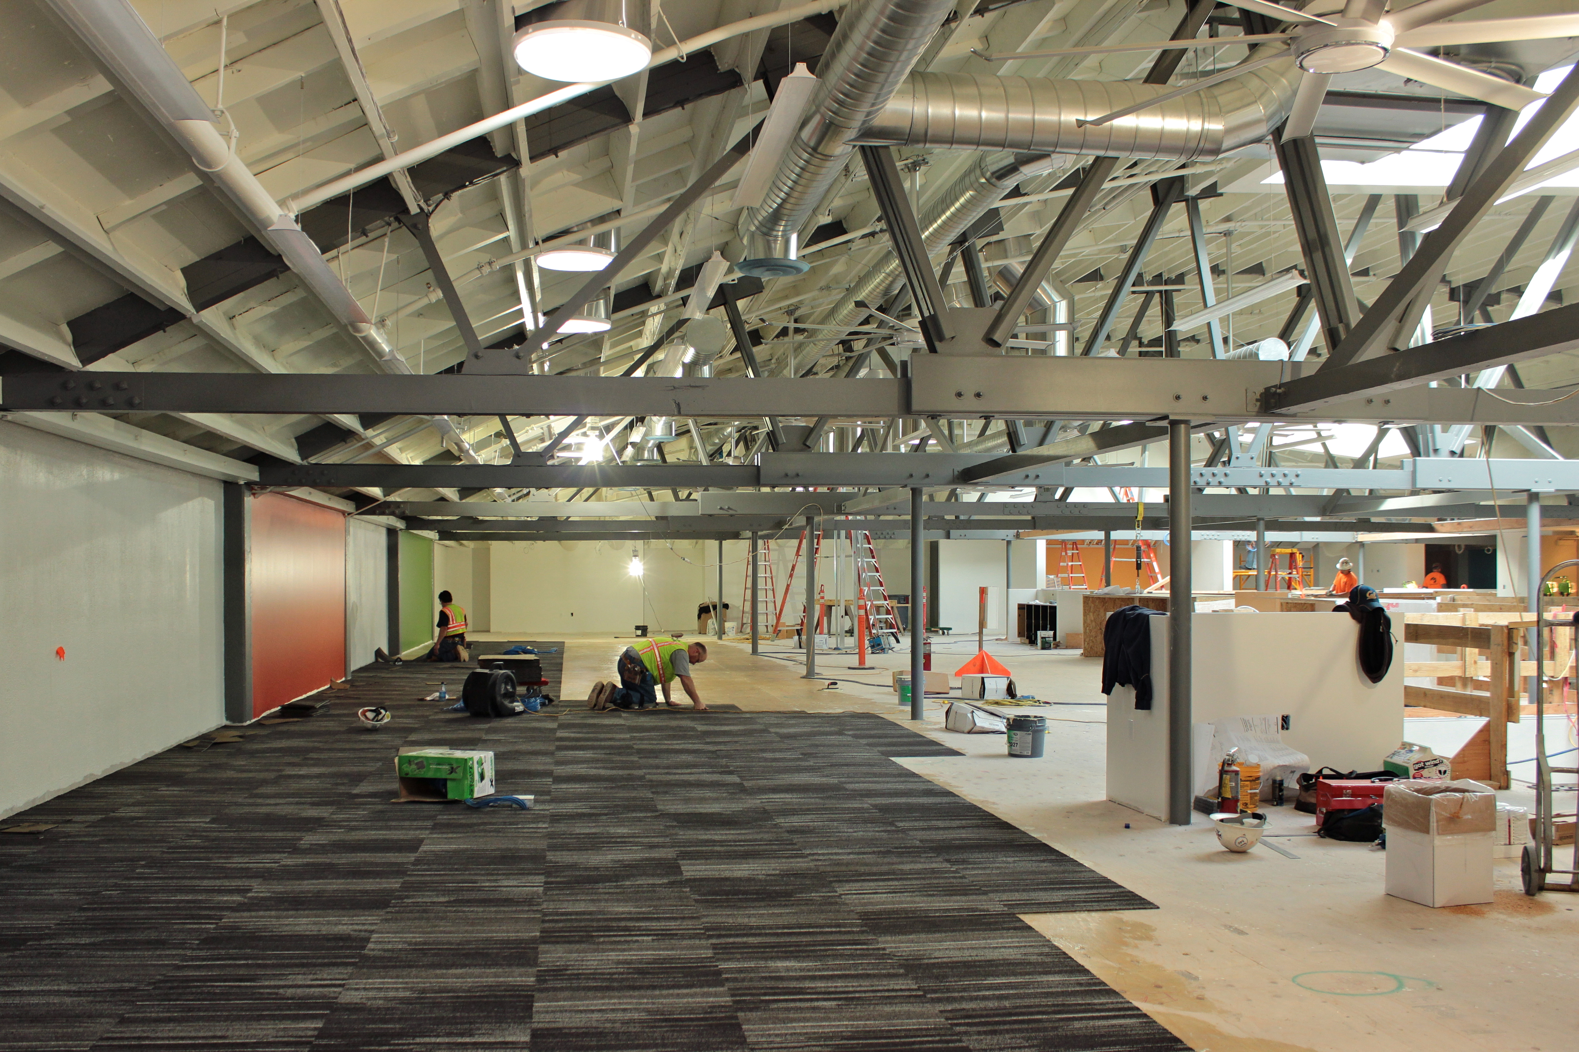

Slide 34
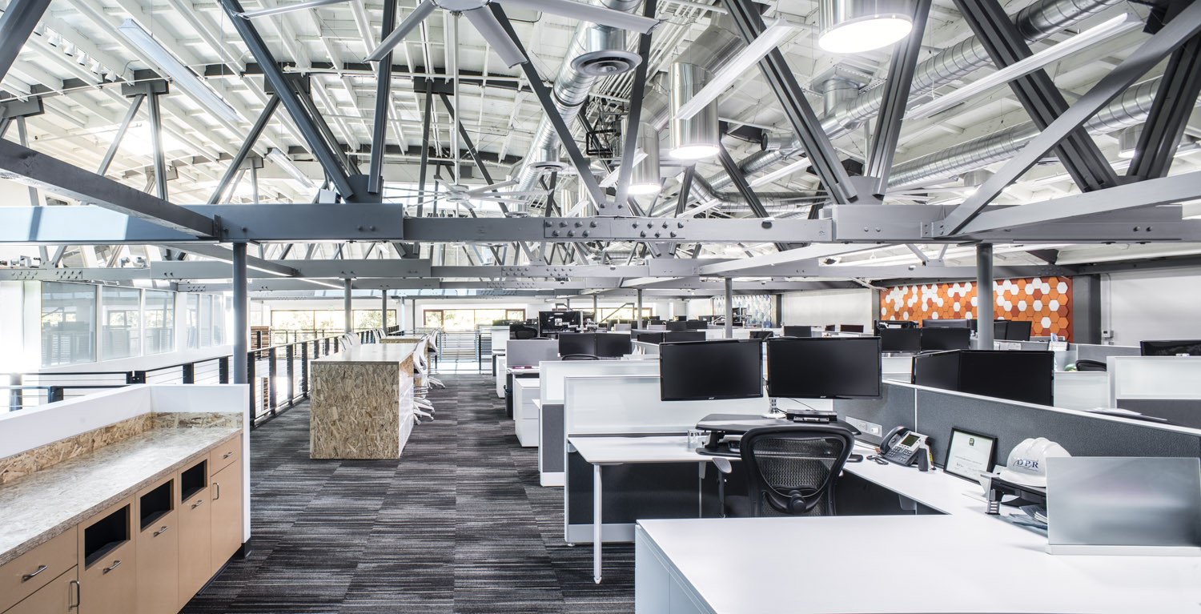

Slide 35
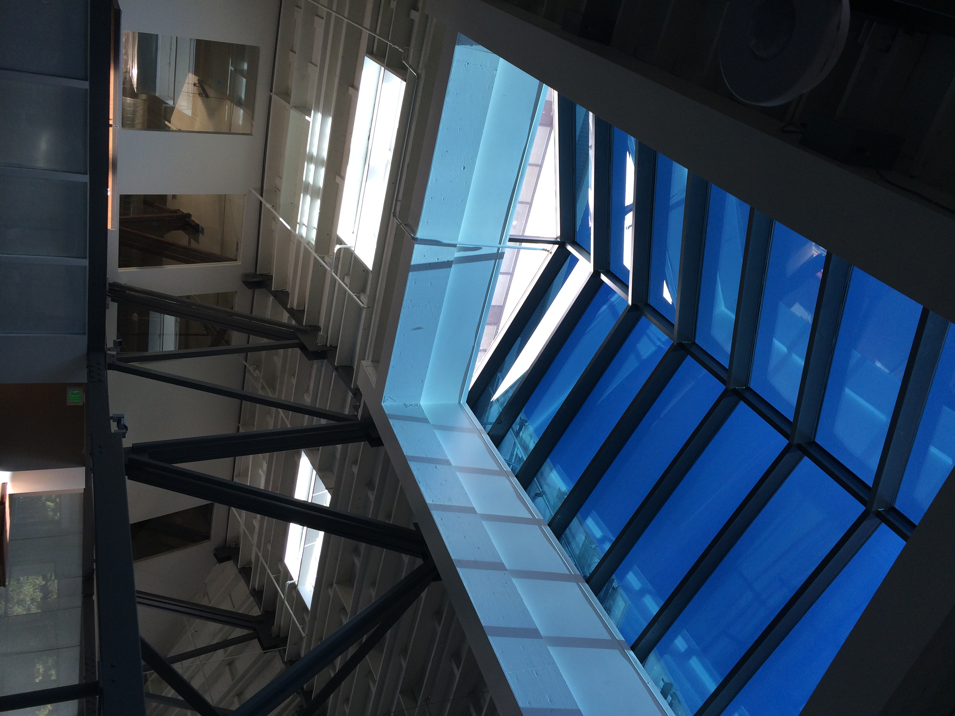
View Dynamic Glass

Slide 36
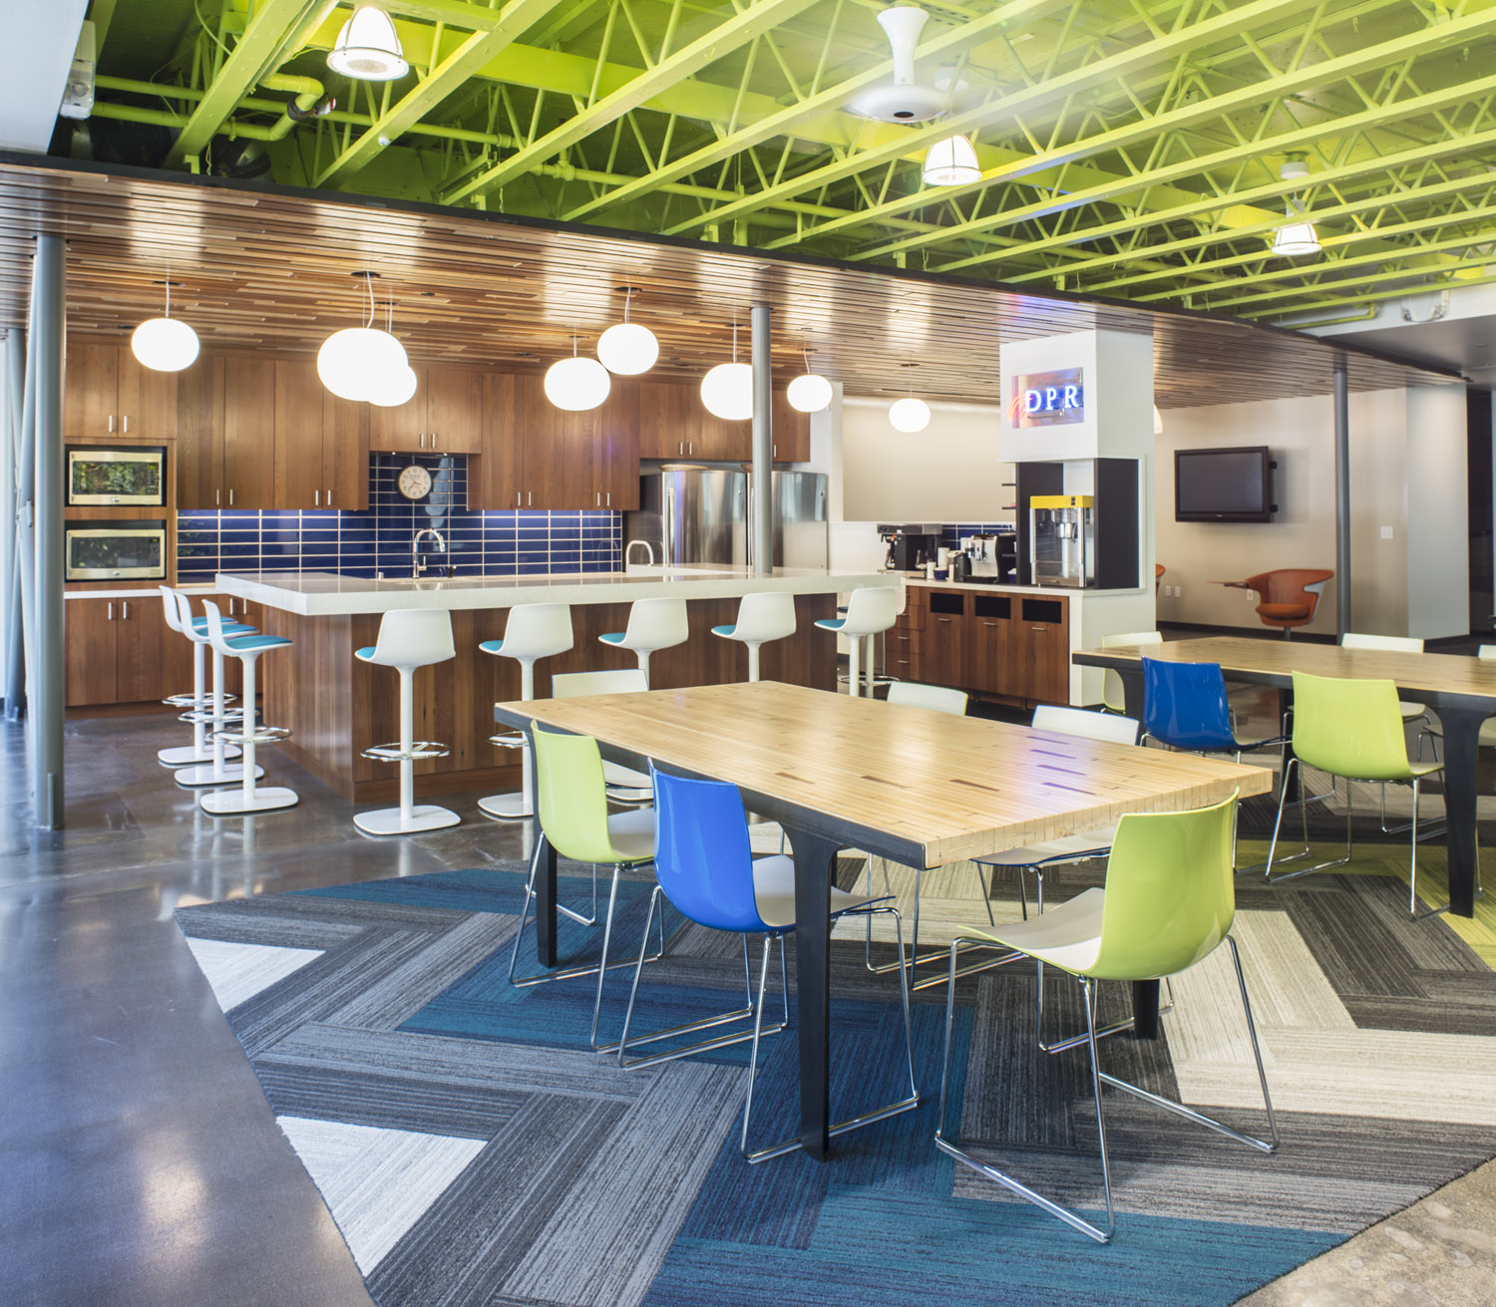

Slide 37
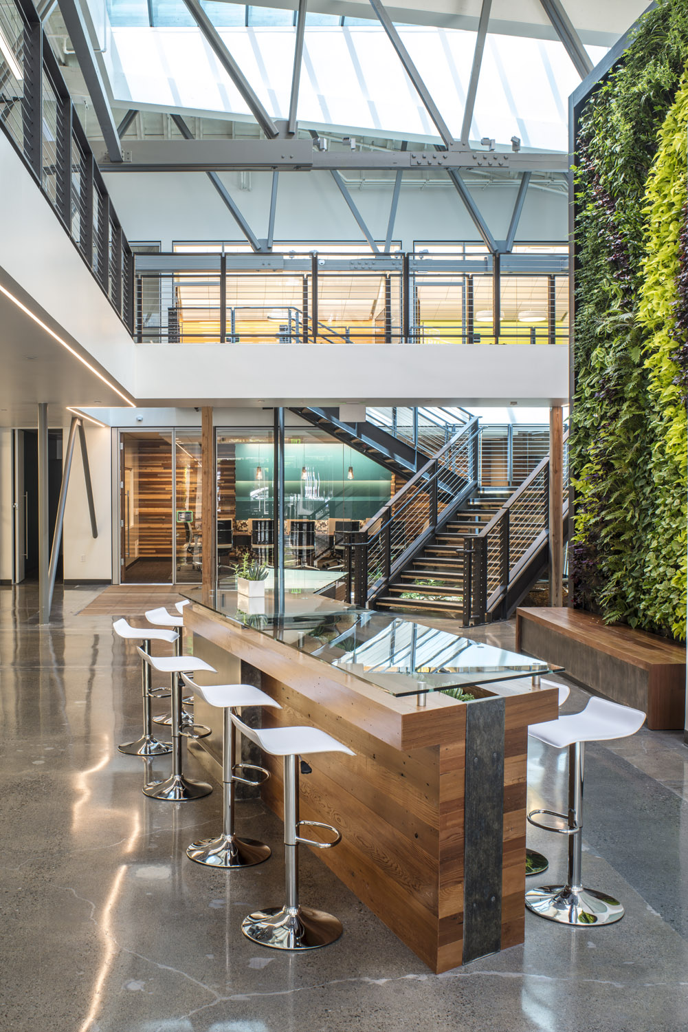

Slide 38
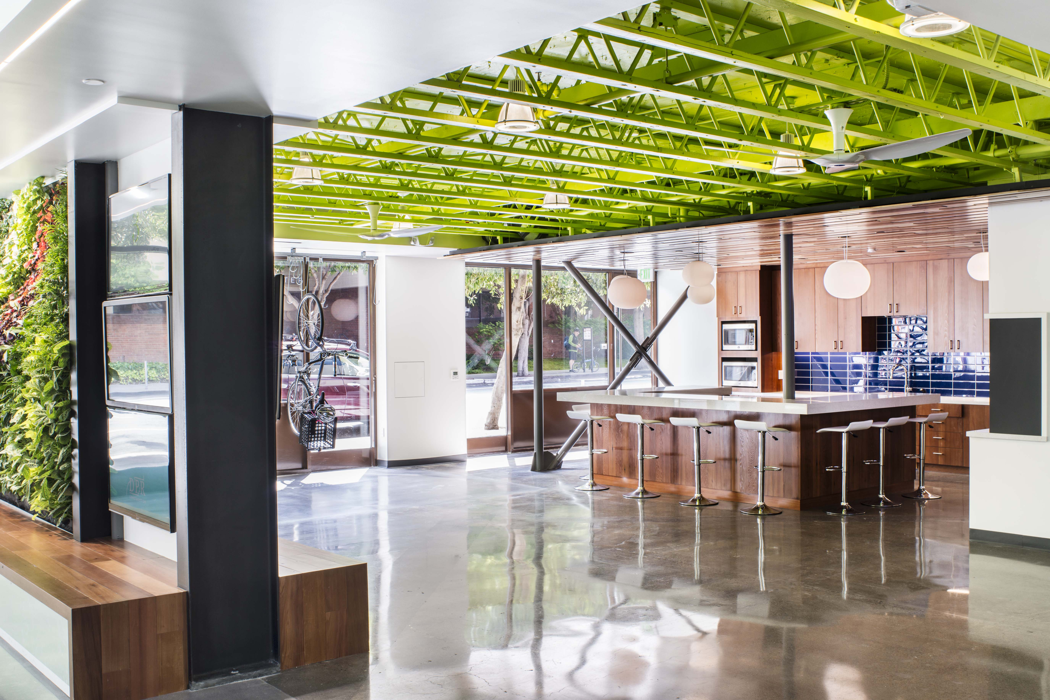

Slide 39
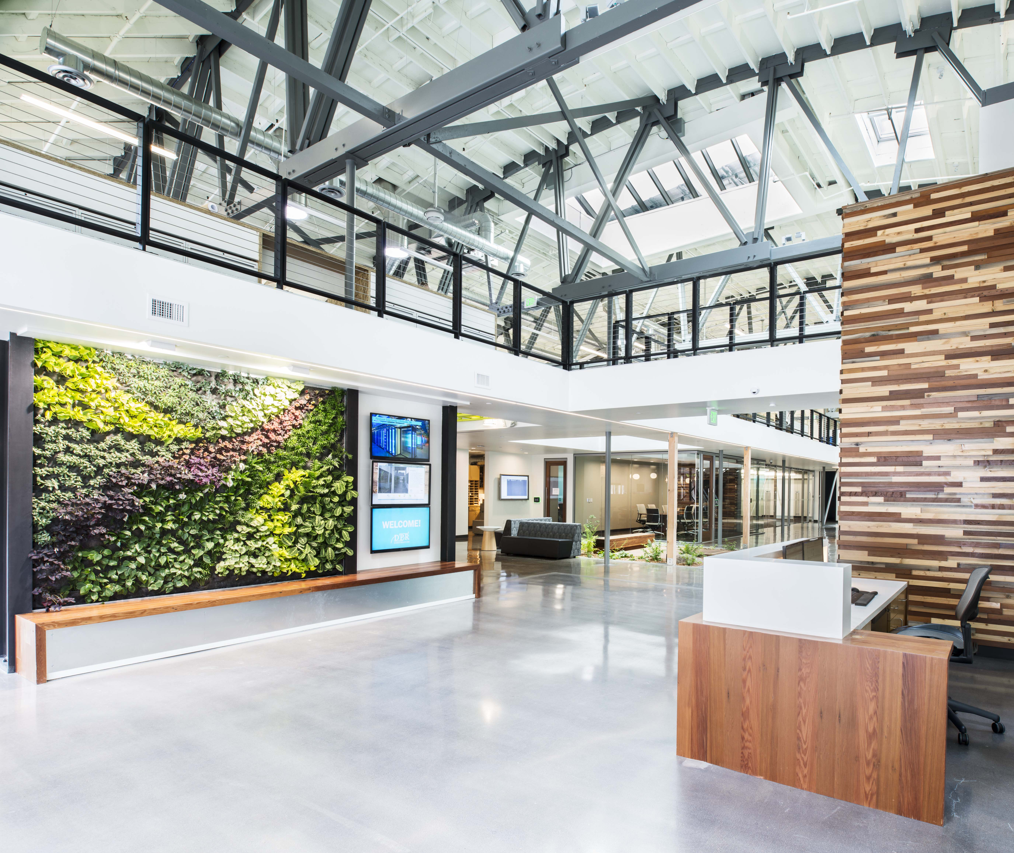

Slide 40
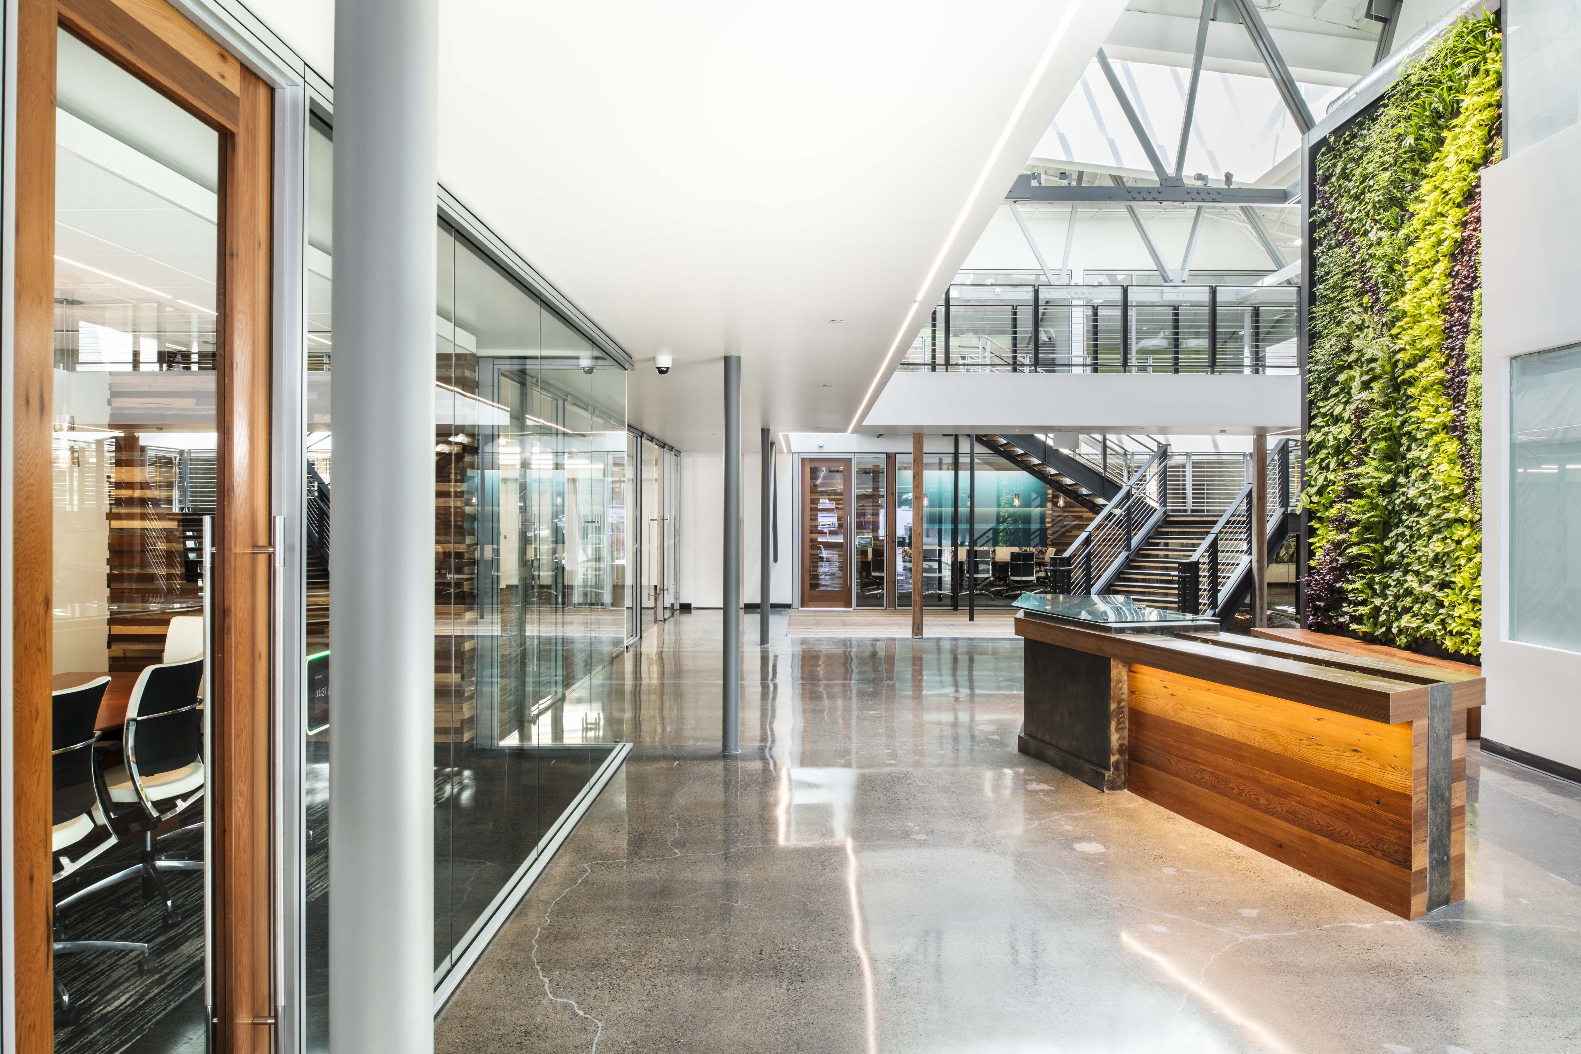

Slide 41
DPR San Francisco Office
Targeting LEED NC v4 Platinum
LEED Dynamic Plaque
118kw photovoltaic (PV) system
Rooftop solar thermal water heating
Solatube750 DS Daylighting System
Velux Solar-powered, automated operable skylights
Essence and Haiku® Big Ass® Fans
Three living walls
Reclaimed Redwood and Douglas Fir
Sloan efficient Fixtures
Living Laboratory: EBI, BIM-FM Showcase

Slide 42
Partners/Vendors

Slide 43
San Francisco, CA
24,000 SF MAJOR RENOVATION, PV ON ROOF
Cost Breakdowns
Core & Shell | $35/SF
Interiors | $117/SF
Subtotal | $152/SF
Green Premium/Upgrades | $22/SF
PV Array (118kW) | $20/SF
Total Construction | $194/SF
FFE | $17/SF
Design/Engineering | $20/SF

Slide 44
The Process.

Slide 45
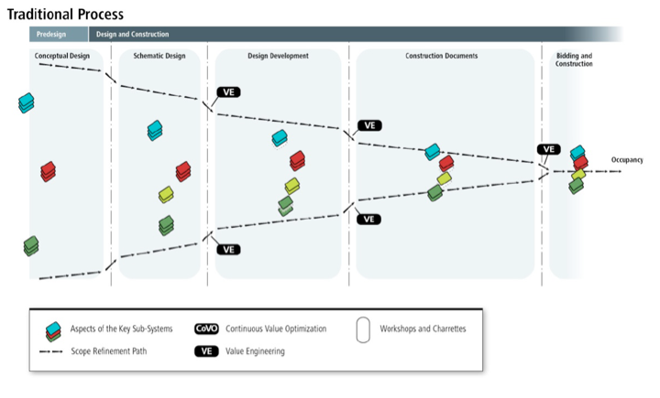
business as usual.

Slide 46
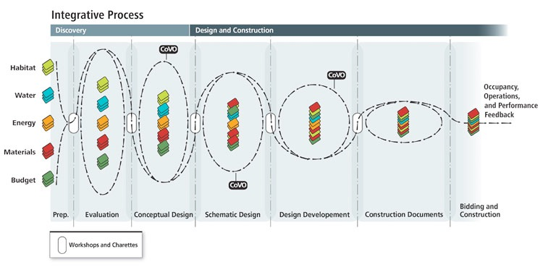
integrated design process.

Slide 47
Thermal Comfort.

Slide 48
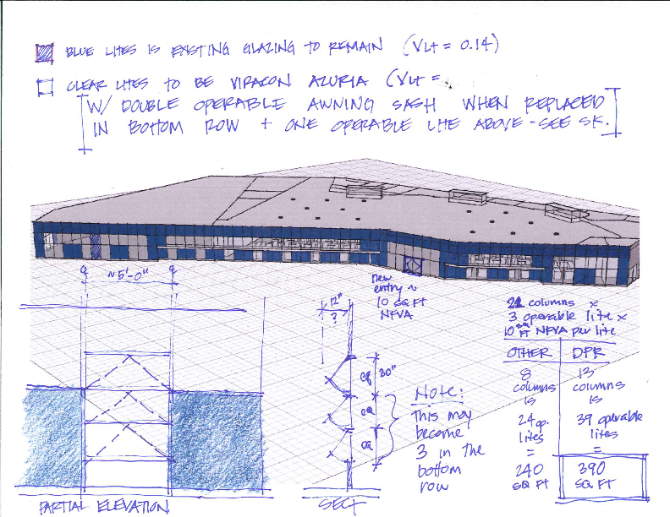

Slide 49
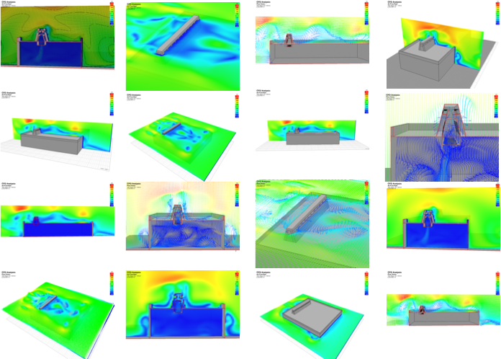

Slide 50
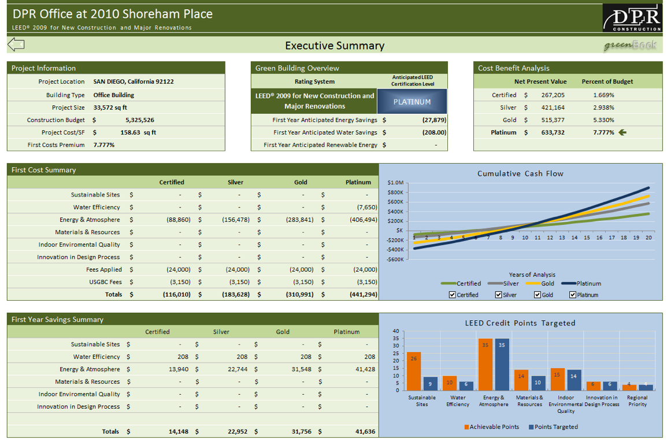
Thermal Comfort.
Notes:
8% Premium for LEED Platinum, 15% for ZNE

Slide 51
The
Results.

Slide 52
Notes:
Take a moment to talk about predictive vs. prescriptive
Title 24 Compliance Model: 380,000 kWh
LEED Compliance Model: 166,000 kWh
Predictive Analysis Model: 116,000 kWh
Actual Consumption: 103,000 kWh

Slide 53
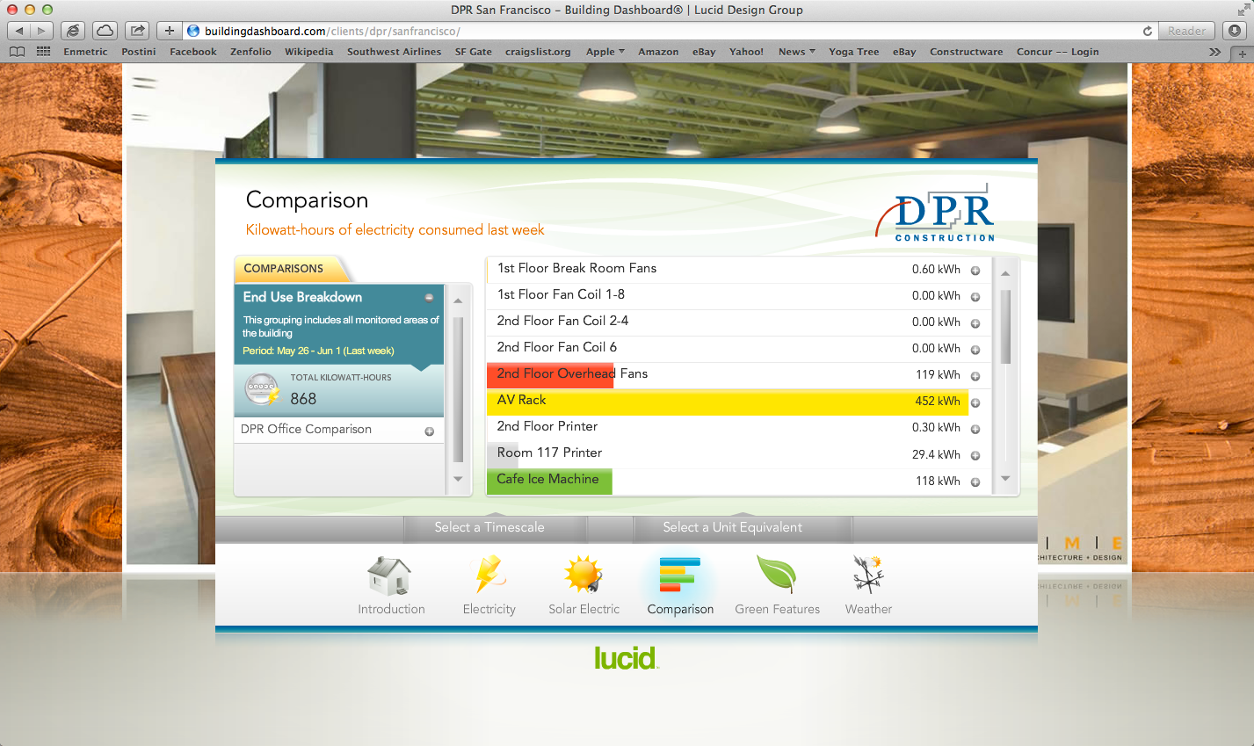
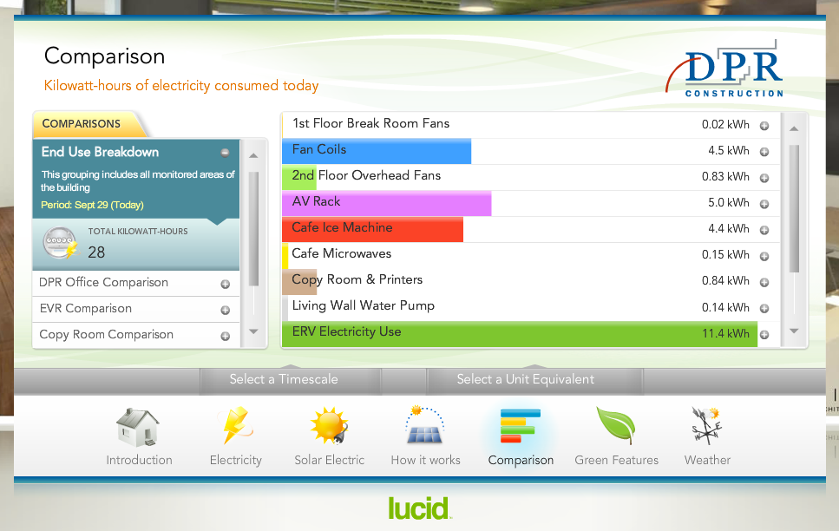
Notes:
Take a moment to talk about predictive vs. prescriptive
Title 24 Compliance Model: 380,000 kWh
LEED Compliance Model: 166,000 kWh
Predictive Analysis Model: 116,000 kWh
Actual Consumption: 103,000 kWh

Slide 54
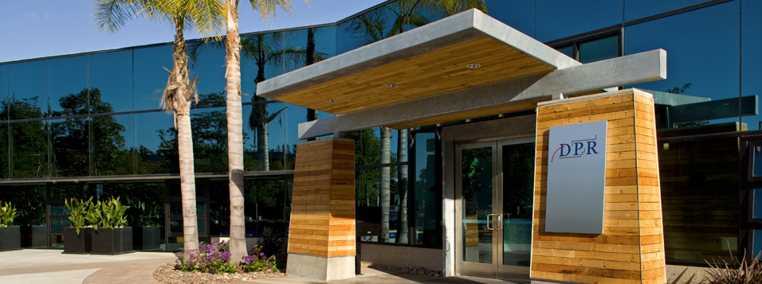
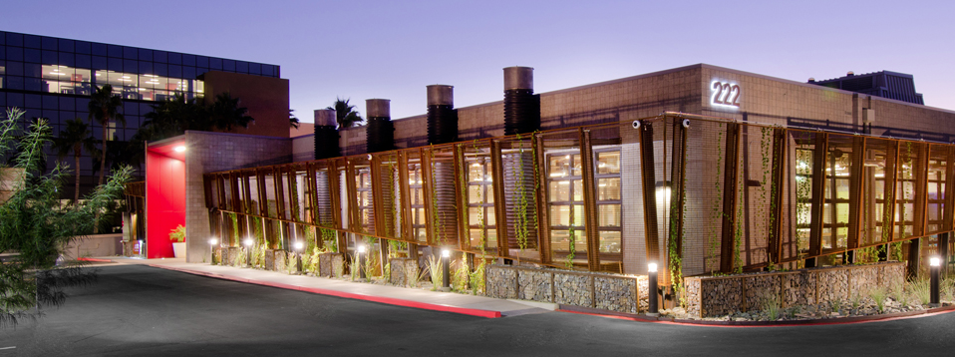
Green SOLUTIONS & IMPACTS
Main Sustainability Strategies Deployed
Expensive
Inexpensive
Most Impactful
Roof Monitors
Operable Windows
Controls System
PV Array (75kW DC)
Bldg. Dashboard
Solatubes
Big Ass Fans
Bldg. Dashboard
Operable Windows
PV Array
Solar Chimney
Operable Windows
PV Array (79kW DC)
Vampire Switch
Solatubes
Bldg. Dashboard
Big Ass Fans
Vampire Switch
Big Ass Fans
Solatubes
PV Array
LED Lighting
PV (118kW DC)
Electrochromic Glass
BMS Controls
Big Ass Fans
Vampire Switch
Dimmable Lighting
Bldg. Dashboard
Vampire Switch
Solatubes
Bldg. Dashboard
EMS Controls
Electrochromic Glass
Notes:
Deploying the right solutions in the right way and evaluating benefits and payback through the right metrics

Slide 55
Renewables in Multi-Family

Slide 56
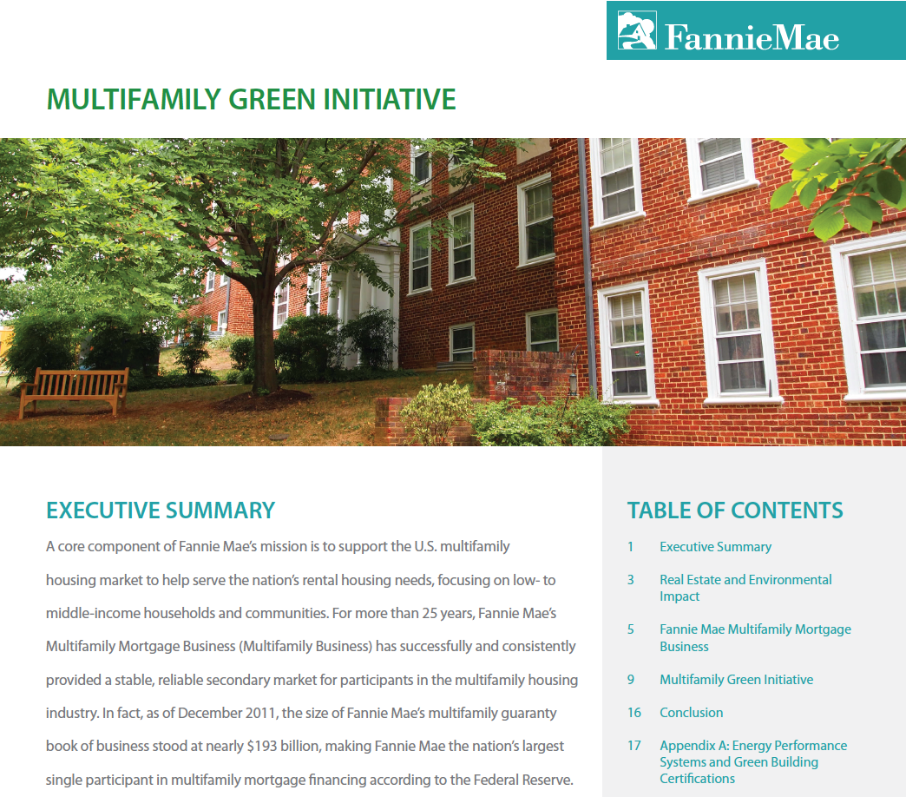

Slide 57
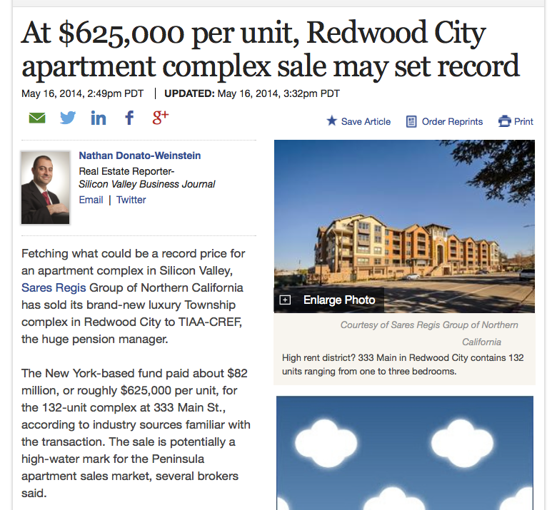
Record Sale

Slide 59
Smart Market Report.

Slide 60
Focus on Green Continues to Increase Steadily for Builders of Multifamily Projects
Less than 16% of projects green
More than 90% of projects green
61%–90% of projects green
79%
79%
16%–60% of projects green
9%
69%
18%
54%
24%
46%
6%
24%
17%
31%
6%
46%
37%
6%
21%
21%
31%
19%
2011
2013
2015
2018
Source: Green Multifamily and Single Family Homes SmartMarket Report, McGraw Hill Construction, 2014

Slide 61
Incremental Cost of New Green Homes Has Decreased According to Single Family Builders
Very Similar Results in 2013 for Multifamily Builders and Remodelers
Lower for those doing more than 30% green work
Source: Green Multifamily and Single Family Homes SmartMarket Report, McGraw Hill Construction, 2014

Slide 62
More Than Two-Thirds Find Customers Are Willing to Pay More for Green, Particularly Single Family Remodelers
1%–4%
Don’t Know
Over 4%
Won’t Pay More
BUILDERS
REMODELERS
MULTIFAMILY
73% report customers will pay more
79% report customers will pay more
68% report customers will pay more
5%
11%
13%
29%
16%
38%
16%
45%
19%
34%
44%
30%
Average: 3% (no change from 2011)
Average: 5% (no change from 2011)
Average: 5%
Source: Green Multifamily and Single Family Homes SmartMarket Report, McGraw Hill Construction, 2014

Slide 63
Use of Renewables Expected to Rise in Next Three Years According to Both Single Family and Multifamily Builders
SINGLE FAMILY
MULTIFAMILY
Solar Photovoltaic Panels
Solar Thermal
Groundsource Heat Exchange
Wind
Solar Photovoltaic Panels
Solar Thermal
Groundsource Heat Exchange
Wind
2013
2016
Source: Green Multifamily and Single Family Homes SmartMarket Report, McGraw Hill Construction, 2014

Slide 64
conclusions
Spend time upfront defining success factors
Sustainable solutions are site specific
Cost/benefit/TCO to meaningful benchmarks
Right-size energy systems prior to renewables
Take advantage of all incentives
People & culture drive performance
Trend is green is still gaining traction
Notes:
Broad terms – if you don’t have the time to truly innovate on the front end, off the shelf status quo will result.
Each site has to address its own path to Net Zero or dark green. NO two buildings are typically alike, especially in renovation of existing structures.
Set a payback period that must be adhered to (10 years)
Dig into local codes and determine all rebates / incentives to aid in payback periods
Now there are enough Net Zero buildings that folks aren’t feeling like they are cutting edge by doing such, thus adoption rates are increasing.
Respect the individuals – if they aren’t happy in a super efficient space, then they aren’t going to drive to the performance needed. Creature comforts and likeability of the space are critical.

Slide 65
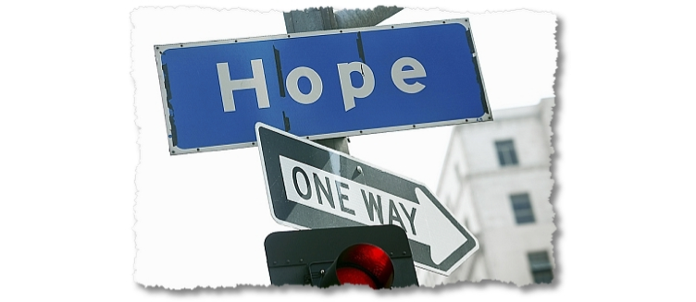

Slide 66
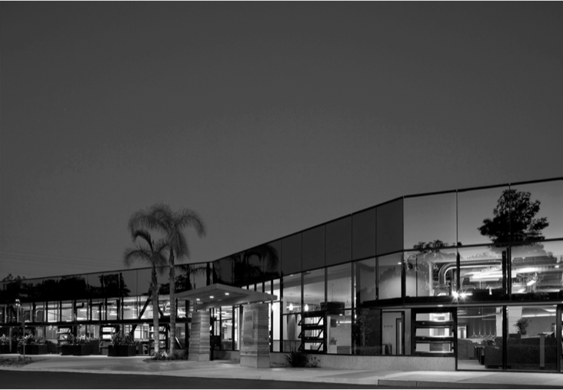
questions?
tedv@dpr.com

Slide 67
Notes:
• REMEMBER TO TALK ABOUT THAT ONE THING!!!

